Slide 1
TEAM
and
CHANGES
Report to the LIOB Public Advisor’s Office, California Public Utilities Commission
February 23, 2016

Slide 2
CPUC’s TEAM and CHANGES Programs
The CPUC created two programs to provide education and complaint resolution services for limited English proficient (LEP) consumers. The programs also assists seniors and the disabled.
Notes:
Consumers need to understand their bills and services and receive assistance resolving disputes. Usually this is provided by the carriers, utilities or the CPUC’s consumer affairs. However, limited English proficient (LEP) consumers typically do not receive this assistance for two reasons: 1. LEP consumers avoid contact with large corporations and governments. 2. There is not enough written information in languages other than English, and not enough telecommunications, utility and CPUC staff available to communicate directly in several languages.

Slide 3
Telecommunications Education and Assistance in Multiple-languages

Slide 4
CHANGES
Community Help and Awareness of Natural Gas and Electricity Services

Slide 5
TEAM
Complies with CPUC Direction
D.06-03-013 (Consumer Protection Initiative).
D.07-07-043 (Limited English Proficiency Decision).
CPUC Resolution CSID-002 (Created the TEAM Program).

Slide 6
CHANGES
Complies with CPUC Direction
CPUC Resolution CSID-004 (Initiated a Pilot).
CPUC Resolution CSID-005 (Ordered Independent Evaluation).
D.12-12-011 (Ordered Additional Tracking, Reporting and Success Measurement Criteria).
D.14-08-030 (Extended the Pilot for Review).
D.15-12-047 (Ordered an Ongoing Program).

Slide 7
Program Structure
TEAM and CHANGES provide services to LEP consumers, in the language of their choice, through a statewide network of community based organizations (CBOs).

Slide 8
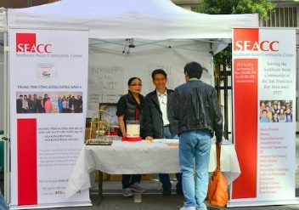
Program Components
Outreach - informs consumers that the services exist at a CBO in their community.

Slide 9
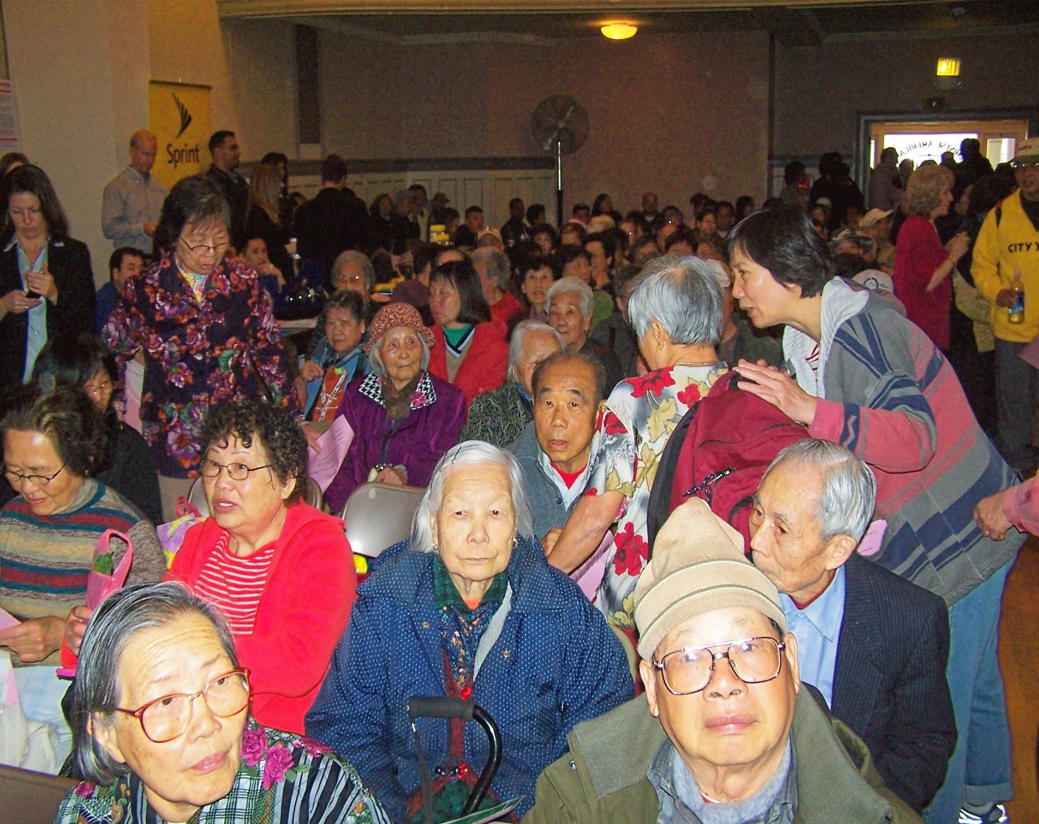
Program Components
Education - explains telecommunications and energy utility services, bills and assistance programs, which help consumers control costs.

Slide 10
Program Components
Complaint Resolution, or Needs/Dispute Resolution - helps resolve disputes, or helps receive assistance to pay bills/avoid disconnection.

Slide 11
Issues
TEAM
“Insurance” for inside wiring has been sold to tenants, who have only one landline phone. Landlords, not their tenants, are responsible for maintenance of inside wiring up to the first connection.
These consumers should not have been sold the insurance.
TEAM advocates for adjustments.

Slide 12
Issues
TEAM
LEP clients need help understanding the rules to enroll and remain on California LifeLine. Also clients who write in their language’s characters, which do not use the Roman alphabet upon which English is based, do not have the standard signature or initials acceptable for the forms.
TEAM is discussing this with CAB.

Slide 13
Issues
TEAM
Predatory Sales Practices – wireless companies hand out free cell phones, but their “Sales Pitch” doesn’t explain that the client’s signature on the English-only receipt, switches them to the company’s service.
TEAM CBO held a workshop to alert the community, resulting in 57 complaints within a week.

Slide 14
Issues
CHANGES
Core Transport Agents (CTAs) have used abusive sales practices to get people to switch:
Authorization from minors.
Taken pictures of utility bills to use as authorization.
Misrepresented the service.
Public Advisor’s Office has provided a report to CPUC staff.

Slide 15
Issues
CHANGES
CARE High Use Treatment - CARE consumers have been confused about the IOUs’ High Use practices for CARE customers.
The contractor rapidly trained CBOs and updated user guides; helping caseworkers to educate and to assist consumers who are subject to the treatment.

Slide 16
CPUC’s Creation of Ongoing CHANGES Program
Ongoing program funded at $1.75 million yearly.
Includes “Trend Analysis” and will track trends or issues, and report findings to CPUC.
In addition to regular evaluation by Public Advisor’s Office, the program will be independently evaluated every three years.

Slide 17
New TEAM and CHANGES Contract
The TEAM and CHANGES programs will be provided by the same contractor to provide consumers with ease of access.
Provision by the same contractor will result in economies of scale and frugal expenditure of public funds.

Slide 18
New TEAM and CHANGES Contract
Request for Proposal was issued in December 2015, and has been advertised.
Public Advisor's Office is evaluating bids and plans to submit the contract to the state’s Department of General Services for approval in March.
Estimate new contract in place by May 2016.

Slide 19
More Information:
Public Advisor’s Office
415-703-2074: 866-849-8390
Ravinder Mangat: rm1@cpuc.ca.gov
415-355-5556

