Slide 1
LIOB Meeting: Communications Section
August 2013

Slide 2

Marketing Overview for 2013
Ethnic advertising and community outreach continue to be key components of SCE’s local marketing, education, and outreach efforts.
  To date, in 2013, SCE has or is purchasing paid advertising in 54 ethnic media outlets, of which 17 (31%) are ethnic-owned
  Reaching Hispanic, Asian and African-American markets
  Produced in 7 languages: English, Spanish, Cambodian (Khmer), Chinese (Mandarin and Cantonese), Korean, Tagalog and Vietnamese
FPO
Notes:
Conducted 3 Ethnic Briefings
-- Timing: June 19, 20, and 29
-- Location : Garden Grove, San Bernardino and Rosemead.
-- Audience: communities with ethnic media serving Asian, Hispanic and African American populations (in-language materials were provided)
-- Topics: reliability and security of the power delivery grid, what customers can do to reduce impact to their bills, downed power line safety and outage safety

Slide 3
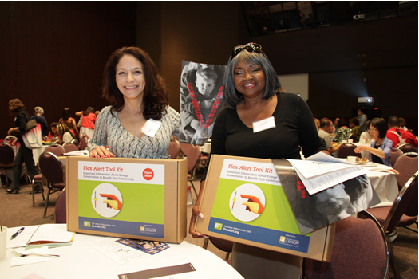
Marketing Overview for 2013
Ethnic Community Outreach:
To reach our ethnic and at-risk customers, SCE continued to leverage established relationships with:
  Community Based Organizations
  Faith Based Organizations
  Capitation agencies
  City and Government partners
Conduct Grassroots Outreach:
  Community Forums
  Emergency Preparedness Forums
    In partnership with the American Red Cross
  Ethnic Events
  Door to door canvassing (for Energy Savings Assistance program)
Notes:
General Community Forum
- Conducting 7 forums
- Locations: Palm Springs, Santa Barbara, Costa Mesa, Tulare, Pomona, Adelanto, San Juan Capistrano (may add El Monte)
- Topics: Income Qualified programs, safety, SmartConnect, DSM programs, etc
Example: SCE Community Forum in Costa Mesa
Provided information in English, Spanish and Vietnamese
Attendance: 150 people

Slide 4
2013 Safety Campaign
Objective:
To continue the Safety message from 2012 motivating customers to think about safety
Markets:
General Market, Hispanic, Asian (Cambodian, Chinese, Korean, Filipino, Vietnamese), African American
Media Channels:
Broadcast TV, Cable TV, Radio, Out of Home, Online/Digital, Print, Media Relations
Other Channels:
Bill Messaging, SCE.com
Ethnic Community Outreach:
Emergency Preparedness Community Forums (Dare to CARE)
Notes:
Safety Advertising Campaign
A year-long campaign geared at educating the public about power line safety
75 ethnic media outlets, 7 languages:
English, Spanish, Cambodian (Khmer), Chinese (Mandarin and Cantonese), Korean, Tagalog (print) and Vietnamese
Media: TV, radio, print, Out-of-Home, digital
Timing: In-market (pulsed) week of January 30 to March 31; back in market (pulsed) week of May 7 to week of December 17
Budget: In 2012, we plan to spend about $2 million ($2,003,474) with ethnic ad agencies and ethnic media for the Safety ad campaign
Note: This advertising campaign is primarily shareholder funded.
Emergency Preparedness Community Forums (Dare to CARE)
- Timing: June 22, Aug 8, Oct 25, Nov 29
- Topics: Focus on Safety and Emergency Preparedness (teaching residents how to prepare for a disaster, which may include lengthy outages)
- Audience: Targeting Faith Based Community Organizations. Had attendees from a variety of FBOs, who would then take back what they learned and share with their members
Show our Safety TV ads at community forums and other customer events

Slide 5

2013 Summer Readiness Campaign
Objectives:
Encourage conservation
Drive awareness and participation in integrated Demand Side Management programs
Remind customers how to prepare and find information in the unlikely event of rotating outages
Markets: General Market, Hispanic, African-American, Asian (Chinese, Korean, South Asian, Vietnamese, Filipino,)
Media Channels: Print, Radio, Online/Digital, Media Relations
Ethnic/Diverse Community Outreach:
Deaf Nation Expo
Cinco de Mayo Festival
Fiestas Patrias
Beaumont Cherry Festival
Other Channels: Direct Mail, Email, Outbound Call, Bill Messages, Social Media, SCE.com
Notes:
Advertising Campaign
10 ethnic media outlets, 5 languages: English, Spanish, Korean, Vietnamese, Chinese (Out of Home only)
Timing: In-market week of June 11 to week of October 1
In 2012, we plan to spend $449,094 on ethnic media
DSM programs include: the Summer Discount Plan, Save Power Day , the Commercial 10 For 10 Program, EE rebates, Appliance Recycling Program, Home Energy Advisor (online survey), conservation messages, and general energy tools and information such as MyAccount.
Note: This campaign is funded out of Shareholder and Program funds.
Outreach
City of Alhambra ECO Fair in May targeting the Chinese audience. We had 403 customer interactions.
Yucaipa Iris Festival in May targeting the Hispanic audience. SCE had 75 customer interactions.
Beaumont Cherry Festival in June targeting the Hispanic audience. We had 248 customer interactions.
We Connect event in Santa Ana targeting Hispanic audience. We had 528 customer interactions.
Cinco De Mayo Festival in Santa Ana
Promoter said police officially counted over 179,000 at event (around 400 people visited our booth
99% of the people who came to the booth spoke Spanish.
Provided materials (i.e., Energy Tips) in Spanish
We collected about 100 CARE applications.

Slide 6

2013 Income-Qualified Marketing
Objective:
Increase enrollment and participation, among qualified customers, in CARE/FERA and Energy Savings Assistance Program (ESAP)
Ethnic Earned Media Placement:
Very strong relationship with ethnic media outlets
A total of 75 ethnic earned media placements (Print, TV, Radio, Online and Social Media)
A total of 10,011,726 media impressions
Press Material translated into in Spanish, Chinese, Korean, Vietnamese, Khmer, Thai, and Farsi. English materials are provided to the Hispanic, Japanese, Filipino, and Indian outlets.
Markets:
African American (SB American, Long Beach Times)
Chinese (International Daily News, World Journal)
Korean (Korea Times, Korea Daily)
Vietnamese (Viet Bao)
Filipino (Weekend Balita, Asian Journal)
Cambodian (Angkor Borei News)
Hispanic (Univision/Telemundo)
image source: google images
Notes:
Launching a print advertising campaign
Targeting: African American and Asian markets.
Target did not include Hispanic print, as we have done a lot of past efforts within this community and we wanted to increase awareness within the Asian and African American markets
Estimated spend of approx. $76,000 on ethnic print media
Funding of $76k was limited due to bridge-funding year. Expecting to increase funding following CARE/ESAP decision
Looking to expand efforts with ethnic media outlets in Q4 of 2012, or after we receive a final decision on CARE/ESAP
Channels: Out of home, radio, tv, and print (in addition to grassroots)
CARE/ESAP specific ads in over 15 ethnic media publications.
ESAP specific mailers to customers’ preferred language.
Throughout Q1/Q2, SCE sent bilingual postcards (Eng/Chi; Eng/Tag; Eng/Viet; Eng/Ko; Eng/Camb). Here is a quick overview of the lead response rate from these targeted communications. NOTE: On-par with the 2% average response rate compared to other generic English mailers.
Currently testing a new Soundbite script this month which offers customers the ability to listen to the call in multiple language forms (English, Spanish, Korean, Vietnamese, Chinese, Tagalog, and Cambodian). The script is designed to directly connect the customer to our service providers (who support the language) during a campaign. Each campaign will be predetermined as to who our target audience will be. This will ensure that all customers are properly reached.

Slide 7
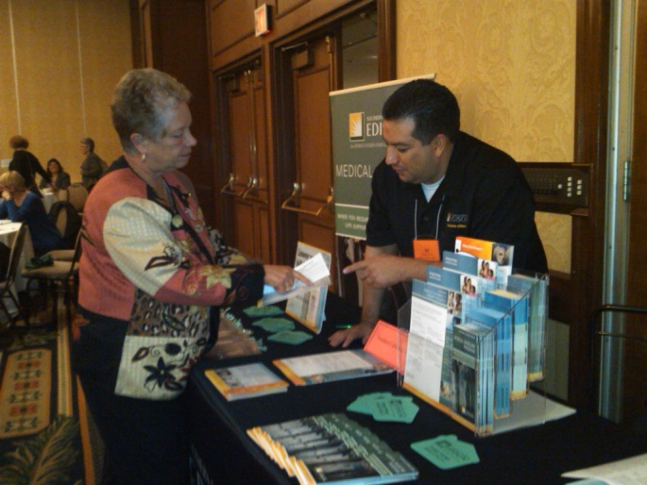
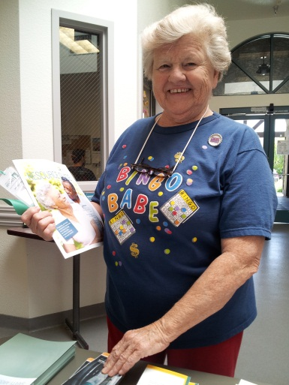
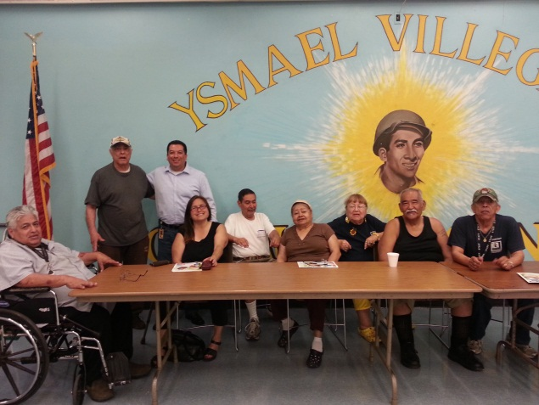
2013 Income-Qualified Marketing
Outbound Calling:
Improved automated outbound calling to support Chinese, Korean Vietnamese, Cambodian and Tagalog-speaking customers. More than 120,000 customers have been targeted.
Ethnic Community Outreach:
CBO/FBO Outreach
Capitation Agencies (more than 200 agencies)
Grassroots Events with bilingual speaking reps
Examples of Ethnic/Diverse Community Outreach:
National 211 Day
“Helping Our Customers Succeed” Huntington Park Community Forum
Ability First – Strut & Roll Disabled Community Fair
“Helping Our Customers Succeed” Carson Community Forum
Los Angeles County Consumer Education Fair
Eddie Dee Smith Senior Expo
“Helping Our Customers Succeed” Pico Rivera Community Forum
Notes:
CARE enrollment applications, recertification and verification letters are offered in multiple languages L
English
Spanish
Korean
Chinese
Vietnamese
Cambodian.

Slide 8
Appendix

Slide 9
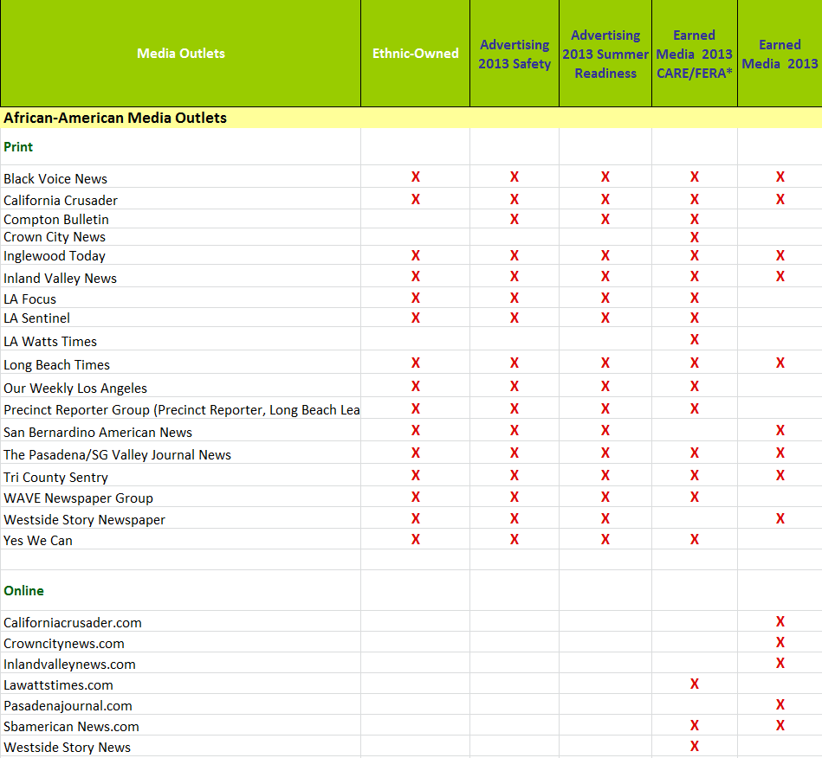
Appendix
Provides information on 2012 paid and/or earned media activity.

Slide 10
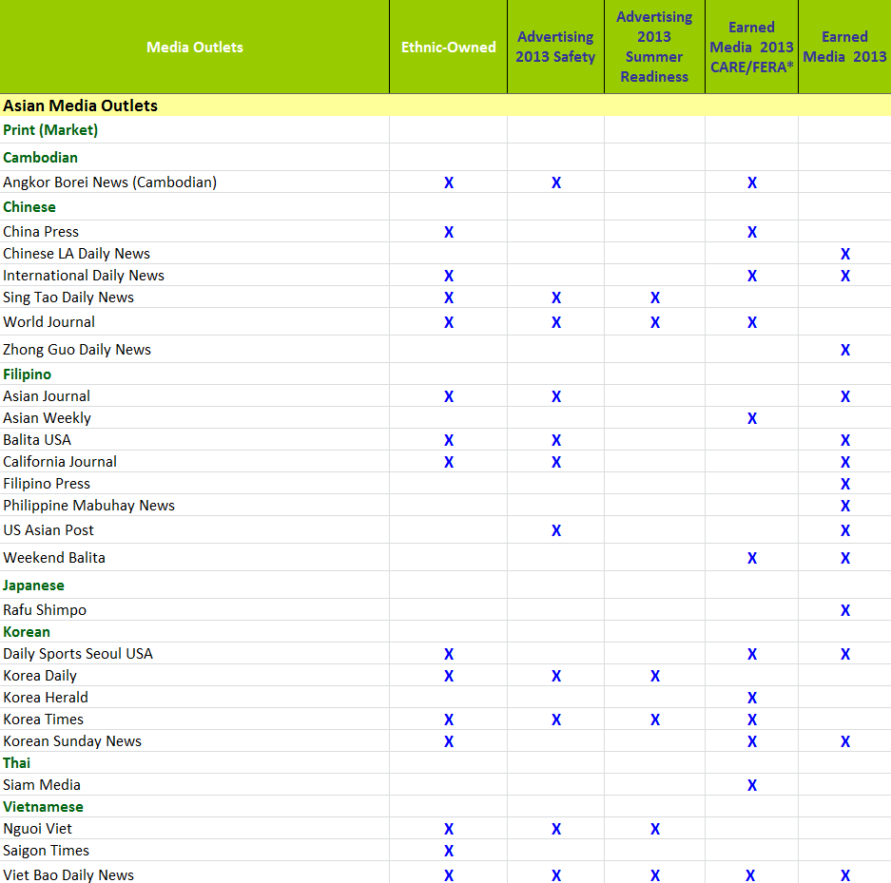
Appendix
Provides information on 2012 paid and/or earned media activity.

Slide 11
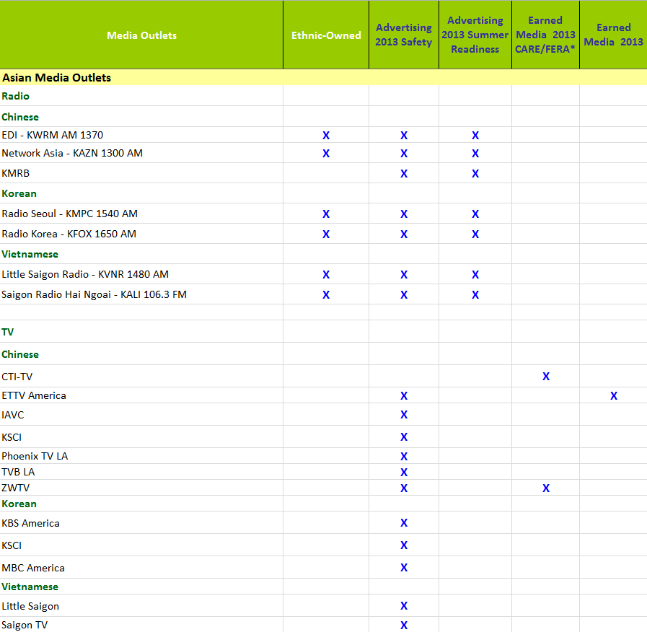
Appendix
Provides information on 2012 paid and/or earned media activity.

Slide 12
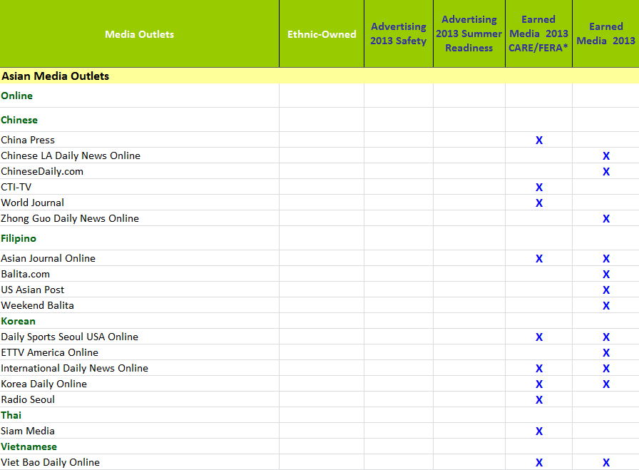
Appendix
Provides information on 2012 paid and/or earned media activity.

Slide 13
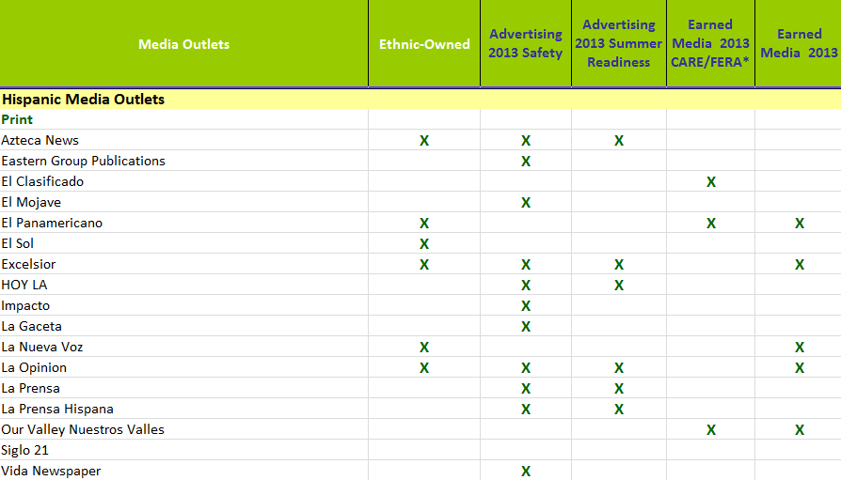
Appendix
Provides information on 2012 paid and/or earned media activity.

Slide 14
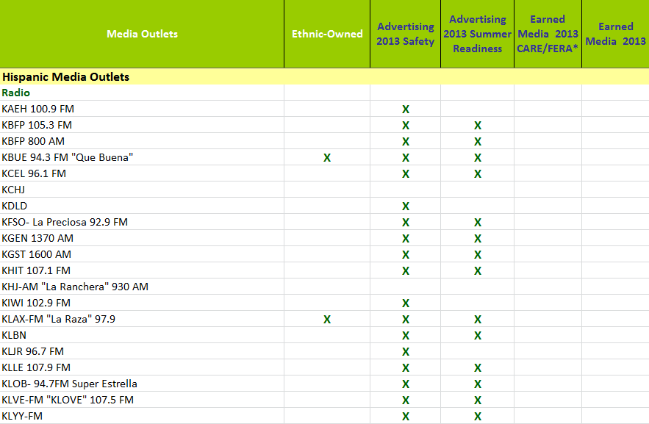
Appendix
Provides information on 2012 paid and/or earned media activity.

Slide 15
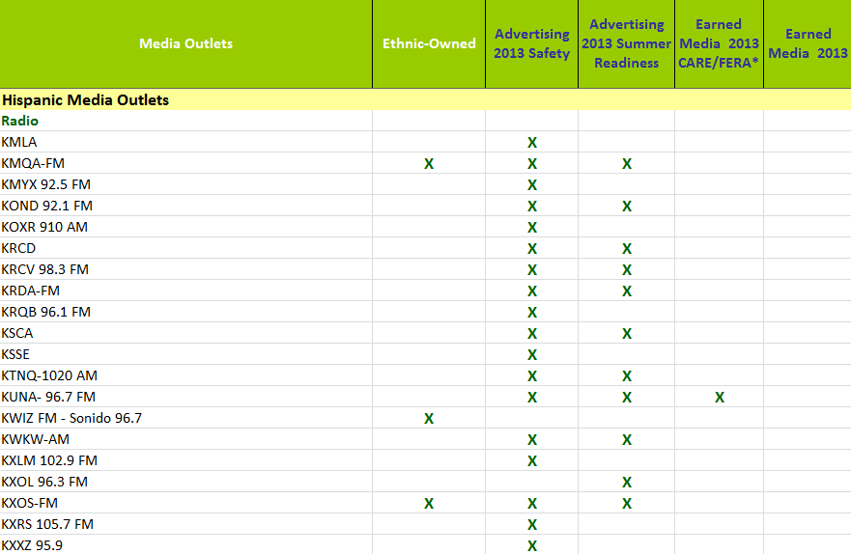
Appendix
Provides information on 2012 paid and/or earned media activity.

Slide 16
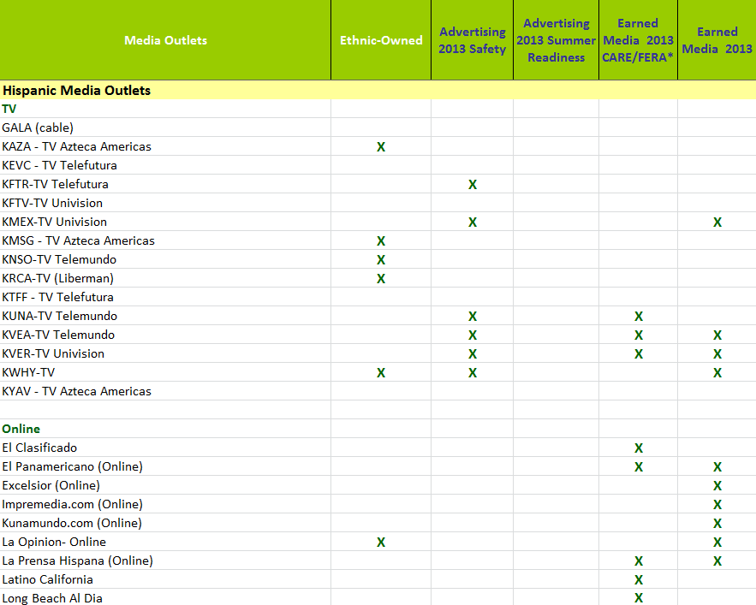
Appendix
Provides information on 2012 paid and/or earned media activity.

