Slide 1
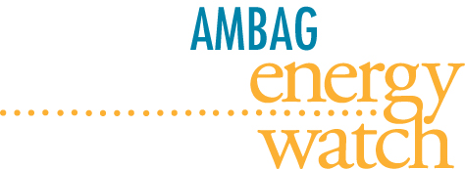
Association of Monterey Bay Area Governments AMBAG Energy Watch Local Government Partnership
Presentation to the Low Income Oversight Board
October 29th, 2015

Slide 2
About AMBAG
The Association of Monterey Bay Area Governments (AMBAG) is a voluntary association of 18 cities and 3 counties in California’s Central Coast region. The Association was formed in 1968 by an agreement between the cities and counties to serve as a forum for discussing and making recommendations on issues of regional significance. In 2005 the AMBAG Board unanimously decided energy was an issue of regional significance.
AMBAG’s Board of Directors is composed of elected officials, appointed by their respective City Council or Board of Supervisors. Each member city has one representative on the Board, while each county has two.
Since it’s formation, AMBAG has confronted regional issues on a cooperative, unified basis between its members and other governments. AMBAG is the designated Metropolitan Planning Organization (MPO) for Monterey, San Benito, and Santa Cruz counties. As the MPO, AMBAG is responsible for metropolitan transportation for the tri-county region.

Slide 3
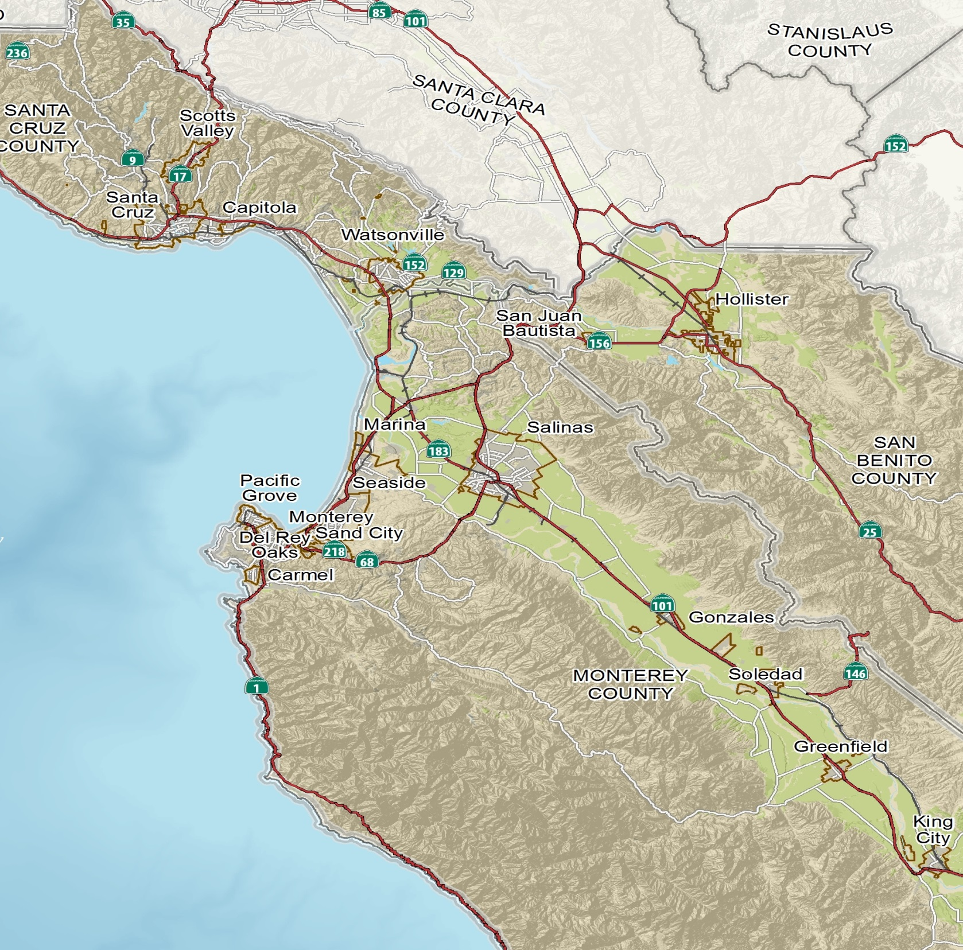
Greater Monterey Bay Region
2010 Census
732,708
Physical Size
5,768 mi²
Counties
Monterey
Santa Cruz
Sen Benito
Cities
18

Slide 4
Greater Monterey Bay Region
Greater Monterey Bay
Pop: 732,708
5,768 mi²
San Francisco
Pop: 837,442
46.87 mi²

Slide 5
AMBAG Energy Watch Program Markets Served
Residents (Just Above Low Income)
Agriculture
Hospitality
Small Business
School Districts
Non-Profits
Municipal Government
Special Districts

Slide 6
AMBAG Energy Watch Programs Service & Support
Project support for complex municipal, special district, school district, and agribusiness energy efficiency retrofit (CRI) projects
Direct Installation Program for Municipal, Non-profit, Special district, School District, Agribusiness, and Hospitality facilities
Residential Direct Installation Program for Just Above Low Income
Residents (MIDI) program
Grant writing and loan acquisition services for complex energy efficiency projects.
Prop 39 Energy Expenditure Plan development and project installation.
Energy Benchmarking of Municipal and School District facilities.
Calculation of Greenhouse Gas Inventories and Development of Draft Energy Action Strategies for 21 AMBAG jurisdictions.
Education & Training courses for all market sectors brought to the AMBAG region

Slide 7
Combined Annual Cost Savings = $2 Million

Slide 8
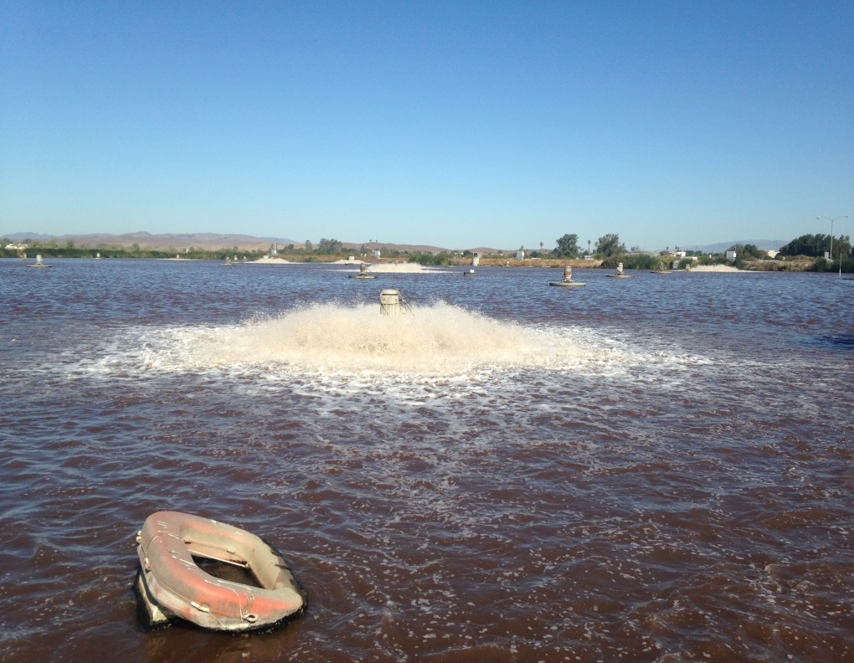
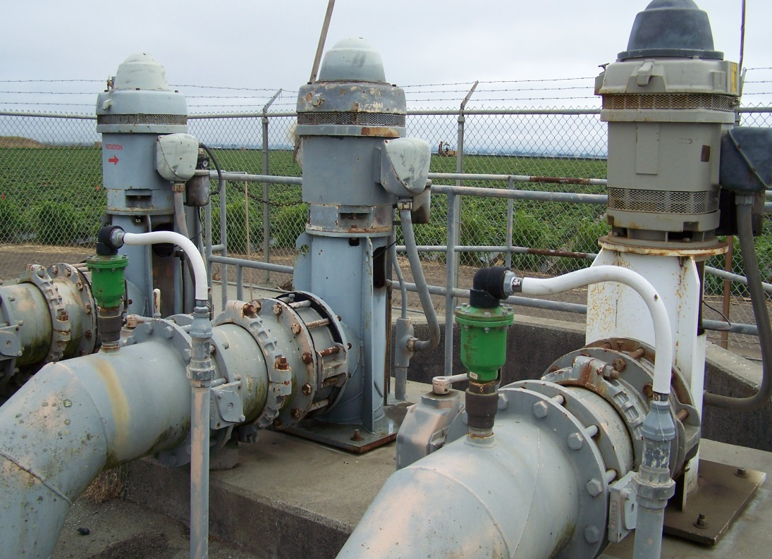
Waste Water & Motor Projects
22% of complex projects

Slide 9
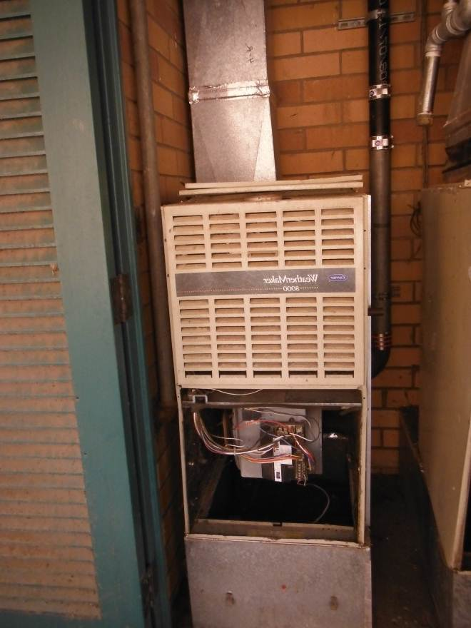
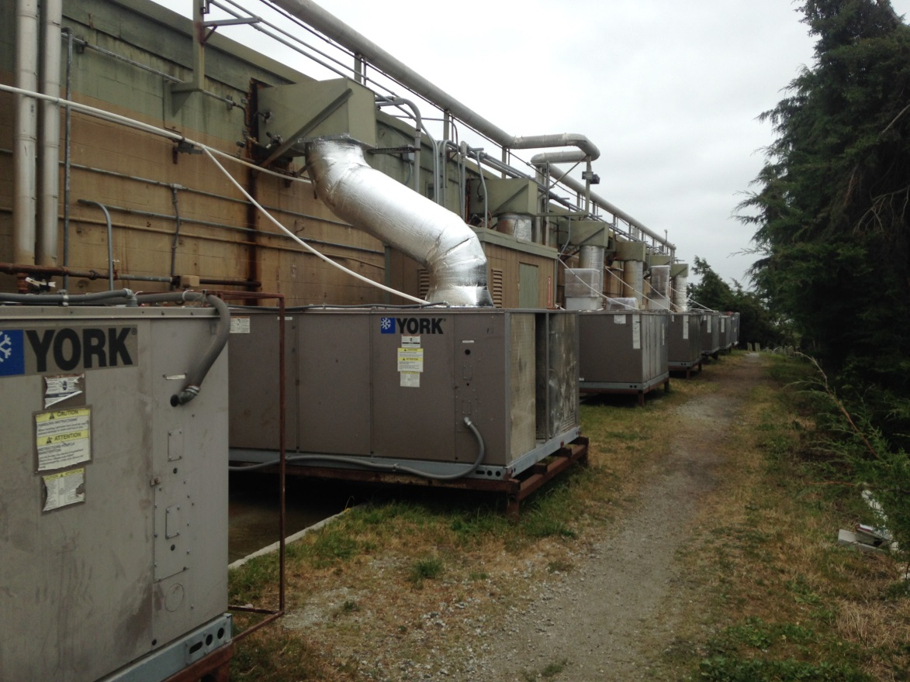
HVAC Projects
21% of complex projects

Slide 10
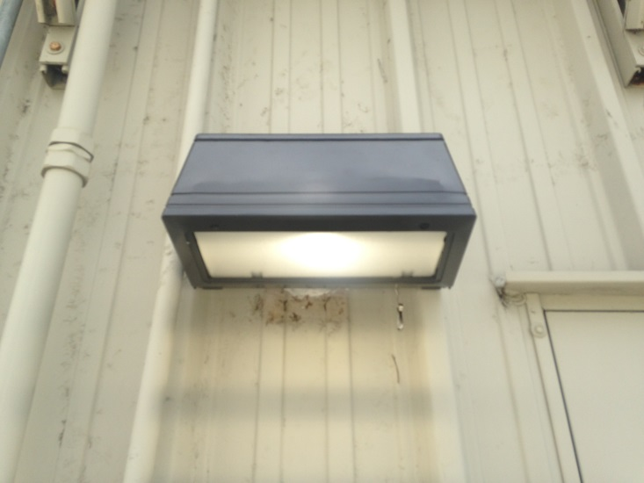
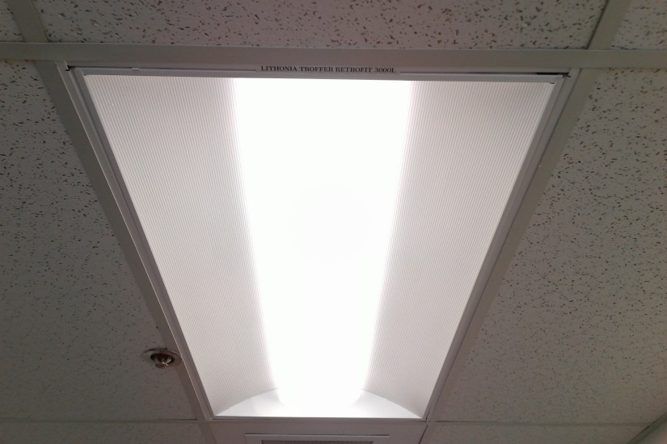
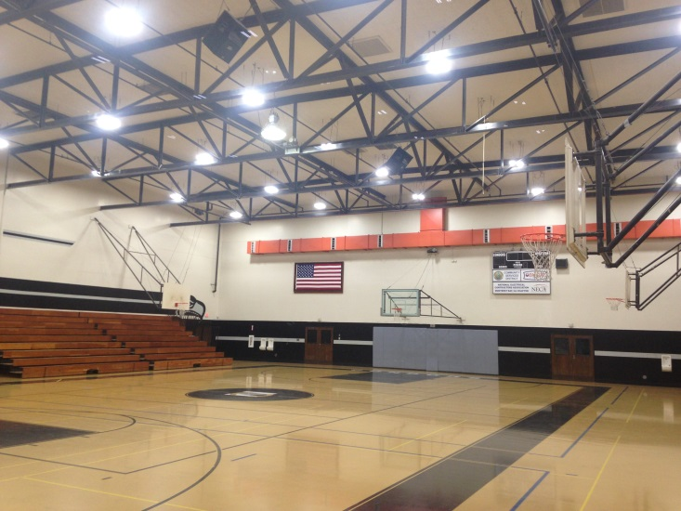
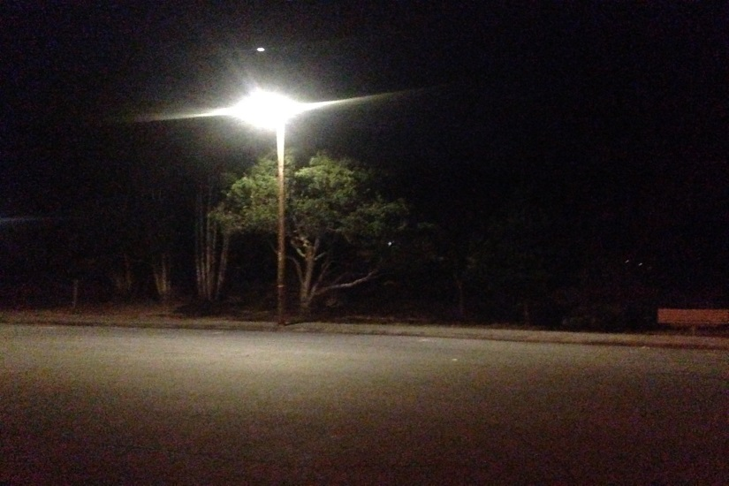
Lighting Projects
57% of complex projects

Slide 11
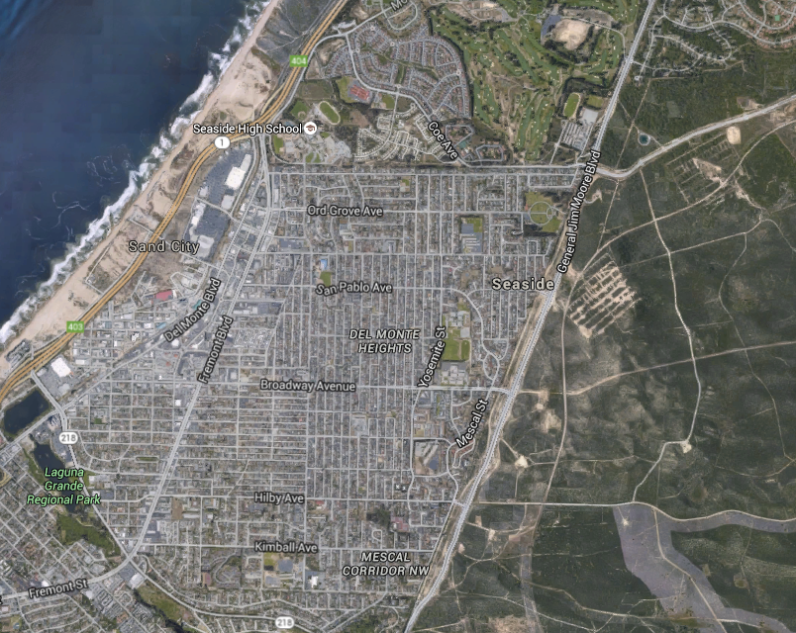
City of Seaside
ONGOING PROJECTS
1.Patullo Swim Center Central Plant Upgrade
2. City Wide Decorative Street Light Upgrades

Slide 12
MIDI Residential Program 2011 - 2015
Serving…
Just Above Low Income Residents
Households Served kWh Saved
2,203 3,044,837

Slide 13
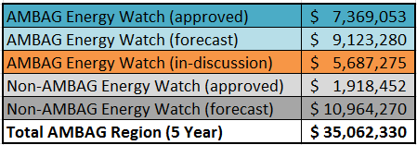
AMBAG Energy Watch Statistics
Have accessed 82% of total EEP funds granted to date.
Working with 76 out of 91 total schools in region.
Forecasted to access 63% of total EEP funds for 5 year program.
In the AMBAG region, the total 5 year Prop 39 available funding amount is $35,062,330. AMBAG Energy Watch has $7,369,053 in approved EEPs to date and is forecasted to submit another $9,123,280. We are also in discussion with LEAs to develop their 5 year EEPs for a total of $5,687,275.

Slide 15
2006
2015
to

