Slide 1
LIOB Meeting: Communications Section
July 2012

Slide 2
Marketing Overview for 2012
Ethnic advertising and community outreach are key components of SCE’s local marketing, education, and outreach efforts
Ethnic Advertising:
  To date, in 2012, SCE has or is purchasing paid advertising in 77 ethnic media outlets, of which 45 (58%) are ethnic-owned
  Reaching: Hispanic, Asian and African American markets
  Produced in 7 languages: English, Spanish, Cambodian (Khmer), Chinese (Mandarin and Cantonese), Korean, Tagalog and Vietnamese
  Pitched stories to approximately 200 ethnic media outlets
  Recently contracted with New America Media [a network of ethnic and independent-media outlets]
  Held 3 ethnic media briefings in June
  Producing advertorials on the topics of Summer Readiness and Safety

Slide 3
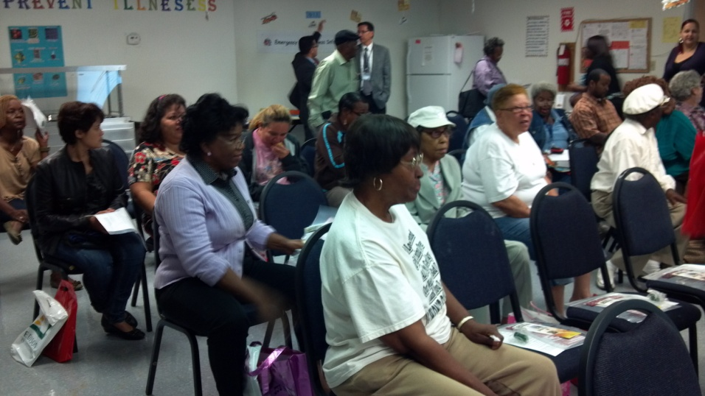
Marketing Overview for 2012
Ethnic Community Outreach:
  To reach our ethnic and at-risk customers, SCE has established relationships with:
  Community Based Organizations
  Faith Based Organizations
  Capitation agencies
  City and government partners
  Retailers
Conduct grassroots outreach
  Community Forums
  Emergency Preparedness Forums
    In partnership with the American Red Cross
  Ethnic Events
  Door to door canvassing (for Energy Savings Assistance program)

Slide 4
2012 Safety Campaign
Objective:
Motivate customers to think about safety
Markets: General Market, Hispanic, Asian (Cambodian, Chinese, Korean, Filipino, Vietnamese), African American
Media Channels: Broadcast TV, Cable TV, Radio, Out of Home, Online/Digital, Print, Media Relations
Other Channels: Bill Messaging, SCE.com
Ethnic Community Outreach:
Emergency Preparedness Community Forums (Dare to CARE)

Slide 5
2012 Summer Readiness Campaign
Objectives:
Encourage conservation
Drive awareness and participation in integrated Demand Side Management programs
Remind customers how to prepare and find information in the unlikely event of rotating outages
Markets: General Market, Hispanic, Asian (Chinese, Korean, Vietnamese)
Media Channels: Print, Radio, Out of Home, Online/Digital, Media Relations
Ethnic Community Outreach:
City of Alhambra ECO Fair
Beaumont Cherry Festival
We Connect event in Santa Ana
Yucaipa Iris Festival
Cinco De Mayo Festival in Santa Ana
Other Channels: Direct Mail, Email, Outbound Call, Bill Messages, Social Media, SCE.com

Slide 6
2012 Income Qualified Marketing
Objective:
Increase enrollment and participation, among qualified customers, in CARE and Energy Savings Assistance
Print Advertising:
Markets:
  African American (Black Voice, Compton Bulletin, Our Weekly, La Sentinel)
  Chinese (World Journal, Sing Tao, China Press LA)
  Korean (Korea Times, Korea Daily)
  Vietnamese (Nguoi Viet, Viet Bao, Saigon Times)
  Filipino (Balita, US Asia Post, Asian Journal)
  Cambodian (Angkor – Borei)
Timing: July 8 – September 23
Current Estimated Print Advertising Spend*: ~$76,000
Other Channels
Customized mailers in customers’ preferred language to promote ESAP
ESAP specific outbound calls in customers’ preferred language
Door to door canvassing
Bill Messages and Onserts, Social Media, and SCE.com
*Includes media buy and production through September.
image source: google images

Slide 7
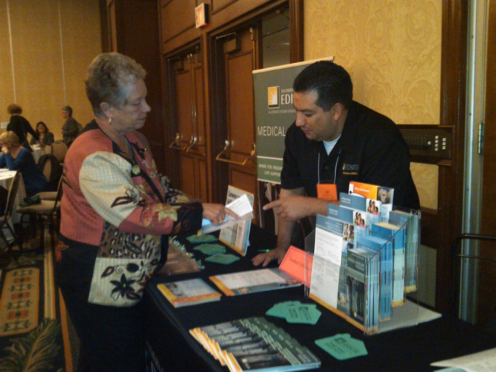
2012 Income Qualified Marketing
Ethnic Community Outreach
CBO/FBO Outreach
Capitation Agencies - over 200
Grassroots Events with In-language speaking reps
Examples of Ethnic Outreach:
Latino Disability Conference
Hosted by Disability Rights California
Event brought together Latinos with diverse disabilities and provided resources to the community
AgeWell Staff and Case Manager Training in Orange
Provided training to staff on Income Qualified programs, medical baseline, and DSM programs
Attendance: 60 people

Slide 8
Appendix

Slide 9
Appendix
Provides information on 2012 paid and/or earned media activity.

Slide 10
Appendix
Provides information on 2012 paid and/or earned media activity.

Slide 11
Appendix
Provides information on 2012 paid and/or earned media activity.

Slide 12
Appendix
Provides information on 2012 paid and/or earned media activity.

Slide 13
Appendix
Provides information on 2012 paid and/or earned media activity.

Slide 14
Appendix
Provides information on 2012 paid and/or earned media activity.

