Slide 1
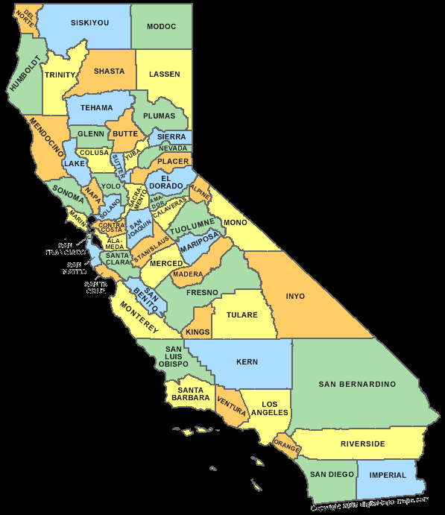
CPUC Low Income Oversight Board October 29, 2015

Slide 2
CALIFORNIA EMERGING TECHNOLOGY FUND Mission
CONNECT  COMMUNICATE  COMPETE
Mobilize leadership statewide to close the
Digital Divide by accelerating the deployment and adoption of broadband to unserved and underserved communities.
Ensure that California is a global leader in the availability and use of broadband technology.
focus  action  results

Slide 3
Everyday Activities Rely on The Internet

Slide 4
California Emerging Technology Fund Background
Established at direction of CPUC in 2005 in approving mergers of SBC-AT&T, Verizon-MCI.
AT&T and Verizon contributed $60M.
Organized in 2006; began operations in 2007.
Conducted research and fact finding.
Adopted a Strategic Action Plan.
Goal to leverage 4-fold (match 3.6; leverage 4.6).
Efficient: 95% Program; 5% Support.
Outcomes-focused, performance-driven with accountability for results.
Progress is being made; Digital Divide persists.

Slide 5
5
Overarching CETF Strategies
to Close the Digital Divide:
Achieve Optimal Impact and a Higher Return on Investment
u
Civic Leader Engagement
v
Venture Philanthropy Grantmaking
w
Public Policy Initiatives
x
Public Awareness and Education
y
Strategic Partnerships

Slide 6
5
Overarching Strategies to Close the Digital Divide:
Achieve Optimal Impact and a Higher Return on Investment
u
Civic Leader
Engagement
w
Public Policy
Initiatives
Achieve
98% Deployment
and
80% Adoption
Public Awareness
and Education
x
v
Venture
Philanthropy
Grantmaking
Strategic Partnerships
y

Slide 8
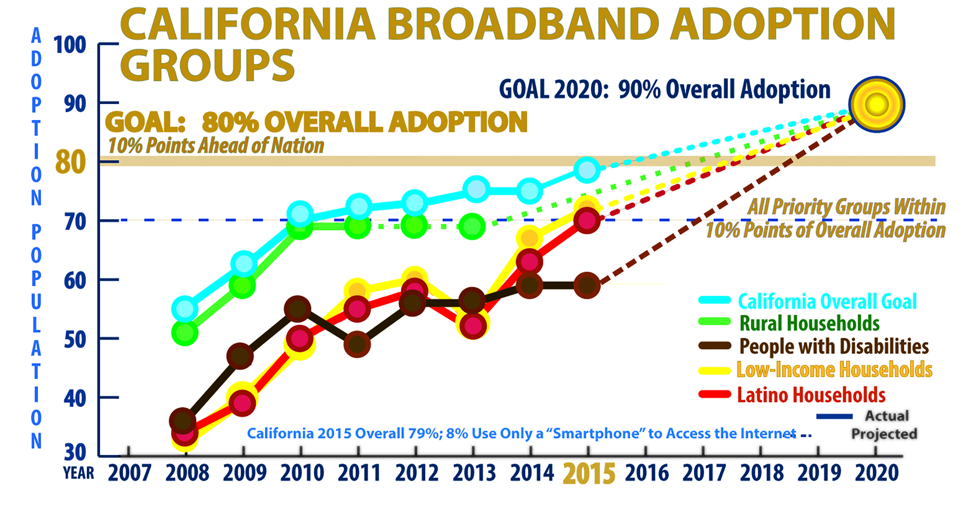
2015 Statewide Survey Results

Slide 9
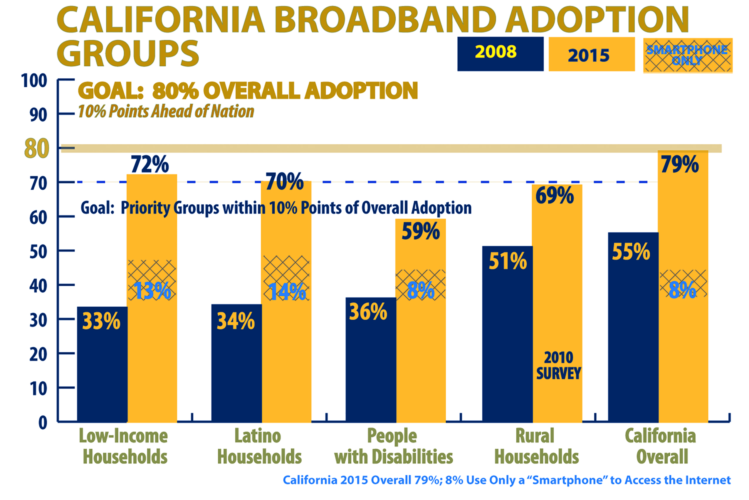
2015 Statewide Survey Results

Slide 10
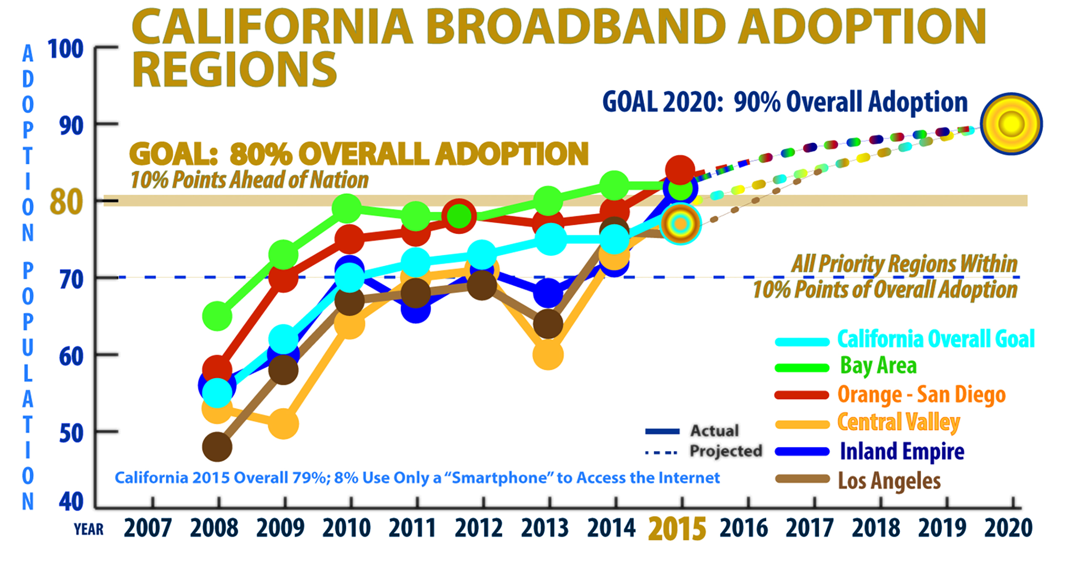
2015 Statewide Survey Results

Slide 11
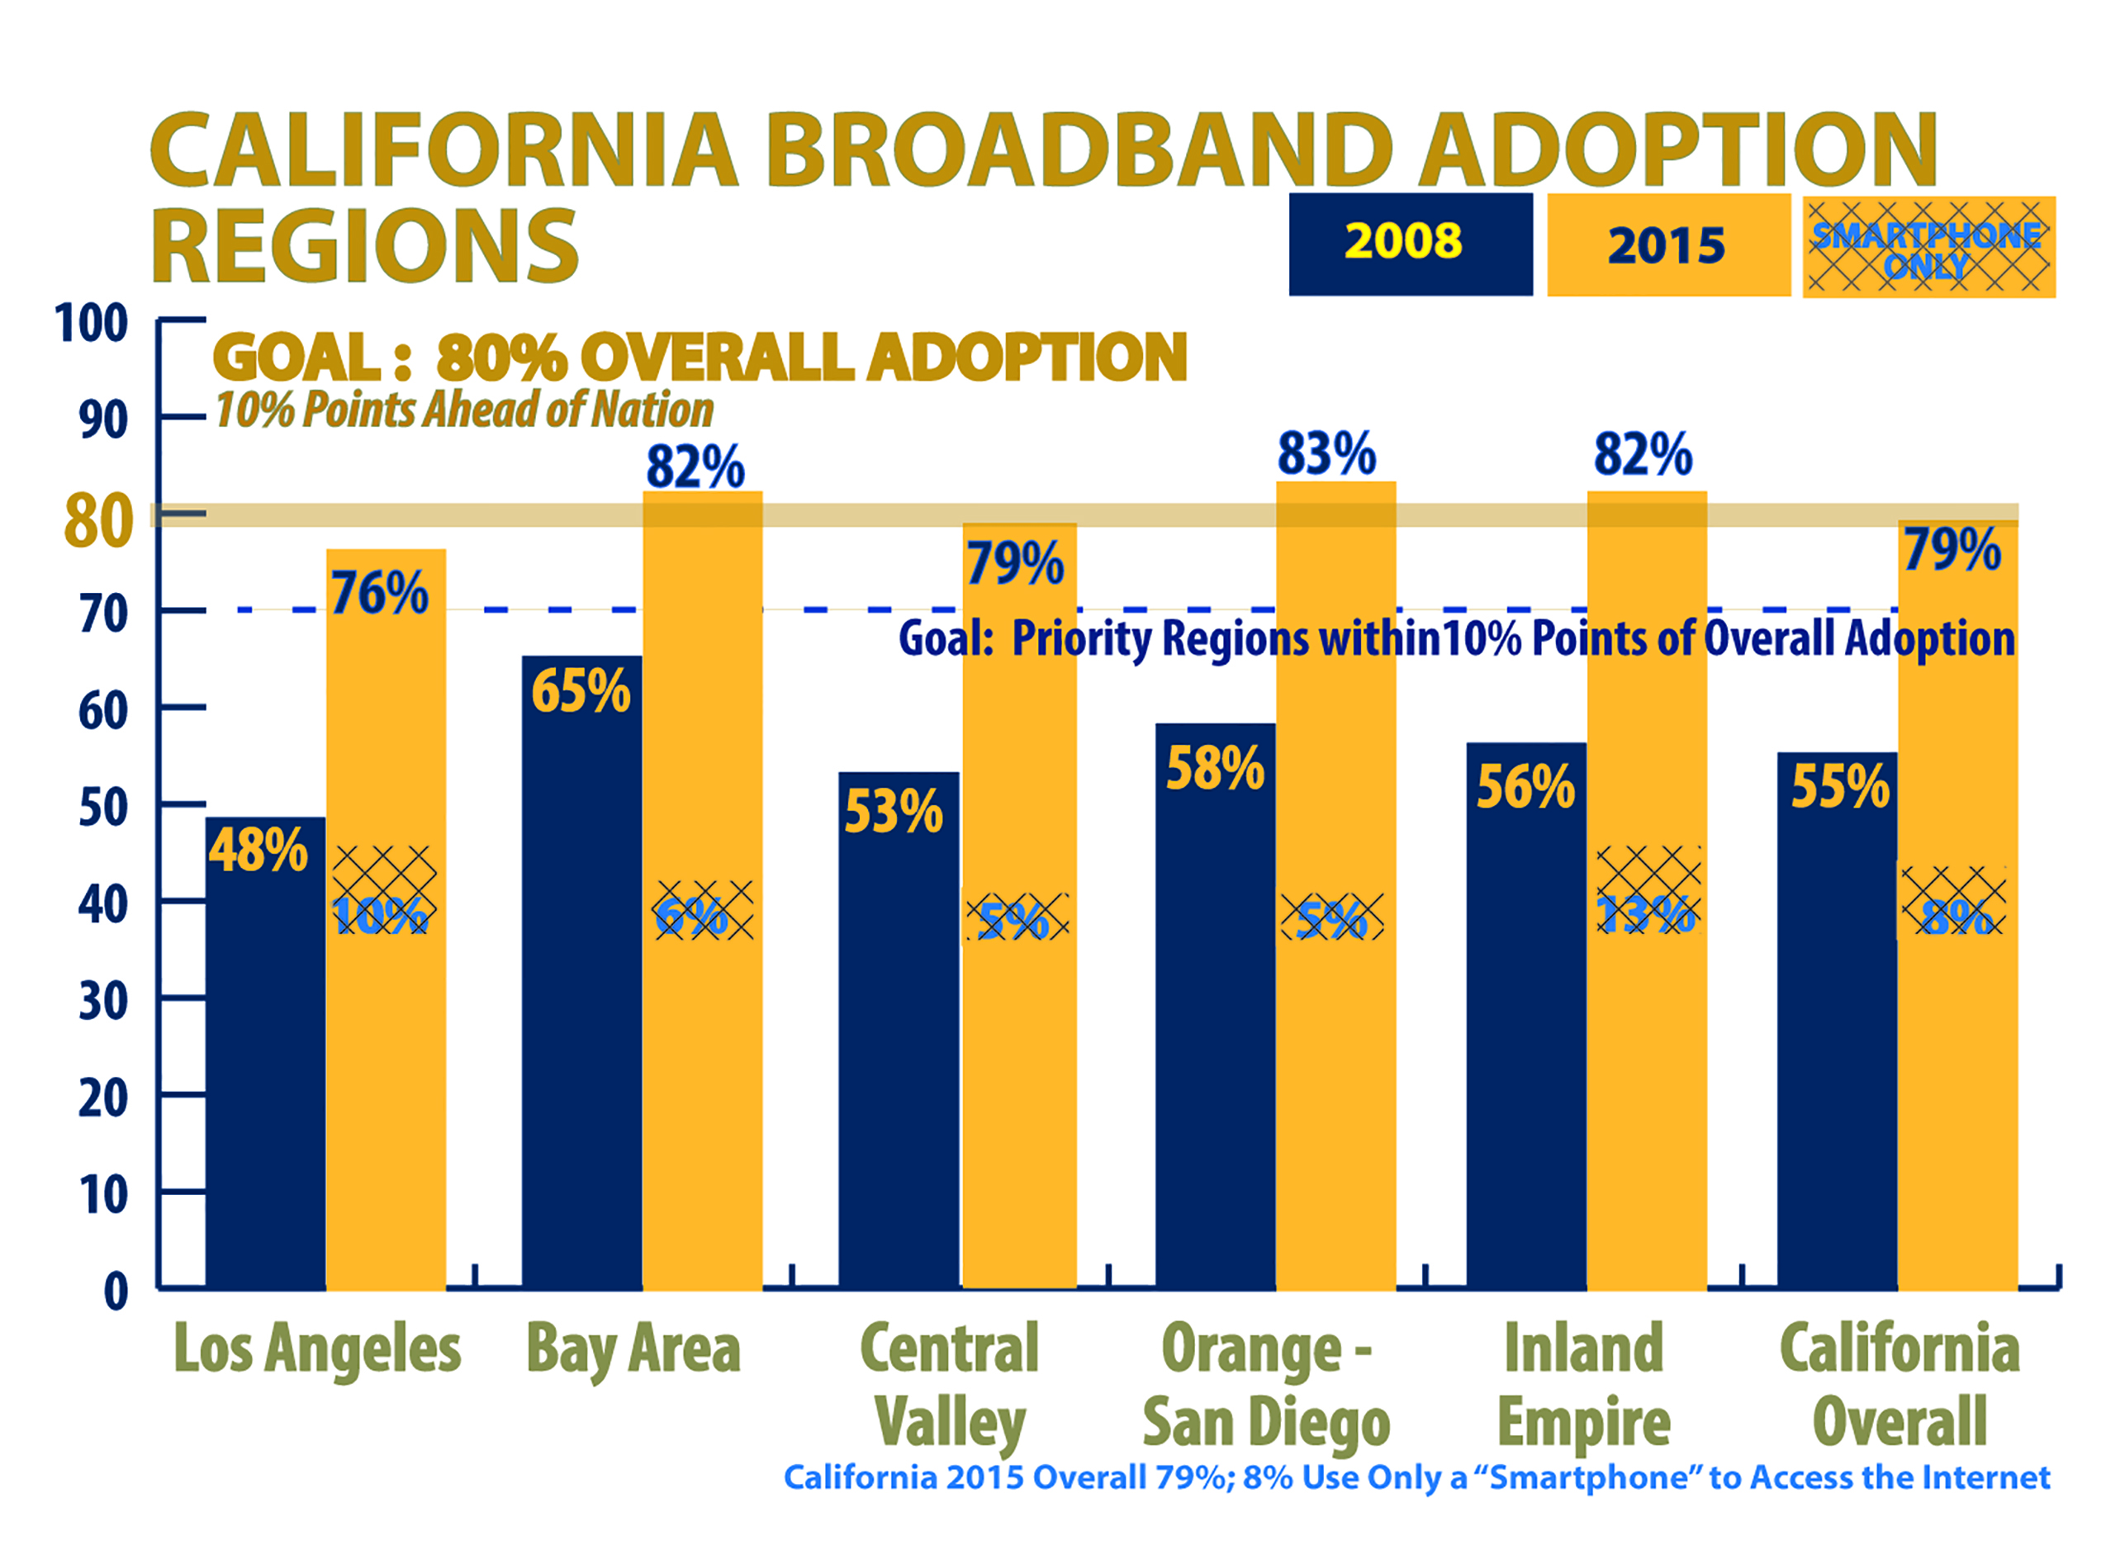
2015 Statewide Survey Results

Slide 12
Digital Divide is Greatest for the Disadvantaged
Percentage of Californians with Broadband at Home
65% of Households Earning Less Than $20,000 a Year (16% by smart phone only – 35% not connected)
63% of Households with Spanish-Speakers (21% by smart phone only – 37% not connected)
59% of People with Disabilities (8% by smart phone only – 41% not connected)
57% of Adults Age 65 or Older – Seniors (1% by smart phone only – 43% not connected)
52% of Non-High School Graduates (18% by smart phone only – 48% not connected)

Slide 13
California Emerging Technology Fund
There are 3 primary barriers to broadband adoption by low-income households:
Cost
Relevance
Digital Literacy
Effective Digital Inclusion programs must address all 3 barriers to tackle the “wall of poverty”.

Slide 14
California Emerging Technology Fund
CETF has obligated all $60M seed capital which will be expended by 2017.
New public policy and additional resources are needed to close the Digital Divide.
Major opportunities exist for Digital Inclusion:
FCC Broadband Lifeline Proceeding
Corporate Consolidations
California Advanced Services Fund
Partnerships with Energy Utilities
Education Policy

Slide 15
California Emerging Technology Fund FCC Broadband Lifeline Proceeding
CETF seeks affordable rate and funding for CBOs as “trusted messengers”: Internet For All Now (IFAN).
Growing support: 54 Groups; 50 Officials
Speaker-elect Rendon, Senate President de Leon
Letter from 24 Legislators
Los Angeles City Council and Mayor Garcetti
67,000 signed petition; emails to FCC.

Slide 16
California Emerging Technology Fund Corporate Consolidations
CETF is a legal party in regulatory proceedings on corporate consolidations with standard recommendations on public benefits for deployment (3) and adoption (5):
Comcast-TWC-Charter (CPUC ALJ PD)
AT&T-DirecTV (FCC Requirements)
Frontier-Verizon (MOU with Frontier)
Altice-Suddenlink
Charter-TWC-Bright House
Seek “appropriate, fair, and comparable” obligations for affordable broadband until FCC Broadband Lifeline Program is operational.

Slide 17
California Emerging Technology Fund California Advanced Services Fund
Established by CPUC and Legislature by reform of high-cost telephony fund. CASF is primarily an infrastructure fund: $315M to date.
Broadband Infrastructure Projects ($270M)
Revolving Loan Fund ($5M)
Regional Consortia ($15M)
Publicly-Subsidized Multi-Unit Housing ($25M)
Applications for infrastructure projects exceed available funding by $6M – need more funding.
Opportunity to set goals for the future (AB238).

Slide 18
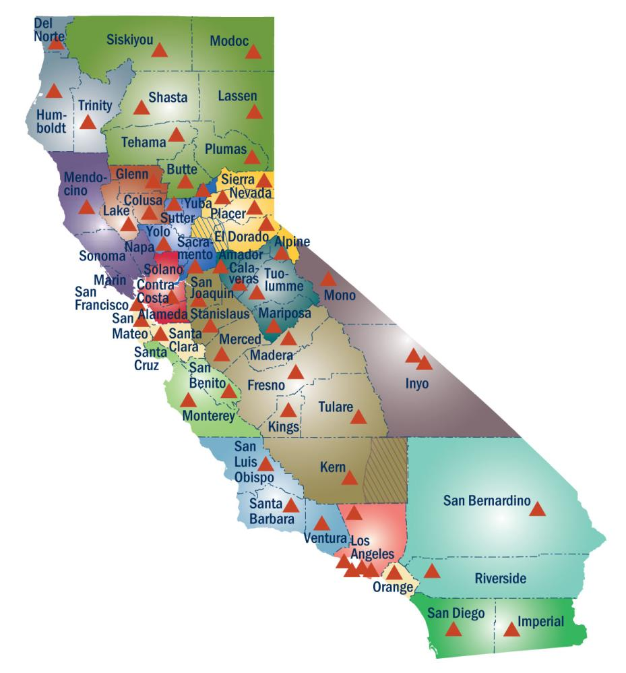
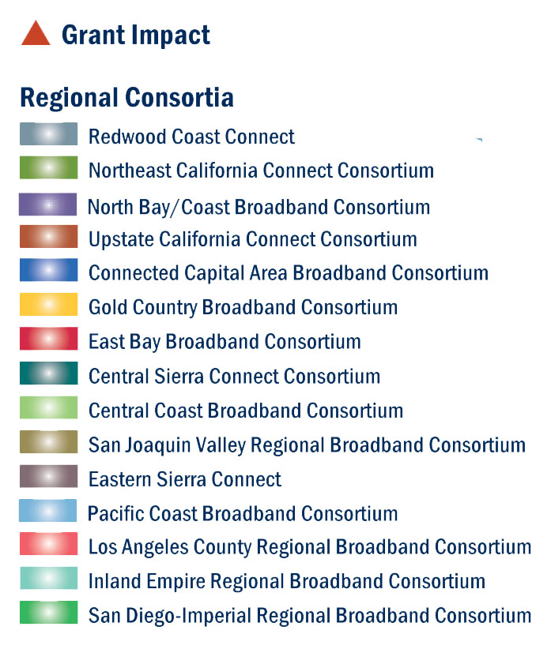
Regional Consortia

Slide 19
California Emerging Technology Fund Partnership with Energy Utilities
SMUD Partnership is moving forward:
Pilot showed value and results once process was refined (11,500 letters, 750 calls to CFLIC, 30% adoption).
New manager is engaged and enthusiastic.
New Partnership Agreement is has been signed.
Plan is to send 2,000 letters per week to reach 90,000 remaining low-income customers.
Progress is being made with other utilities:
Sempra meeting resulted in decision to take next steps.
CFLIC is working with SCE (NUCRA will help).
NUCRA focused on LA Region (LADWP, SCG, SCAPA).
CPUC and LIOB are key to encouraging this strategy and investments by energy utilities in CBOs.

Slide 20
California Emerging Technology Fund Education and Neighborhood Transformation
Effective strategies tackle the “wall of poverty.”
School2Home successfully integrates technology into teaching and learning with deep parent engagement:
Low-performing middle schools in poor neighborhoods.
Transforms school culture with 10 Core Components.
Closes both Digital Divide and Achievement Gap.
Policy needs to focus on low-income neighborhoods.
School2Home model is “centerpiece” of NT.
Neighborhood Transformation integrates existing resources to tackle “wall of poverty” and achieve higher return on both public and private investments.

Slide 21
Centerpiece of Neighborhood Transformation
School2Home
CBO
CBO
Close the Achievement Gap and Digital Divide
Get Connected!
Your Life Made Easier
CBO
CBO
CBO
County-City Integrated Human Services Teams
State-Local Restructuring
5 Big Outcomes: Employment Education Poverty Crime Health

Slide 22
Humor

Slide 23
CPUC Low Income Oversight Board
Opportunities to Tackle Poverty
LIOB would be a welcomed ally on key strategies:
FCC Broadband Lifeline Proceeding
Additional Funding for CASF
Education Policy (School2Home Model and NT)
LIOB would be a powerful voice and collaborator on partnerships with energy utilities:
Consider endorsing strategy and sending letter of recommendation to CPUC Commission.
Align energy efficient programs with Digital Inclusion.
LIOB sponsor roundtable with energy utilities.
Train CBOs participating in energy efficiency programs.

Slide 24
CALIFORNIA EMERGING TECHNOLOGY FUND
CONNECT  COMMUNICATE  COMPETE
Thank You
Low Income Oversight Board
focus  action  results

Slide 25
CPUC Low Income Oversight Board October 29, 2015

