Slide 1
Low-Income Oversight Board Meeting CARE and ESA Programs July 10, 2012 Sunnyvale, California

Slide 2
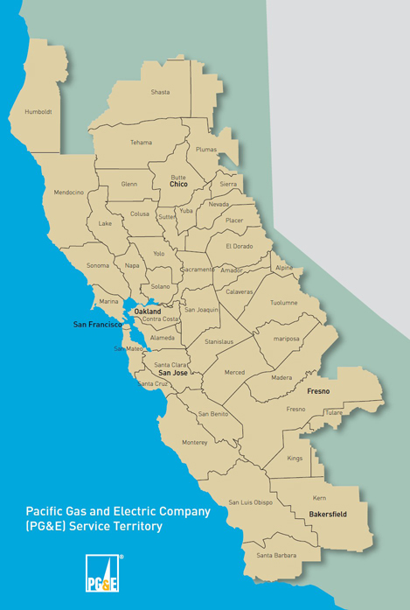
Reaching Our Customers
70,000
Square mile service area
CARE
1,536,237
Enrolled
ESA
639,260
Homes treated
(2004-2011)

Slide 3
CARE and ESA Outreach Methods
Partnerships with Community Outreach Contractors, reaching disabled, senior, ethnic, family-based and faith-based customers across each of our 48 counties
Door-to-door outreach in rural and urban areas
Targeted, bi-lingual direct mail projects
Automated outbound phone calls
Bill inserts
Welcome packet and 15-day notice inserts
Local office partnerships
Leveraging with other PG&E assistance programs
Ethnic television, radio and print campaigns
Online enrollment and referral
Social media
Text messaging
Collateral

Slide 4
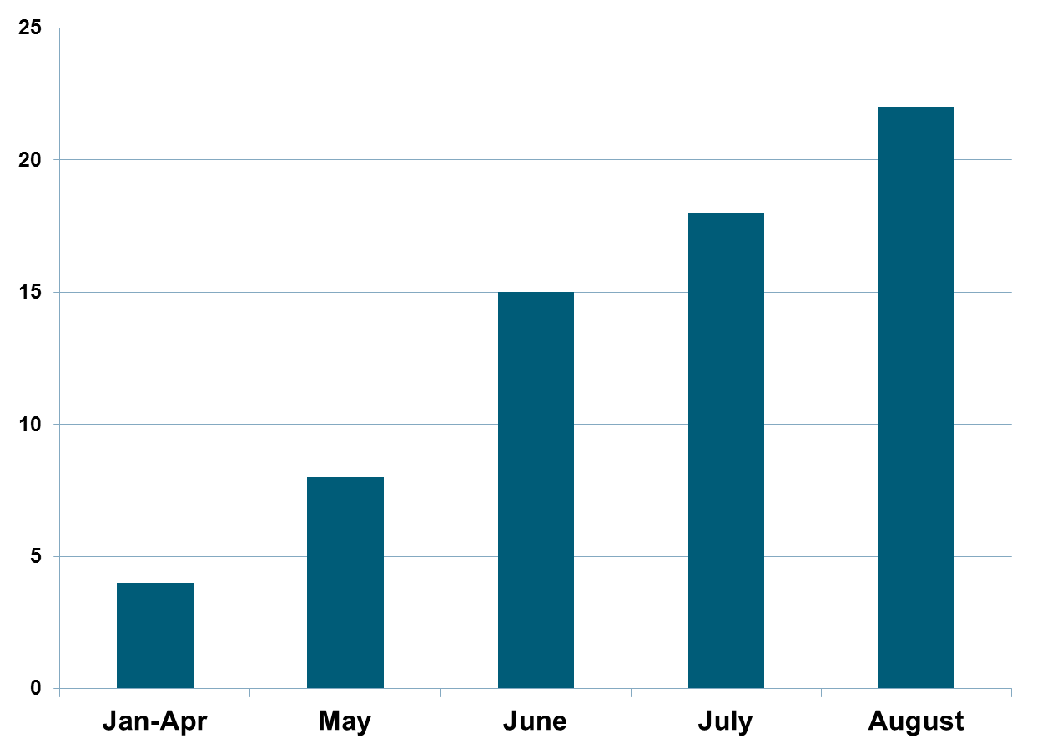
Ethnic-Owned Media Partnerships

Slide 5
Media Partnerships Overview (Jan-Aug)
$222,153 committed to ethnic-owned (EO) media outlets
314% increase in EO media committed – original plan ($53,691) vs. current plan($222,153)
57% of total media budget committed to EO media outlets - EO ($222,153) vs. total ($389,276)

Slide 6
CARE and ESA Print 2011-2012
African-American - Print
Media Outlets | Ethnic- Owned
Bakersfield Observer | Yes
California Advocate Newspaper | Yes
Berkeley Tri-City Post | Yes
Marin County Post | Yes
Oakland Post | Yes
South County Post | Yes
Richmond Post | Yes
San Francisco Post | Yes
Sacramento Observer | Yes
Hispanic - Print
Media Outlets | Ethnic-Owned
Vision Hispana | Yes
El Observador Publications | Yes
El Reportero | Yes
Cronicas | Yes
La Oferta | Yes
Vida en el Valle - Fresno | No
Vida en el Valle - Merced | No
Vida en el Valle - Modesto | No
Vida en el Valle - Sacramento | No
Asian - Print
Media Outlets | Ethnic- Owned
Asian Journal | Yes
Manila Mail | Yes
Sing Tao Daily | Yes
World Journal | Yes
Thoi Bao Daily | Yes
Vietnam Daily | Yes

Slide 7
CARE and ESA Radio 2011-2012
African-American - Radio
Media Outlets | Ethnic-Owned
Bay Bridge Communications- KDIA1640 AM | Yes
KDYA LLC - KDYA 1190 AM | Yes
Hispanic - Radio
Media Outlets | Ethnic-Owned
Celina R. Nocedal - KCNL 104.9 FM | Yes
Multicultural Radio Broadcasting Inc - KIQI 1010 AM | Yes
Multicultural Radio Broadcasting Inc - KATD 990 AM | Yes
Multicultural Radio Broadcasting Inc - KWRU 1300 AM | Yes
Asian - Radio
Media Outlets | Ethnic-Owned
Gore Overgaard Broadcasting - KBIF 900 AM | No
InnerCity Broadcasting - KVTO 1400 AM | No
InnerCity Broadcasting - KVVN 1430 AM | No
Crossings TV - KJAY 1430 AM | Yes
Auspicious Enterpises, Inc - KVTO 1400 AM | Yes
Multicultural Radio Broadcasting Inc - KEST 1450 AM | Yes
Multicultural Radio Broadcasting Inc - KSJX 1500 AM | Yes
Multicultural Radio Broadcasting Inc - KFSG 1690 AM | Yes

Slide 8
CARE and ESA Television 2011-2012
Asian - Television
Media Outlets | Ethnic-Owned
Crossings TV - Comcast Cable 238 | Yes
Crossings TV - Channel Broadcast 8.1 | Yes
The Filipino Channel | Yes
KTSF 26 | No

Slide 9
CARE and ESA News Coverage 2012
Hispanic - Online/Print
Media Outlets | Ethnic-Owned
Vision Hispana | Yes
Asian - Online/Print
Media Outlets | Ethnic-Owned
GlobalNation.net | Yes
Sing Tao Daily | Yes
World Journal | Yes
News for Chinese | Yes
Philippines Today | Yes
Philippines News | Yes
Manila Mail | Yes

Slide 10
CARE and ESA News Coverage 2012
Asian – Radio
Media Outlets | Ethnic-Owned
Sing Tao Radio | Yes
World Radio | Yes
Radio TNT | Yes
Goldenlink Radio | Yes
KBIF Fresno | No
Hispanic – Radio
Media Outlets | Ethnic-Owned
Radio Billingue | Yes
Hispanic – Television
Media Outlets | Ethnic-Owned
Univision Fresno | Yes
Asian – Television
Media Outlets | Ethnic-Owned
KBTV – Crossing TV | Yes

