Slide 1
PUBLIC SAFETY POWER SHUTOFFS:
ENGAGING COMMUNITIES & VULNERABLE POPULATIONS
Kendall Helm
Vice President of Customer Operations
March 6, 2020

Slide 2
PSPS
2019 BROAD COMMUNICATIONS & OUTREACH
Statewide campaign
Communication in multiple languages
Customer notifications (including outbound dialer)
Website
SDG&E campaign
Documentary Video
Print Advertisements
Social Media
Newsletters
Collaboration between IOUs and key stakeholders
Partnered with over 400 community-based organizations and 2-1-1 San Diego

Slide 3
PSPS
2019 TARGETED COMMUNICATIONS & OUTREACH TO VULNERABLE POPULATIONS
Partnerships with community-based organizations
Promote PSPS education and Customer Assistance Programs
Participated in multiple events, meetings and presentations
Engagement with County OES
AFN Working Group and Partner Relay Network
Hosted an After-Action Review with impacted tribes
Created AFN landing page with resources

Slide 4
PSPS
2020 BROAD COMMUNICATIONS & OUTREACH
Customer contact update & non-account holder notification campaign
Paid advertising, search and social media
Newsletters
Community events
Partnerships
County OES & emPower database
New PSPS mobile application

Slide 5
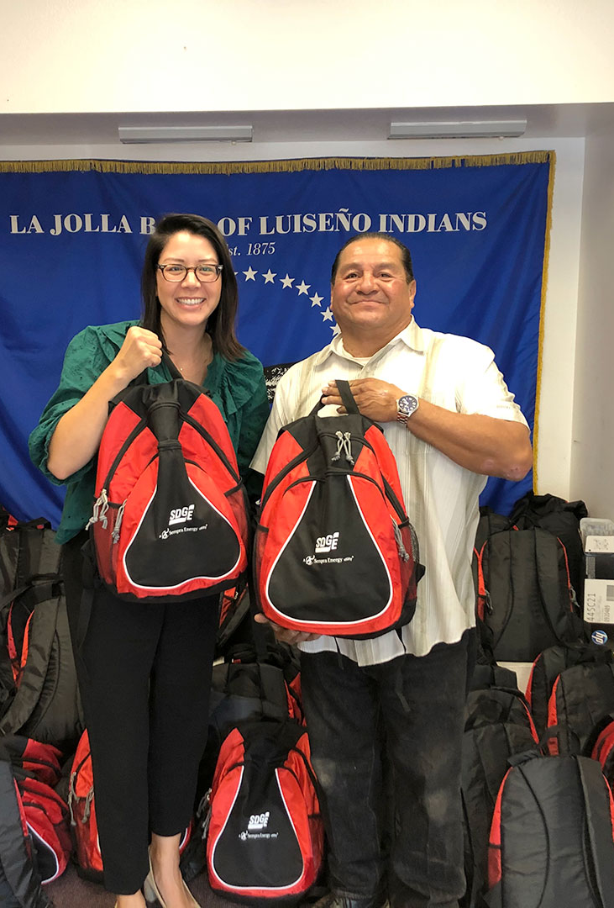
PSPS
2020 TARGETED COMMUNICATIONS & OUTREACH TO VULNERABLE POPULATIONS
Expand partnerships with community-based organizations to:
Promote customers update contact information & sign-up for PSPS notifications
Promote Medical Baseline to increase enrollments
Outreach to Non-Account Holder customers (e.g. Master Metered Mobile Home Parks)
Form AFN Advisory Councils
Statewide (jointly w/IOUs) & Local
Increase tribal nation awareness of offerings and projects
Expand on success of Wildfire Safety Open Houses and Community Fairs by hosting:
Q&A events with communities impacted by 2019 events
Wildfire Safety Fairs in more communities

Slide 6
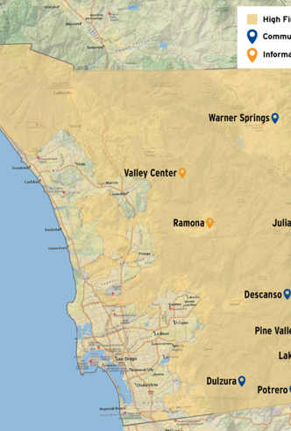
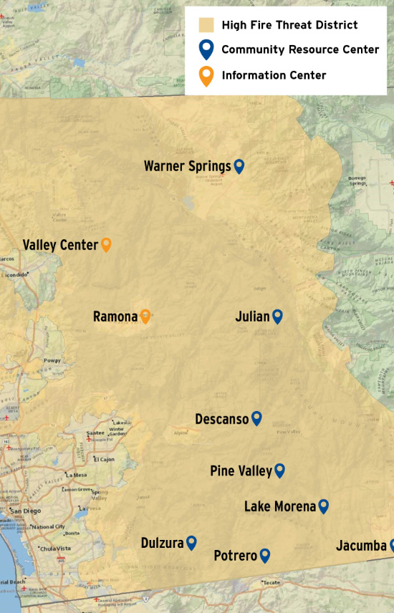
PSPS
COMMUNITY RESOURCE & INFORMATION CENTERS
Provide temporary relief for residents during a Public Safety Power Shutoff
Currently 8 Community Resource Center (CRC) locations
Provide water, snacks, cell phone charging, ice, water trucks for
large animals and up-to-date information on PSPS outages.
2 additional Information Centers added in 2019
All locations staffed by SDG&E Employees

Slide 7
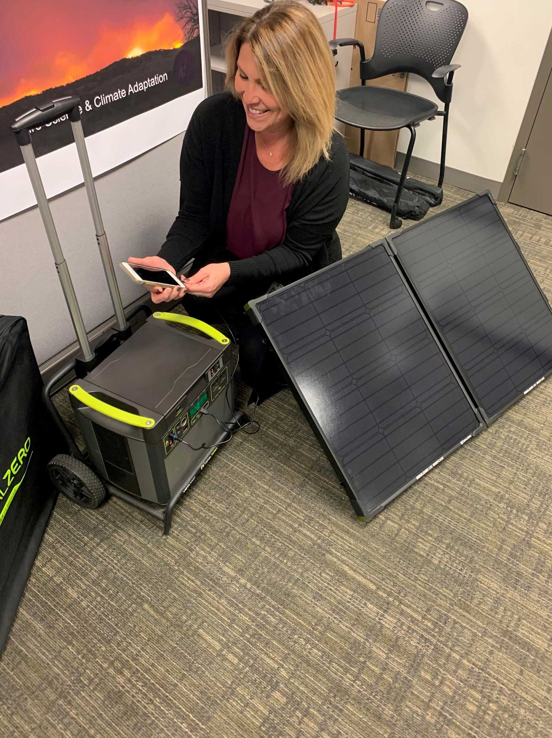
PSPS – Generator Grant Program
PSPS
GENERATOR GRANT PROGRAM
Launched pilot program in 2019
64 participants
Program administered by a neutral third party
Delivers and trains residential customers on how to use portable
generator during PSPS events
2019 pilot participants survey results show:
Program was well received
Customers felt more prepared for a PSPS event
Expanding program in 2020
1,250 generators within HFTD

Slide 8
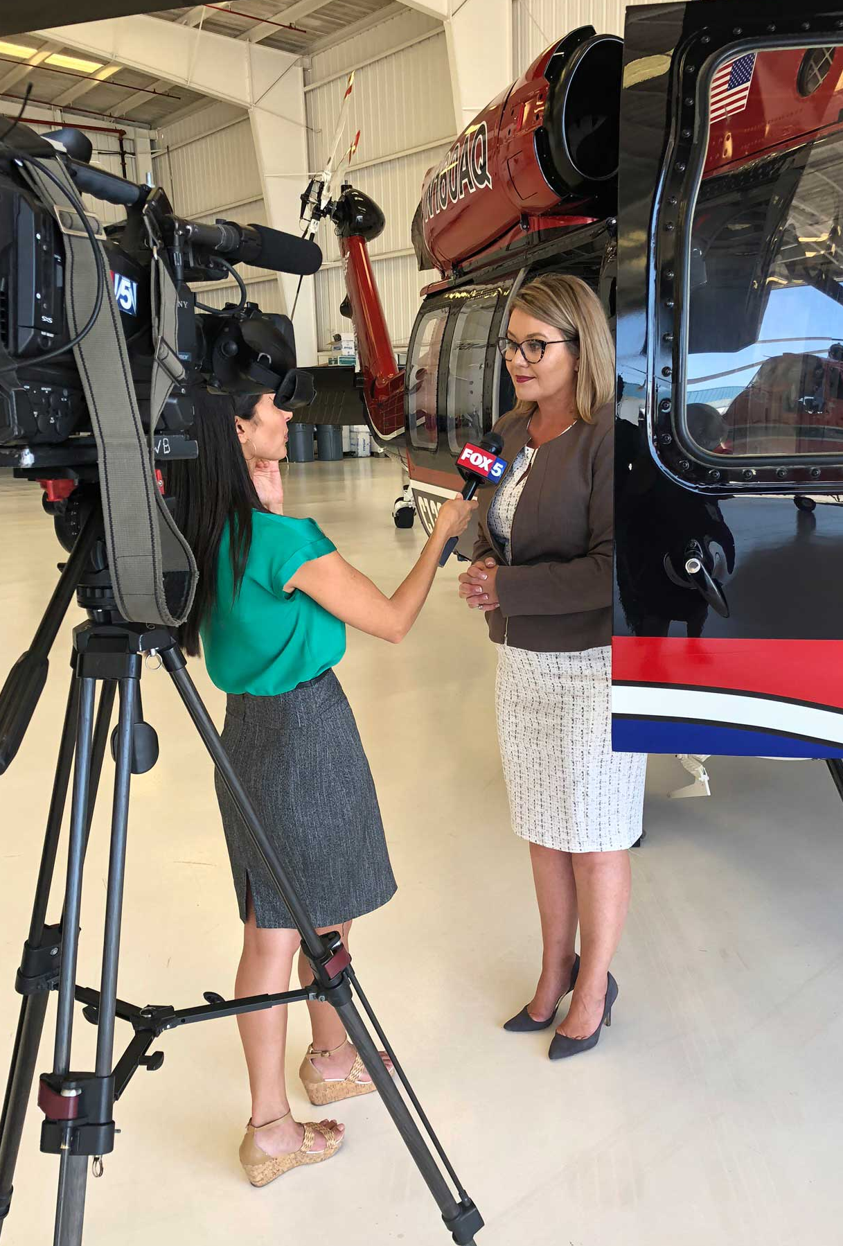
WMP
2020 STAKEHOLDER COOPERATION & COMMUNITY ENGAGEMENT
Communication & Outreach strategy for before, during and after a wildfire or state of emergency
Communication in multiple languages including:
General awareness campaign
Informational and emergency preparedness mailings
Emergency Preparedness Safety Website
Expand partnerships and community open houses and fairs
Expand the Generator Grant Program and Community Resource Centers

Slide 9
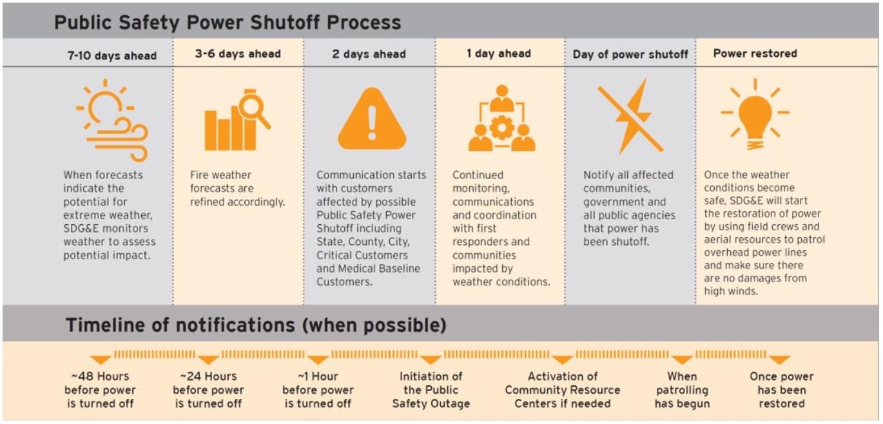
Public Safety Power Shutoffs (PSPS)
OPERATIONAL AND NOTIFICATION FRAMEWORK

Slide 10
NOTIFICATIONS
MEDICAL BASELINE AND LIFE SUPPORT
DURING AN EVENT
!
SUCCESSFUL?
NO
SUCCESSFUL?
NO
NO
SUCCESSFUL?
YES
YES
YES
Texts, Calls and emails to Medical Baseline customer at 48-hrs and 24-hrs in advance, if possible
Customer Contact Center Rep repeats calls at regular intervals to customer
Send field rep to check on customer
If customer does not answer, field rep will leave informational door hanger
CONFIRMED CUSTOMER CONTACT
For Medical Baseline notifications, the notification is considered successful if the customer has answered a phone call, responded to a text message, opened an email or clicked on a link included in an email.
Field reps will notify customer of Public Safety Power Shutoff and encourage them to spend time with a friend or family member, if needed. If customer is experiencing a medical emergency, rep will offer to dial 911 and wait with the customer until emergency services arrive.

