Slide 1
SCE AB 2868 Behind the Meter Program Proposal
Energy Storage for MASH/SOMAH

Slide 2
Overview & Objectives
The AB 2868 Energy Storage for MASH/SOMAH* is a proposed behind the meter program targeted at low income multifamily locations that participate in SCE’s Multifamily Affordable Solar Housing (MASH) or Solar on Multifamily Affordable Housing (SOMAH) programs.
Program Objectives include the following:
Install up to 4 MW of energy storage at MASH/SOMAH locations
Verify building owner, tenant and grid benefits are realized through M&V analysis
Identify optimal incentive amount for this segment to add storage to solar by using a stepped incentive scale with the incentive amount per Watt hour (Wh) decreasing over time as more MW are installed:
*Proposed in the 2018 Energy Storage Procurement & Investment Plan application filed on 3/1/2018

Slide 3
Customer Benefits
Building owners of affordable multifamily housing locations will receive incentives to add energy storage to solar systems.
Initial incentive amounts should cover the majority of purchase and installation costs when combined with available tax credits
Incentives will then decrease as more MW of storage are installed in order to determine the optimal incentive amount:
Both building owners and tenants will receive bill savings when on a TOU rate with evening on-peak time periods (3-5pm or 4-9pm)
Energy storage enables solar generation to be exported when customers receive the highest compensation
Virtual Net Energy Metering (VNEM) compensation is applied to customer TOU bills based on the time energy is exported

Slide 4
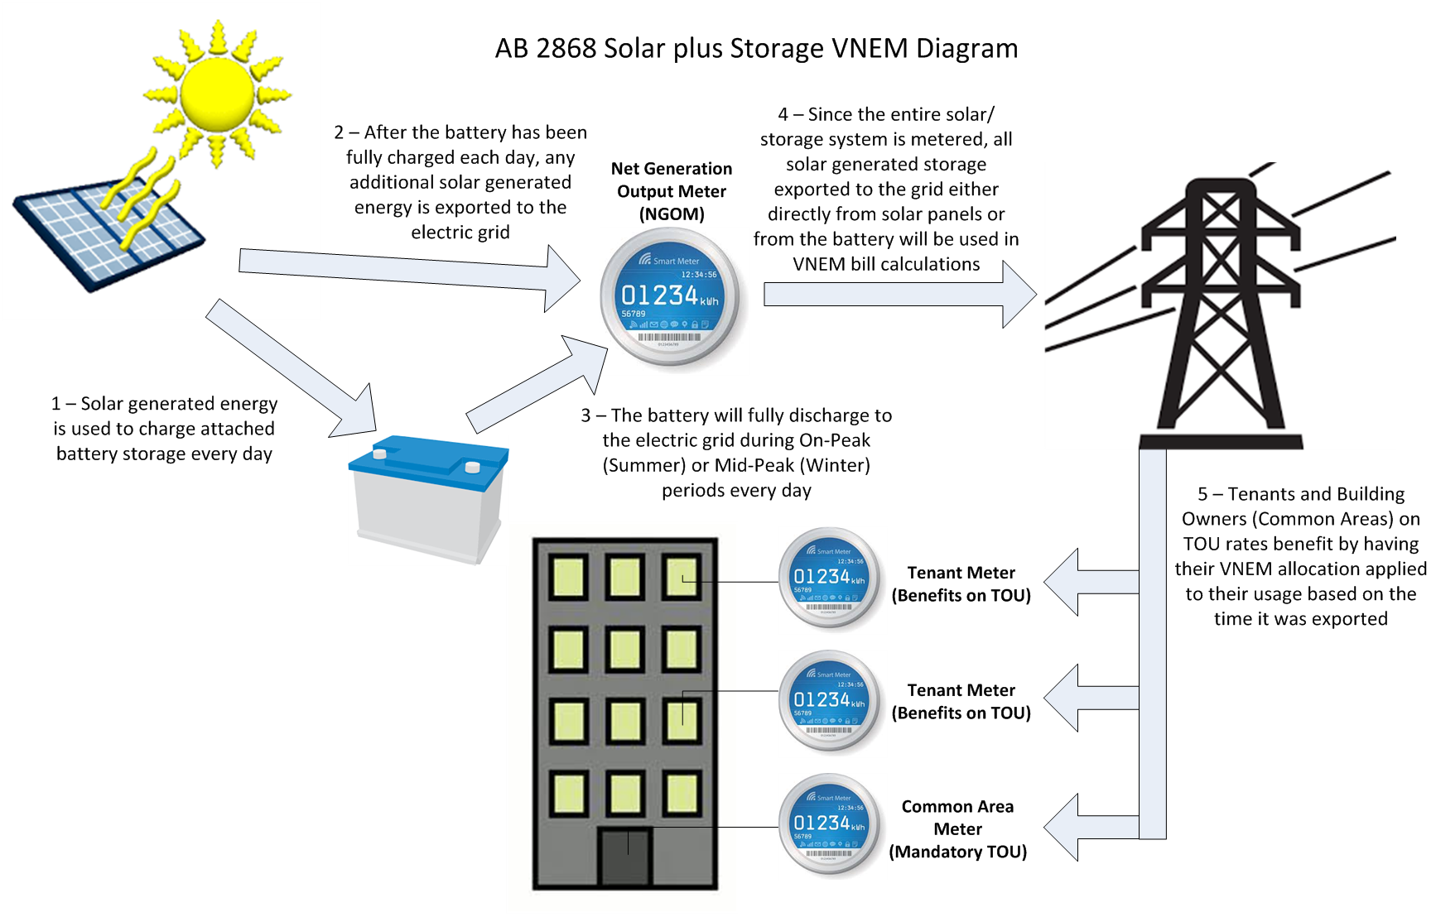

Slide 5
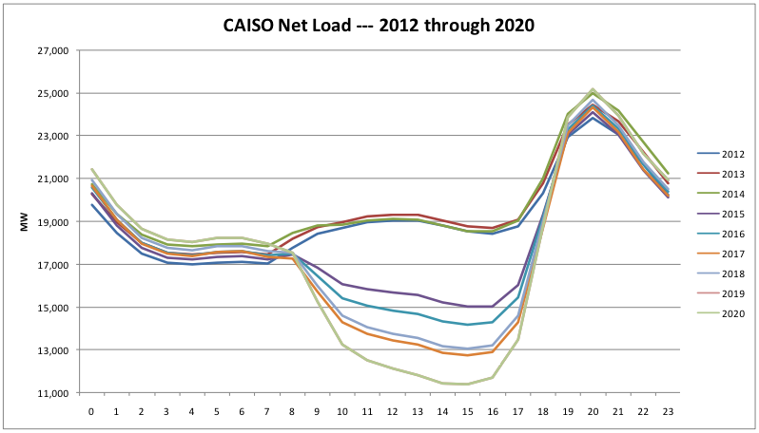
Grid Benefits
Adding storage to MASH/SOMAH solar installations will provide benefits to mitigate the affects of the “duck curve”
Solar generated energy will be stored instead of being exported to the electric grid at the time it is generated, typically during afternoon hours
Stored solar generated energy will be exported to the electric grid during evening hours when solar generation decreases and typical customer electricity usage increases

