Slide 1
CPUC En Banc on Time of Use Marketing, Education & Outreach LIOB Presentation
February 23, 2016
Kristi Wilkins
Senior Director Solutions Marketing

Slide 2
General ME&O Approach
Identify
Need for Communication
Select
the Customer based on Data
Understand What Motivates the Customer
Determine Message Channel and Timing
Drive
Action

Slide 3
Residential Rates Approach
Overall Rates Impacts
Rate Reform Impacts
Customer Bill Impact
AET/AGT
GT&S
GRC
Minimum Bill
Tier Collapse/Narrowing
E7/E8 Elimination
E6 Closure
New TOU Rates
SUE
TOU Default
Impact of the changes at the individual customer bill level

Slide 4
Residential Personas
Living for Today (In Need of Assistance)
14%
Mix of renters and home owners. They receive late payment notices & call the IVR frequently. They have medium-to-high bills. In general, are less likely to have the means to invest in EE upgrades.
Stable Living (Sustaining Renters)
11%
Primarily renters living in temperate areas. These households are typically of family stage & beyond. They rely on relatively low income, but are able to manage their money. They are often on CARE, but do not miss payments.
Style Seekers (Convenience Driven)
5%
These are young, pre-family households renting in the Bay Area/North Coast. They are likely to soon enter a new life stage (marriage/children) & own a home in the future. Their lifestyle leads to lower engagement & is accessible via email.
Eco-Active Go-Getters (Energy Efficient City Dwellers)
18%
Mix of renters and homeowners living in the Bay Area/ North Coast. While low engaged, these customers have low bills, low cost to serve, and efficient energy usage when compared to other similar households.
Gadget Family (High End EE Opportunity)
6%
More affluent, established homeowners with large homes and above norm energy usage for their requirements. Confronted with a lack of time, these customers are generally not focused on usage, but will engage given the right product/message.
Way Wired (Established & Savvy)
14%
Customers are more affluent, established households living in the Bay Area or North Coast. They typically have higher bills, yet are savvy about their usage and utility company offers. Rebate use is well established. There are fewer enrolled in My Energy and E-Bill.
Heart & Home (Mainstream Homeowner)
12%
Low-to-moderate income homeowners living in smaller homes. They tend to engage with PG&E through more traditional channels (pay by check, lower My Energy enrollment).
Beyond Their Means (Need Support)
5%
Homeowners who struggle with managing money. They often receive late payment notices and many are on CARE. They live in moderately sized homes with high energy bills. Similar to the Gadget Family, they use energy at a higher rate than their peers.

Slide 5
Enhanced Language Preference Data
New customer level data for direct targeting &
geographic targeting
19 dominant countries of origin
7 language usage segmentations
Hispanic and Asianicity levels of acculturation
Applications
In-language direct communications
In-language media buys
Go local location selection
Hispanic Language Usage Segment | Percent of Segment |  | Description
HL1: English Dependent | 12% |  | Individualized Hispanic Language Usage Segment indicates the overall
HL2: Bi-Lingual English Preferred | 34% |  | language preference (English versus Spanish) for individuals. The
HL3: Bi-Lingual English & Spanish Equally Used | 31% |  | segments are based on the language capabilities of the individual
HL4: Bi-Lingual Spanish Preferred | 18% |  | Hispanic, overall capability of their household and the language
HL5: Spanish Dependent | 5% |  | characteristics of their Hispanic neighbors.
 |  |  | Only for Dominant Region: Hispanic

Slide 6
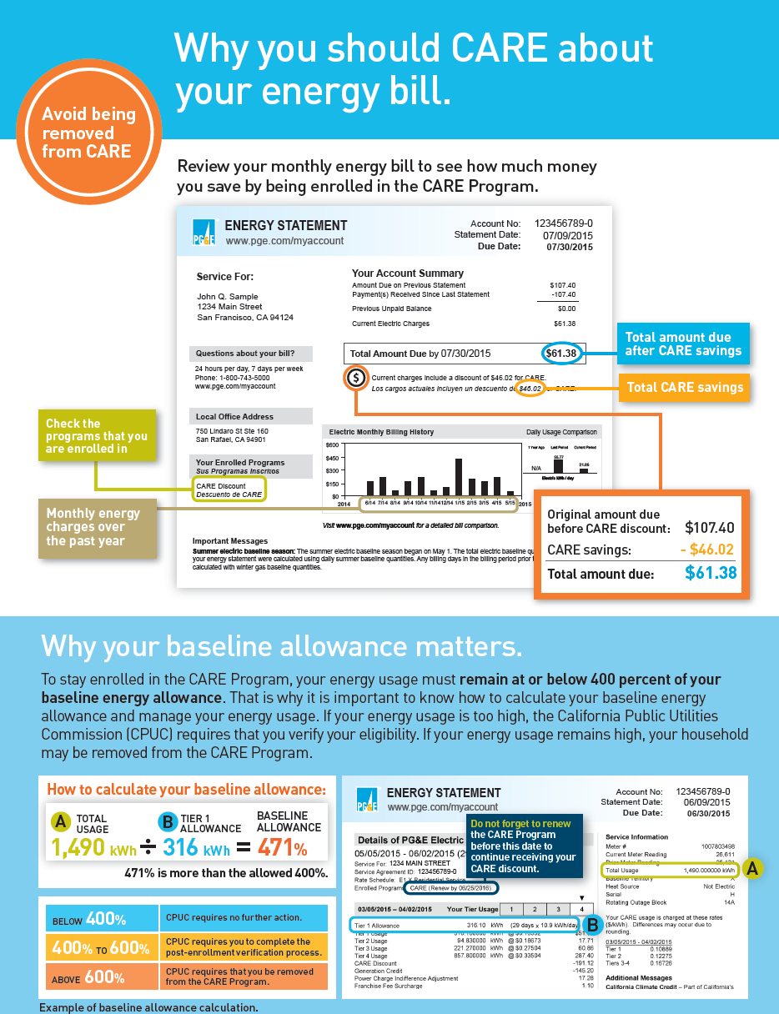
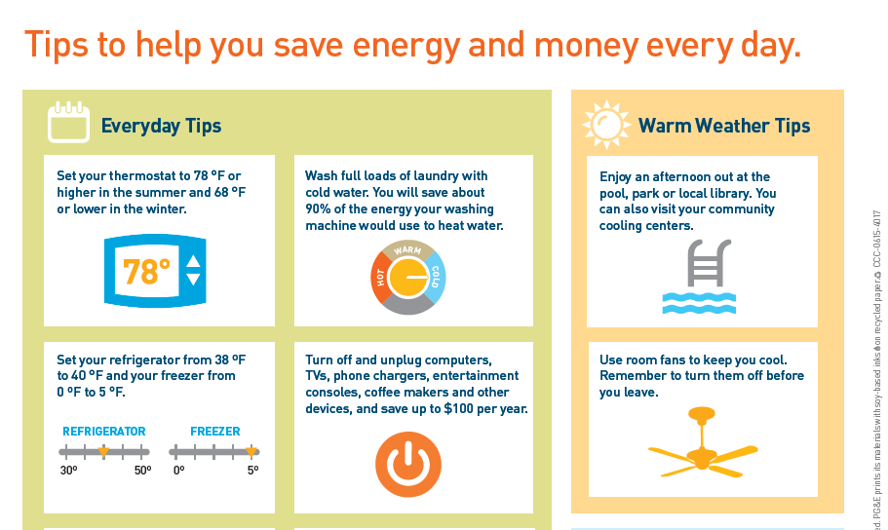
Leveraging Usage Data - Example
CARE Retention for High Energy Users:
Segmentation: CARE customers who exceed 400% of their monthly baseline allowance
Objective: Notify impacted customers that they must complete a verification process to stay in the program and educate them about baseline allowance
Results:
3% increase in customers adhering to program guidelines to retain CARE discount

Slide 7
Leveraging Multiple Sources of Data
Communities of Color Outreach:
Segmentation: Six ethnic groups targeted by income level and current program participation (22 versions total)
Objective: Communicate with ethnic customers in-language about ways to make smart energy choices.
Integration: CARE, ESA, SmartRate, Energy Upgrade CA, Billing Options, Home Energy Checkup
Results: Direct outreach to 1 million customers in 6 ethnic groups, average email open rates of 32.85% and Click-through rate of 3.18%. Industry Average: Open Rate 20%, CTR 1.77%

Slide 8
Rate Reform ME&O to-date
Phase II Rate Reform (2014)
Wave 1 August: versioned by impact 10-15% & 15-20%
Waves 2 & 3
Income qualified Non-CARE
Income qualified CARE
General Market
Summer Heat (2014/2015)
Most-Impacted, General Market
Direct Mail with summer heat tips
Targeted digital and radio ads
Minimum Bill (Sept, 2015 )
Non-CARE NEM
CARE NEM
Non-CARE Non-NEM
CARE Non-NEM
Minimum Bill (Feb, 2015)
Non-NEM
NEM
Tier 1/2
Income Qualified Non-CARE – CARE & Home Energy Check-up
CARE Customers – Home Energy Check up and ESA
General Market – Home Energy Check up & Balanced Payment Plan
CCA, NEM & ESA Customers – Home Energy Check-up
E7 Elimination
NEM Customers (3 versions)
Non-NEM Customers (5 versions)
Customers with disabled SmartMeters or no SmartMeter
E8 Elimination
NEM customers
Non-NEM Customers (8 versions)

Slide 9
TOU Targeted Outreach
PSYCHOGRAPHIC SEGMENTATION FOR TOU DEFAULT IN 2019
Needs First
Personas
Living for Today
Beyond Their Means
Motivations
Search for security
Open to Assistance
Bargain Hunters
Somewhat Fearful
In It Together
Personas
Heart & Home
Eco-Actives
Stable Living
Motivations
Doing the right thing
Respect and responsibility
Part of community
Cool and Connected
Personas
Way Wired
Gadget Family
Style Seekers
Motivations
Cool new thing
Proven to be a winner
Smart & Savvy
Independent

Slide 10
TOU Communication Plan–A Phased Approach
Audience | 2016: Introduce the “what” and the “why” | 2017: Explain TOU vs. Monthly Rate Plans | 2018: TOU is coming, here’s how to succeed | 2019: TOU is here
Needs First | Keep it simple. Rate Reform may impact your rates and bills. Are you on your best rate? Offer rate analysis and introduce TOU concept. | TOU gives you the chance to lower your bills. Introduce tips for shifting behavior and tools to reduce energy usage to save money. | Here’s how you can succeed with your rate plan. Promote ESA, CARE, Balanced Payment Plan, etc. | Lower your bills now. Continue to promote ESA, CARE, Balanced Payment Plan, etc. Additional tools (alerts, stickers, etc.).
In It Together | Better for all of us and environment. Rate Reform is supporting the State’s Energy Conservation mandate. Promote TOU concept as better for the grid and offer a rate analysis. | TOU gives you the chance to do your part. Introduce tips for shifting behavior and tools to reduce energy usage and support sustainability. | Here’s how you can succeed with your rate plan. Promote Energy Upgrade CA, SmartAC, Lighting, etc. | Do your part now. Continue to promote Energy Upgrade CA, SmartAC, Lighting, etc. Additional tools (alerts, stickers, etc.).
Cool and Connected | More sophisticated system, priming grid for shift to renewables. Rate Reform is adapting rate structures to support today’s grid. Promote TOU concept as better for the grid and offer a rate analysis. | TOU gives you the chance to embrace a smarter approach to energy. Introduce tips for shifting behavior and online tools to manage your energy usage. | Here’s how you can succeed with your rate plan. Promote Energy Upgrade CA, SmartAC, Lighting, Home Energy Checkup, Solar, etc. | Take control now. Continue to promote Energy Upgrade CA, SmartAC, Lighting, Home Energy Checkup, Solar, etc. Additional tools (alerts, stickers, etc.).

Slide 11
Communication Plan – Segment Outreach
Audience | Segment-Specific Core Tactics | General Tactics
Needs First | Additional direct mail Outbound calling CBO co-marketing & support Landlord channel support/outreach Co-marketing with CARE, ESA | Direct mail/inserts Owned media content – pge.com, social channels Brand communications Co-marketing tactics Channel communications
In It Together | Email Google search Lock into “do it yourself” mentality Community groups/organizations co-marketing Co-marketing with SmartAC, Energy Upgrade
Cool and Connected | Targeted online media – mobile and apps Heavier messaging on PG&E social media channels Email Google search Co-marketing with Home Energy Checkup, solar programs, EV, etc.

Slide 12
Integration Points for Exploration
Audience | Opportunity
Low Income | CARE Acquisition CARE Welcome Kits CARE High Usage Communications Low Income Residential Newsletter Community Based Outreach Events ESA Contractor Training Communities of Color campaign
NEM & Renewables | NEM Welcome Communications Solar Choice Welcome Kits Solar Choice Newsletter
General Audience | Residential Newsletter Local Offices Hold Messages in call center Regional Energy Networks (RENS) Energy Upgrade California Contractors & Statewide Campaign Pge.com Home Page pod Home Energy Reports module SmartRate Customer Communications PG&E new service welcome Kit

Slide 13
PG&E Partner Toolkit
Develop “kit” of content and promotional tools that can be easily branded, customized and leveraged by external channels (CBOs, cultural organizations, etc.)
Messaging | Turnkey Assets
Key messages, benefits and ready-to-use copy points for each message phase For placement on website pages, use in social media, event talking points Segmented content for identified, common audience groups (i.e. diverse customers and communities) FAQs for conversations, events and customer service | Sidebars for print and e-newsletters, direct mail Social media posts Website widget with button to PGE.com Rate Reform page(s) Customizable e-mail blasts RR-related tips lists to be used online and in print PowerPoint template for community events

Slide 14
Thank You

