Slide 1

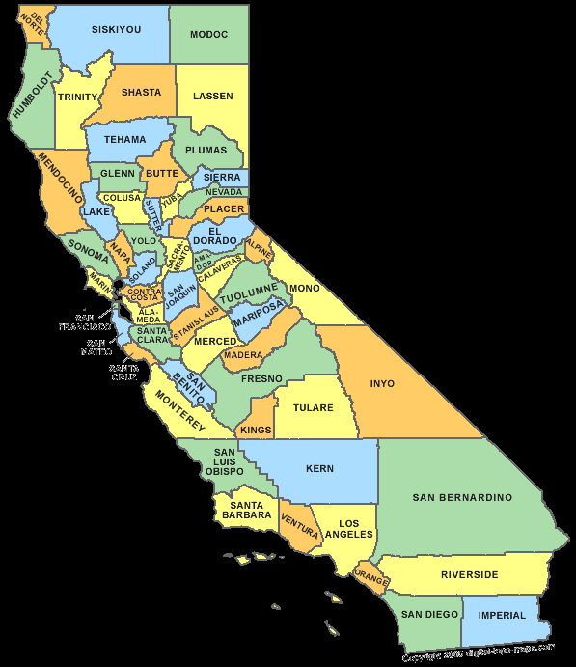






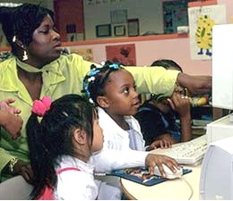


Low Income Oversight Board
Affordable Broadband Pilot Project
Utility CARE Customer Outreach
December 2018

Slide 2
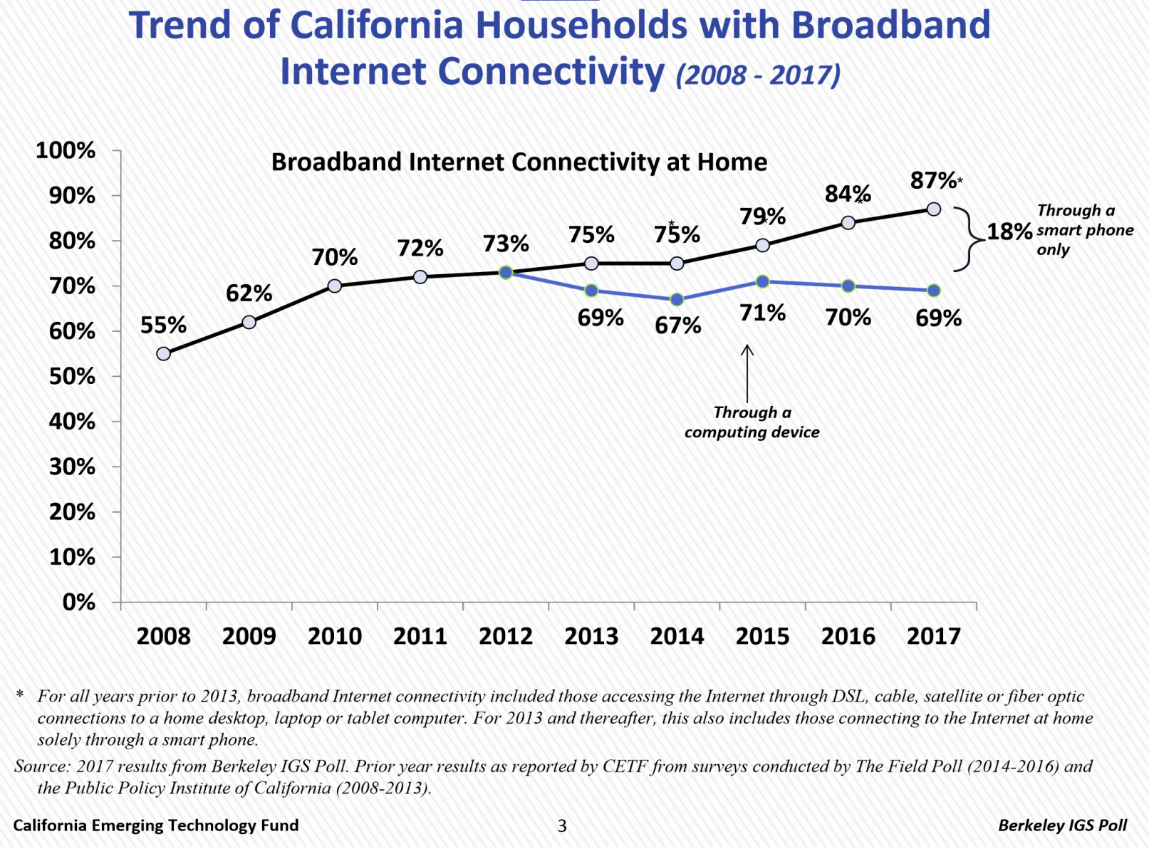
2017 Statewide Survey Results

Slide 3
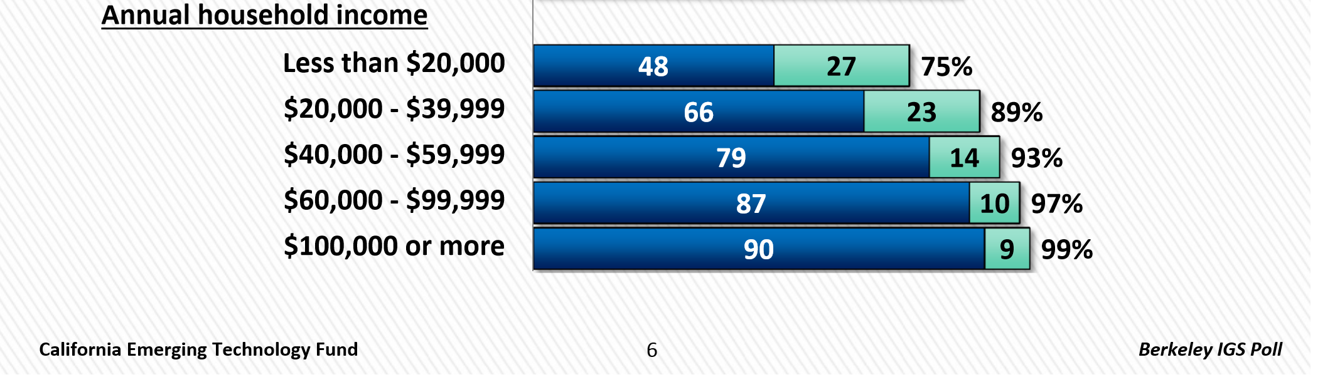
2017 Statewide Survey Results
Broadband Adoption Tied to Income
48% of Households Earning Less Than $20,000 a Year (27% by smart phone only)

Slide 4
Internet Service Provider
Affordable Offers
Existing Low-Income
Affordable Broadband Offers

Slide 5
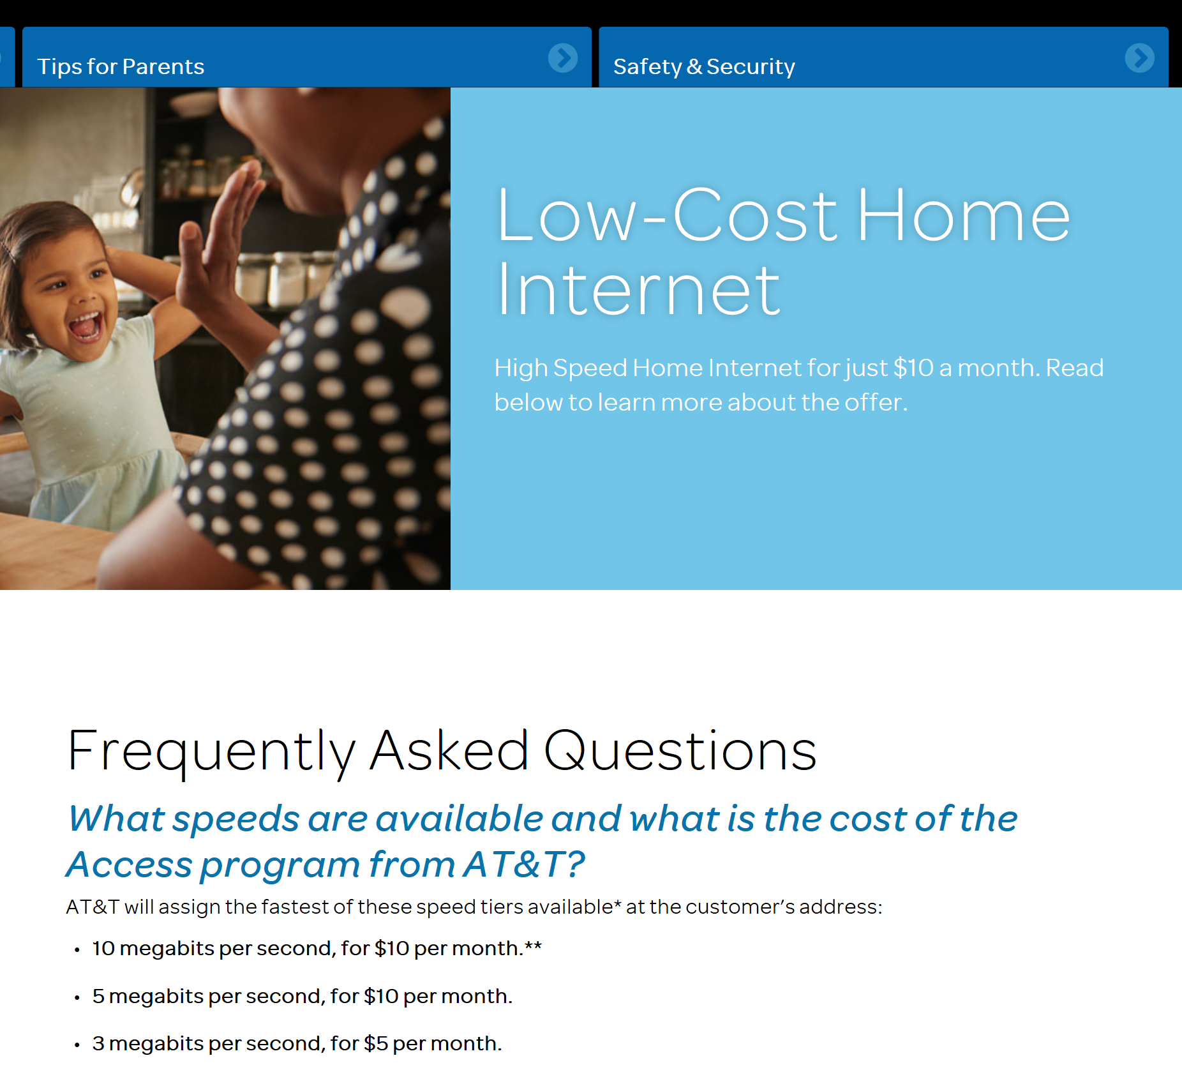

AT&T affordable offer

Slide 6
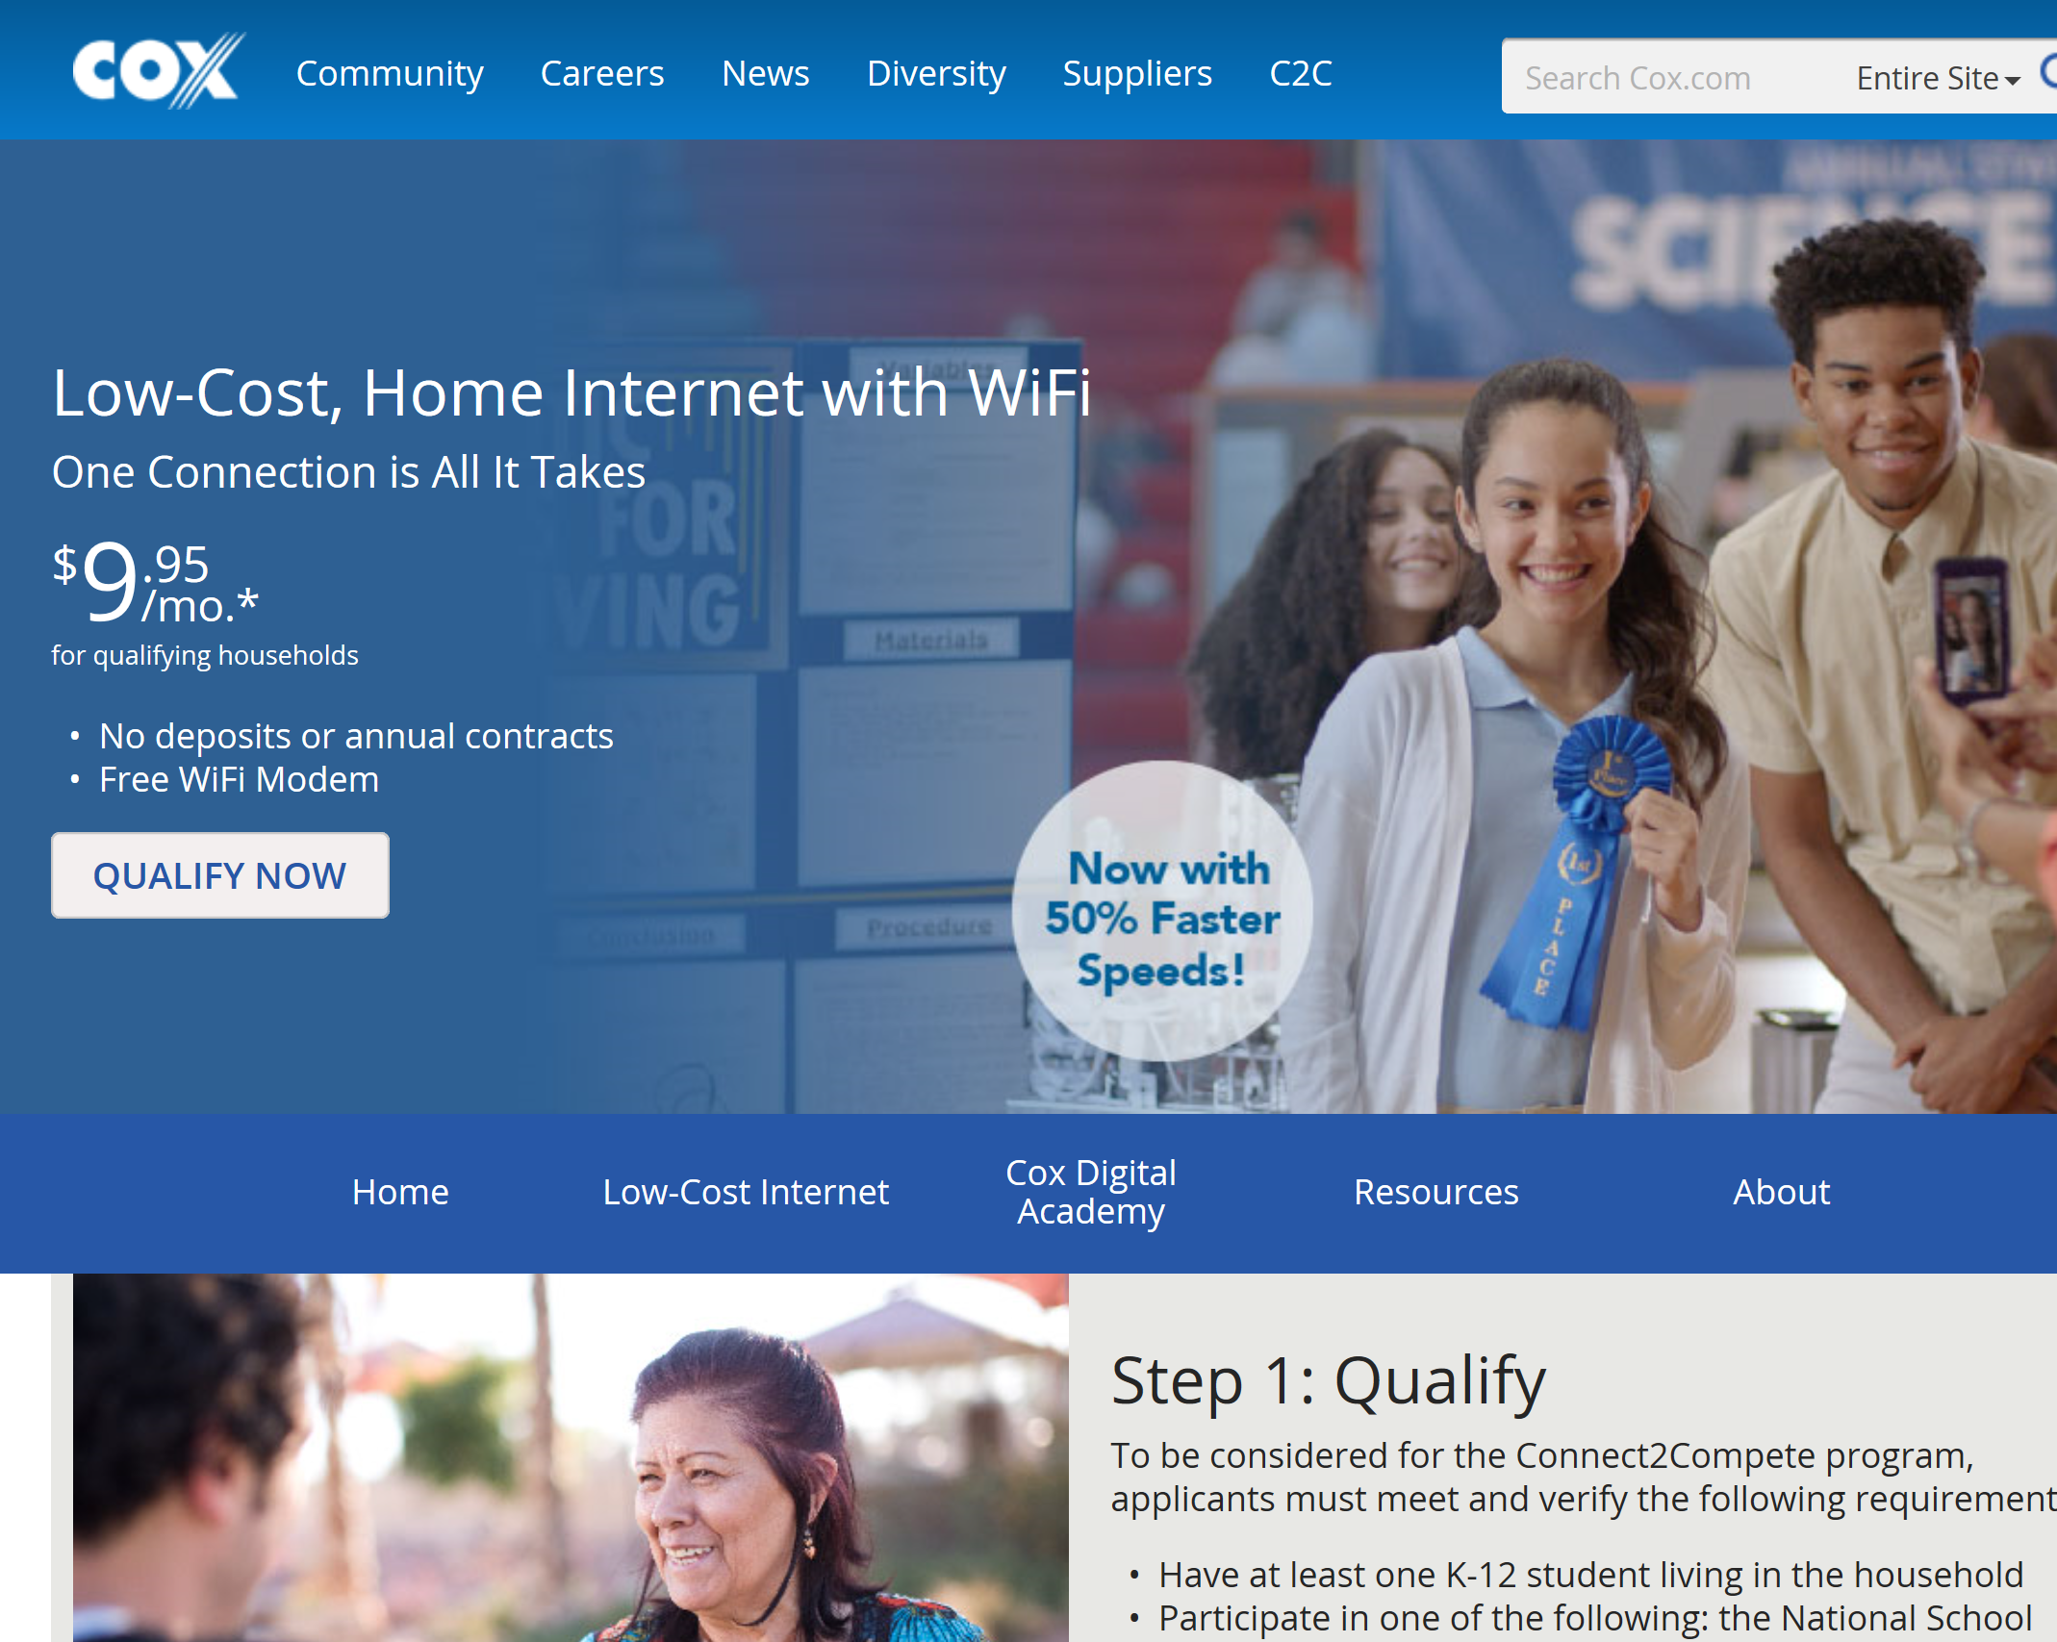
Cox affordable offer

Slide 7
EXISTING Affordable Broadband Offers
Increasing Choices and FCC Lifeline
Mobile Citizen $15 per month ($100 Hot Spot)
            Income Eligibility Required (Speed = 8-18 Mbps)
Comcast $10 per month (Free Wifi Router) Natl. School Lunch, Seniors, & Veterans (Speed = 15Mbps)
AT&T $10 per month (Free WiFi router) CalFresh or SSI - (Speed 3-12Mbps -$5 per/mo if 5 Mbps or less)
Frontier $14.99 per month (+$5 for WiFi) CalFresh, SSI, or Medi-Cal - (Speed = 7-25Mbps)
Charter $14.99 per month (+$5 for WiFi)
Natl. School Lunch or SSI (Speed = 30Mbps)
Cox $9.95 per month (free WiFi router)
Natl. School Lunch or SSI (Speed = 15Mbps)

Slide 8
Pilot Project Summaries

Slide 9
2017 Fresno Survey – The Information Gap
Detailed Survey - Fresno’s Lowest Income Census Tract
307 Respondents
23% of Households have no Internet access
All households have children, and ALL ARE ELIGIBLE for discounted Internet service.

Slide 10
2017 Fresno Survey
Detailed Survey - Fresno’s Lowest Income Census Tract
However, ONLY 33% actually have low-cost Internet.
AND…virtually everyone who wants the Internet and doesn’t have low-cost Internet service wants information on low-cost Internet.

Slide 11
SMUD Project Results
90,000 letters sent to customers enrolled in SMUD’s Energy Assistance Program Rate (EAPR).
However, 61.4% of households earning less than $40,000 per year already have meaningful Internet access (although pay more than affordable offers).
That means 38.6% of households that don’t have meaningful Internet access.
From that we get:
A Likely Target Population of 34,700
(90,000) x (38.6) = 34,700

Slide 12
SMUD Project Results
From the 34,700 people in the Likely Target Population…
4,055 individuals called in response to the letter
25% of calls were turned into adoptions (1093 adoptions)

Slide 13
SDG&E – 211 San Diego Pilot
Three components to project:
Text Message Outreach
IVR Message
Utility Caller Screening
211* referred callers directly to Cox and/or AT&T
*211 would have directly assisted with adoptions, but CETF did not have the funding available for that level of service.

Slide 14
2017 San Diego Pilot Project Income Levels
Total Respondents = 19,647

Slide 15
SDG&E – 211 San Diego Pilot
Total Results :
  19,647 total individual contacts;
  4,492 broadband screenings completed (23%)
  772 unique referrals to Cox or AT&T (17%)
  149 verified adoption outcomes
    66 adoptions
  289 referrals for free or low-cost device
  77 referrals for digital literacy training

Slide 16
SDG&E – 211 San Diego Pilot
Results of Text Message Campaign
  Texts sent: 5,450
  Individuals Screened: 109
  Individuals Referred: 79
  15 outcomes verified
    4 adoptions

Slide 17
SDG&E – 211 San Diego Pilot
Results without the Text Message Campaign:
  14,197 total individual contacts;
  4,383 broadband screenings completed (31%)
  716 unique referrals to Cox or AT&T (16%)
Effectiveness Comparison
 | With Text | Without Text
Contacts | 19,647 | 14,197
Screenings | 4492 (23%) | 4383 (31%)
Referrals | 772 (17%) | 716 (16%)

Slide 18
SDG&E – 211 San Diego Pilot
Effectiveness Comparison SMUD vs. 211/SDG&E
 | SMUD | 211 San Diego
Contacts | 90,000 letters sent | 14,197 calls received
Screenings | 6,818 callers screened | 4,383 callers screened
Interested | 4,055 | 716 referrals
Outcomes | 1,093 adoptions | 52 adoptions

Slide 19
SDG&E – 211 San Diego Pilot
Converstion Rates | SMUD | SDG&E
Contacts to screenings | 7.58% | 30.87%
Screenings to Adoptions | 26.95% | 7.26%
Using the SMUD Likely Target Population (LTP)
Converstion Rates (LTP) | SMUD | SDG&E
Contacts to screenings | 19.65% | 30.87%
Screenings to Adoptions | 26.95% | 7.26%

Slide 20
SoCalGas Pilot Project
This ongoing project has three components:
CARE Recertification Letter
Single Subject Letter
  Refer to 211
  Refer to Internet for All 800 number
Utility Caller Screening
This project will be completed early next year.

Slide 21
Why CARE?
What is the Connection
Between CARE and
Affordable Broadband?

Slide 22
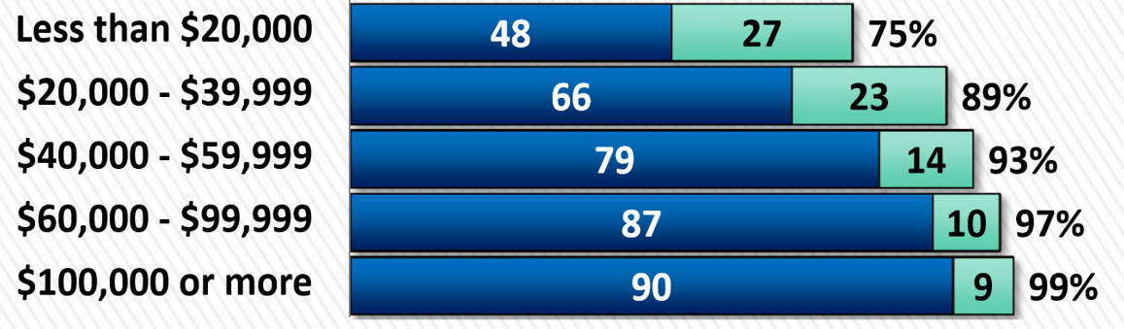
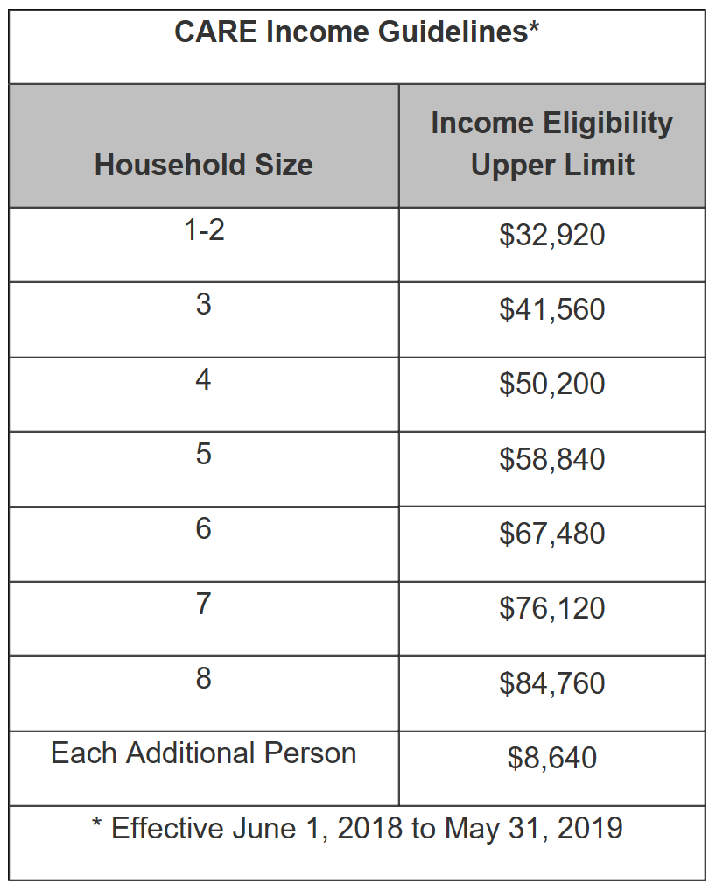
Income is the common denominator
Broadband Adoption by Household Income

Slide 23
Call to action
The Digital Divide is not closing. Those without the Internet suffer demonstrable harm and fall farther and farther behind every day. Absent government intervention the Digital Divide will not close.
We urge the LIOB to act on behalf of low-income Californians and communicate to both the IOUs and to the CPUC your strong support for the Utility Outreach Project.

Slide 24
CALIFORNIA EMERGING TECHNOLOGY FUND
CONNECT  COMMUNICATE  COMPETE
Thank You
focus  action  results

