Slide 1
Water Utilities Update
Low-Income Oversight Board
Water Division
Viet (Kevin) Truong
March 15, 2017

Slide 2
Topics
Drought Update
Conservation Actions
Statewide Low-Income Program

Slide 3
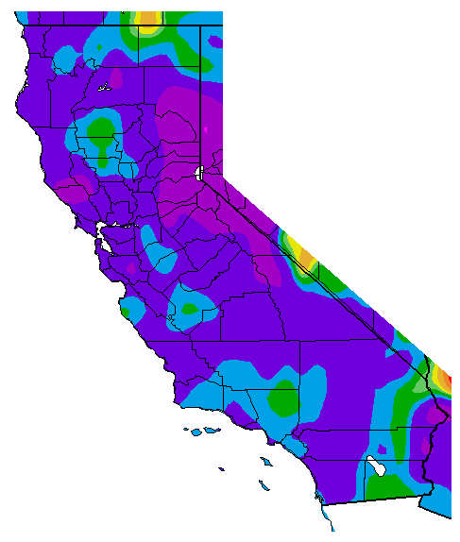
Precipitation
Percent of Average Precipitation
(Oct 1, 2016 – March 6, 2017)

Slide 4
Reservoir Storage (As of March 6, 2017)
100%
Department of Water Resources

Slide 5
California Still in a Drought?
Above Average Rain/Snowfall
Above Average Reservoirs Levels
However…
Drought Proclamation
Still remains in effect
Groundwater levels have significantly declined
Excess pumping during drought
Resulting in Land Subsidence
SGMA – Does not become effective until 2040
Surface Water has been replenished
but Groundwater has not
Notes:
5

Slide 6
Conservation Actions
SWRCB extended emergency water conservation regulation on Feb 8th
Continue to prohibit water waste
Continue monthly water reporting by water utilities
No more mandatory conservation
Re-evaluate after wet season
Plans to make ban on water waste & regular water reporting permanent
Make water conservation a way of life
Notes:
6

Slide 7
Conservation Reporting
June 2015 to January 2017
California
Saved 2.51 Million Acre-Feet of Water
22.5% compared to 2013
Enough to supply 12.5 million people for a year
IOU’s
Saved 0.41 Million Acre-Feet of Water
25.3% compared to 2013
IOU’s have consistently performed better
Notes:
7

Slide 8
Affordable, Safe Drinking Water Initiative
AB 685 (2012) – Human Right to Water
Water Code Section 106.3
Progress:
SB 88 (2015) – Consolidation
SB 552 (2016) – Managerial services help from SWRCB for failing water systems
SB 1263 (2016) – Prevention of new unsustainable water systems
AB 401 (2015) – Low-Income Water Rate Assistance Act
Supports Human Right to Water
Statewide Low-Income Water program
Plan development and feasibility report issued by SWRCB
To the Legislature by 2018
Notes:
8

Slide 9
Thank You
Viet (Kevin) Truong
Utilities Engineer
CPUC – Water Division
(415) 703-1353
vt4@cpuc.ca.gov

