Slide 1
Water Utilities Update
Low-Income Oversight Board
Water Division
Viet (Kevin) Truong
July 20, 2016

Slide 2
Topics
Drought Update
Drought Actions
Low-Income Discounts

Slide 3
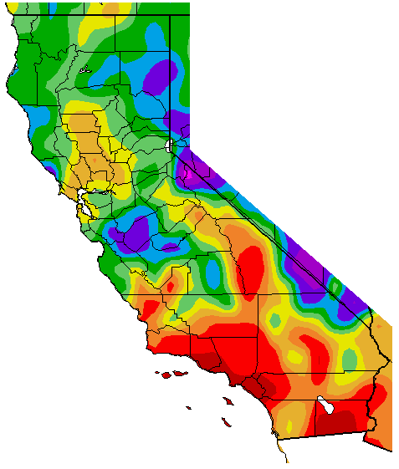
California Remains in a Drought
Percent of Average Precipitation
(Oct 1, 2015 – Jul 11, 2016)

Slide 4
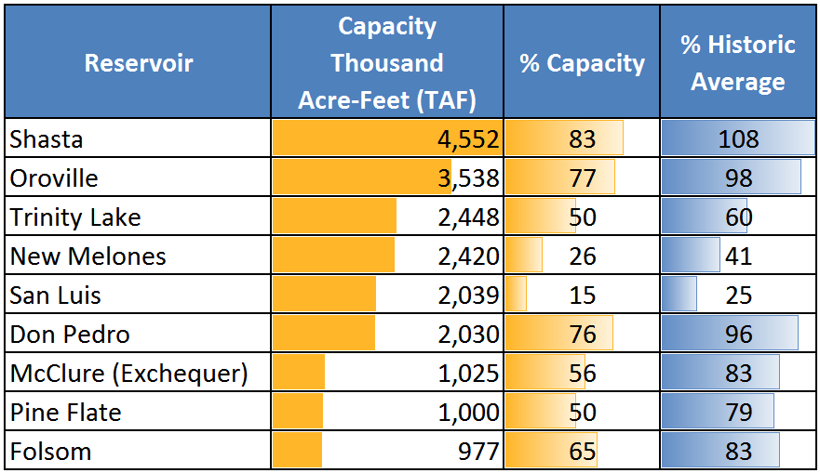
Reservoir Storage (As of July 11, 2016)
100%
100%
Department of Water Resources

Slide 5
Mandatory Restrictions
June 2015 to May 2016
California
Saved 1.6 Million Acre-Feet
24.5% Cumulative
IOU’s
Goal: 215,000 AF
Saved: 260,000 AF
27.4% Cumulative
IOU’s surpassed their goal
Notes:
5

Slide 6
Drought Actions
May 9: Governor’s Executive Order B-37-16
“Making Water Conservation a California Way of Life”
Adjust emergency regulation through January 2017
May 18: SWRCB Resolution No. 2016-0029
Self-Certification
Effective June 1, 2016
June 23: CPUC Resolution No. 5103-A
IOU’s must comply with SWRCB
56 of 60 districts reported a 0% conservation standard
Modify/Reduce Schedule 14.1
No more Drought Surcharges
Notes:
6

Slide 7
Outlook: 2017
Expected La Niña
cooling of the water temperatures
Usually results in less precipitation
Rainy months
November through March
Colder Temperatures needed
For snow
A dry 2017 winter will put us back to square one, despite this year’s average precipitation.

Slide 8
Low-Income Discounts in 2015
Data exchange twice a year
235,000 enrolled
19% of residential customers
Increase of 100% before data exchange
$27 Million in discounts
Up from $24M in 2014
Average discount $9.50 per month
Notes:
8

Slide 9
Low-Income Discount Rulemaking
Purpose
Standardize Low-Income Programs
Called for in 2010 Water Action Plan
Goals
Simplify programs
Uniform discounts
Address burden of increasing rates
Easy to understand for Low-Income Customers
Rulemaking release date expected in 2016

Slide 10
Thank You
Viet (Kevin) Truong
Utilities Engineer
CPUC – Water Division
(415) 703-1353
vt4@cpuc.ca.gov

