Slide 1
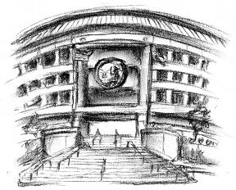
Water Utilities Update
Low-Income Oversight Board
Water Division
June 24, 2019

Slide 2
Topics
Low-Income OIR Workshop
School Lead Testing
Conservation
Proposed Legislation
Acquisitions
Human Right to Water Report

Slide 3
Water Low-Income OIR
R.17-06-024
Workshop held on May 2nd
“Water Rate Design for a Basic Amount of Water at a Low Quantity Rate”
Determining and establishing basic quantity
Affordable = no tradeoffs of basic needs
Adjustments to rate design
Marginal-Cost Pricing
Shift more revenues to fixed charges
Account for conservation
Consider multi-family
Notes:
3

Slide 4
School Lead Testing
Assembly Bill 746
92%
1,323 Schools Tested
492 exempted
19 over limit (1.0%)
- Corrective actions taken
IOUs serve
1,963 Schools
Statewide (as of Mar 2019)
13,500 schools
8,423 tested/exempted (62%)
243 over limit (1.8%)
Deadline July 1, 2019

Slide 5
Water Conservation & Production Reports
2013 Baseline
IOUs
21.3% savings since Jun’15
246 billion gallons total
Statewide
18.4% savings since Jun’15
1.5 trillion gallons total

Slide 6
Proposed Funding for Safe and Affordable Water
Gov. Gavin Newsom Budget Trailer Bill
$140 million per year
Water tax on water bills
$0.95 to $10 per month based on meter size
Excludes low-income customers
Fees on animal farmers, dairies and fertilizer producers
Two thirds vote required by July 1st
Rejected by state Senate; pending in state Assembly
Alternate proposals
SB 200 (Monning)
Appropriate $150 million annually from General Fund
SB 669 (Caballero)
Appropriate from General Fund during state budget surplus year
AB 217 (Garcia)
Fee of $0.50 per connection per month
Notes:
6

Slide 7
Acquisitions of Smaller Water Systems
Benefits of Consolidation
Economies of Scope and Scale
Majority of troubled water systems serve less than 500 people
Technical, Managerial, and Financial (TMF) Capability
Unaffordable for disadvantaged communities
Streamline Operations
Maintenance and infrastructure costs are rising
Access to Low-Income Programs
Statewide Policies
SB 88 (2015): consolidation authority to SWRCB
SB 552 (2016): TMF help for failing water systems
SB 1263 (2016): prohibits creation of new small water systems
CPUC continues active consolidation
Notes:
7

Slide 8
Acquisitions of Water IOUs
Class A: 9
Class B: 5
Class C: 20
Class D: 62
39 acquisitions of water IOUs since 2007
2 so far in 2019: Rio Plaza by Cal-Am & Mesa-Crest by Park (Liberty)
Also 1 acquisition of municipal (Rolling Hills)
1 new water IOU created in 2016 (Sierra Park)
5 pending acquisitions
3 IOUs: Fruitridge Vista by Cal-Am, Hillview by Cal-Am, & Hat Creek by Del Oro
2 Municipals: Perris by Park (Liberty) & Bellflower by Cal-Am
Notes:
8

Slide 9
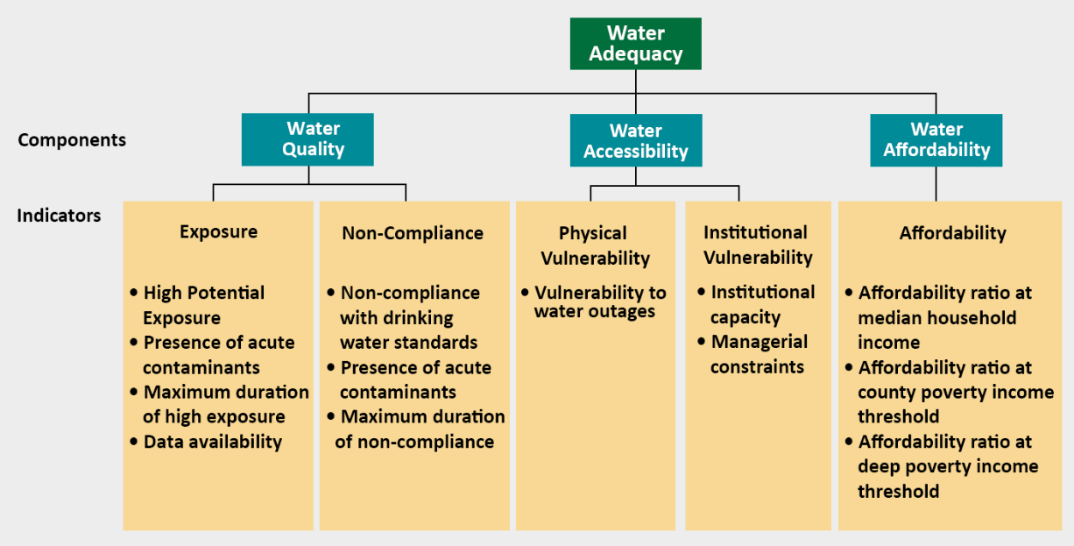
Human Right to Water Report
Office of Environmental Health Hazard Assessment
Develop framework for evaluating water quality, accessibility, and affordability
Meet the goals of AB 685 (2012)
Draft report released on Jan 3rd
Notes:
9

