Slide 1
Southern California Edison Company
CARE and ESA Programs Report
Quarterly LIOB Meeting
El Cerrito, CA
March 6, 2019

Slide 2
SCE CARE Program
CARE Enrollment, Penetration and Expenditures
Year | Customers Enrolled | Estimated Eligible Customers | Penetration Rate | Expenditures | % of Authorized | Discounts
2018 Year End | 1,205,539 | 1,422,225 | 85% | $7,337,847 | 103% | $383,564,658
2017 Year-End¹ | 1,222,526 | 1,457,787 | 84% | $6,706,298 | 67% | $381,750,137
2016 Year-End | 1,235,755 | 1,520,058 | 81% | $6,070,197 | 82% | $348,951,329
¹ 2017 Customer enrollment data from Annual Reports

Slide 3
SCE CARE Program
Good News | Positive Program Developments | Areas Requiring Improvement
2018 penetration rate increased to 85% 1,205,539 households participating by year-end 2018 Lessons learned from the continuous use of advanced data analytics led to improved targeting Initiated first SMS/Text messaging campaign to encourage CARE enrollment | On target to implement Disaggregated Data Project Phase 1 by end of first quarter 2019 Completed first successful data transfer to CPUC Lifeline Admin | Vigorous FERA promotion to meet 50% aspirational goal by year-end 2023

Slide 4
SCE CARE Program
PY 2019 Goals | Plans | Progress
Strive to reach CARE aspirational enrollment goal of 90% File post 2020 Application/Testimony File FERA Marketing Plan | Achieve FERA penetration targets as described in SCE’s 2019-2020 FERA Marketing Plan Bundle IQP program communications to increase appeal Continue to implement current compliance directives | Focused on reducing attrition and increasing enrollment through various means Continued to maintain 85% penetration through Jan 31

Slide 5
CHANGES Program Year-End Updates
According to the CHANGES Statistics Report for 2018 program year activity provided by Milestone Consultants on 2/21/2019, the following information was published and is specific to SCE.
Note: Data provided by CHANGES vendor has not been verified by SCE.
Needs Assistance Provided
Add Level Pay Plan | 0
Assisted with CARE Re-Certification/Audit | 9
Assisted with Changes to Account | 18
Energy Efficiency Tool | 4
Assisted High Energy User with CARE Doc Submission | 1
Assisted with Reconnection | 1
Billing Language Changed | 0
Consumer Education Only | 0
Electricity Aggregation | 1
Energy Alerts | 0
Energy Assistance Fund (SCE) | 69
Energy Assistance Fund (PG&E) | 0
Enrolled in Demand Response Programs | 0
ESAP | 32
Gas Assistance Fund (SCG) | 0
HEAP | 352
Medical Baseline | 31
Neighbor to Neighbor (SDG&E) | 0
REACH | 0
Reported Safety Problem | 1
Reported Scam | 1
Set Up 3rd Party Notification | 0
Set Up New Account | 1
Payment Extension | 28
Payment Plan | 23
Wildfire Related Issue | 0
Total | 572
Consumers provided with Consumer Education | 5,348
Disputes Resolved
Add Level Pay Plan | 2
Assisted with CARE Re-Certification/Audit | 1
Changed 3rd party Company | 2
Consumer Education Only (must be pre-approved) | 1
Medical Baseline Application | 0
Enroll in Energy Assistance Programs | 19
Request Meter Service or Testing | 0
Request Bill Adjustment | 4
Request Customer Service Visit | 0
Schedule Energy Audit | 0
Payment Extension | 21
Payment Plan | 57
Solar | 5
Stop Disconnection | 44
Time of Use | 5
Wildfire Related Issue | 0
Total | 161

Slide 6
SCE ESA Program
Number of Homes Treated, Program Expenditures
Program Year 2018 Activity¹
 | Home Treated Goal | Homes Treated | % of Goal | Authorized Budget | Expenditures | % of Authorized
2018 | 93,251 | 82,574 | 88.6% | $79,106,455 | $63,354,132 | 84%
2017 | 54,509 | 80,333 | 147% | $70,740,828 | $61,120,956 | 86%
¹ 2018 YE data is preliminary and is subject to change in May 1 Annual Report.

Slide 7
SCE ESA Program
Energy Savings
Program Year 2018 Activity¹
 | Electric (GWh) Goal | Electric (GWh) Achieved | Gas (MM Therm) Goal | Gas (MM Therm) Achieved
2018 | 30.8 | 47.3 | n/a | n/a
2017 | 30.8 | 31.8 | n/a | n/a
¹ 2018 YE data is preliminary and is subject to change in May 1 Annual Report.

Slide 8
SCE ESA Program
2018 Year-End Unspent Funds¹
Amount Authorized 2018² | Unspent Funds in 2018 | Total Unspent Funds 2009-2016 | Unspent Collections in Balancing Accounts at Year End 2018
$79,106,455 | $12,628,505 | $65,837,599 | $78,466,105
¹ 2018 YE data is preliminary and is subject to change in May 1 Annual Report.
² 2018 authorized budget pursuant to Resolution E-4884 issued December 18, 2017.

Slide 9
SCE ESA Program
Good News | Positive Program Developments | Areas Requiring Improvement
Serviced 82,574 homes in 2018. Lessons learned from tribal outreach efforts opened new communities that we can target. Successfully renegotiated existing contracts with service providers. SCE was the first Utility to implement the new Statewide Energy Education Resource Guides. We are continuing to explore new ways to educate our customers. | Launched new measures - 2nd Refrigerator & Smart Thermostats On target to offer the following new measures: Freezers & HE Washers Continued to leverage lessons learned through our tribal efforts. Currently working with Fort Irwin base housing. Base housing is now privatized Plan to income verify households based on military pay grade Explore additional opportunities to serve other sites where the base housing has been privatized | First touch enrollments acquisition is becoming a challenge. Need to enhance marketing plan to target customer pool who most likely have received past program information but have not enrolled. Continued challenges in implementing Multi-Family CAM in ESA program. No substantial results to date. The EMAPS system that SCE utilizes to track, process, and complete program enrollments is becoming complex and overly customized. SCE is considering proposing a new system for the post 2020 program cycle.

Slide 10
SCE ESA Program
PY 2019 Goals | Plans | Progress
Achieve 98,953 homes treated; 33,920,000 kWh savings and 5,429 kW of load. File post-2020 Application / Testimony Develop a strategic procurement plan as part of the post-2020 Application. Integrate innovative ideas to ESA program to deliver deep energy savings. Continue to formalize partnerships with CSD and tap other organizations or initiatives (e.g. San Joaquin Valley Pilot) where we could leverage ESA funding. | Create new tools to help service providers conduct grassroots marketing and outreach efforts. Develop co-branded materials for service providers to utilize at public events. Continue to utilize direct mail campaigns. On target to mail over a million pieces in 2019. Finalize funding agreement with CSD by April 1, 2019. Collaborate with SW team to enhance current ESA program structure in order to deliver deep energy savings and target high usage customers. Socialize proposed program changes to stakeholders. | Hosted Annual Training Summit to educate service providers on new program changes and marketing efforts. Discussions with CSD in progress. Implementation Phase of San Joaquin Valley Pilot in progress. Approximately 60 TCAC list project leads have been provided to Multifamily CAM Pilot contractors to begin project development.

Slide 11
SCE Marketing & Outreach
Good News | Positive Program Developments | Areas Requiring Improvement
Continued to refine customer data analytics to better target customers. Initiated first SMS/Text messaging campaign to encourage CARE enrollment. Continued collaboration with ESA contractors. | Leveraged bundled marketing to create awareness for multiple income qualified programs. | Continued development with CBOs and other county orgs such as 2-1-1. Continue to refine program message to attract new participants to meet enrollment goals.

Slide 12
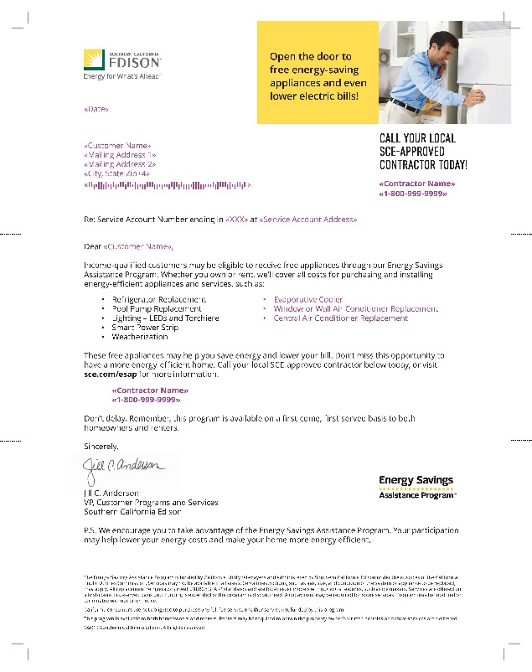
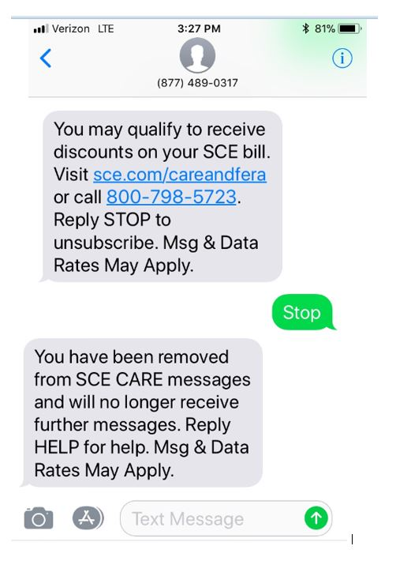
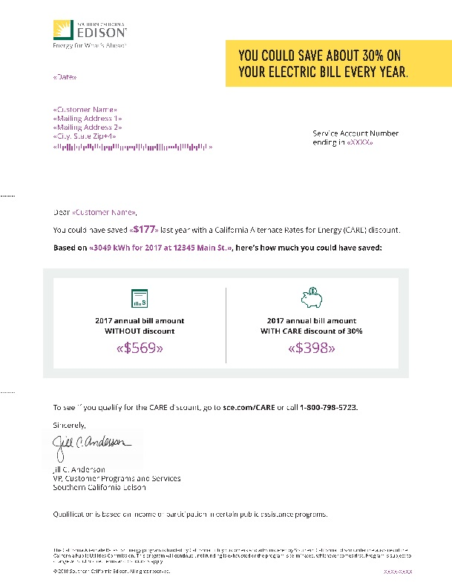
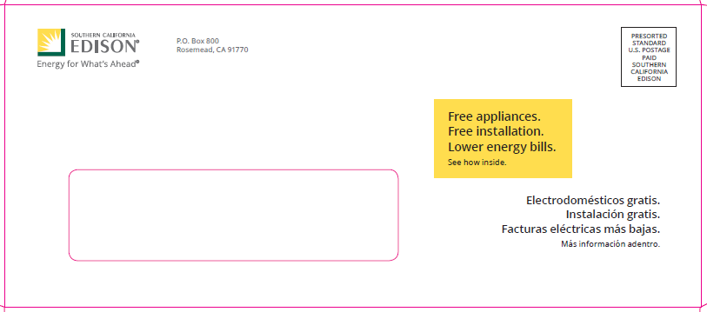
SCE Marketing & Outreach – Targeted Efforts
Direct to Consumer Marketing efforts promoted both CARE and ESA to create a suite of offerings to use less and to pay even less each month

Slide 13
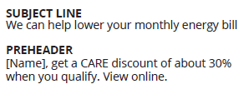
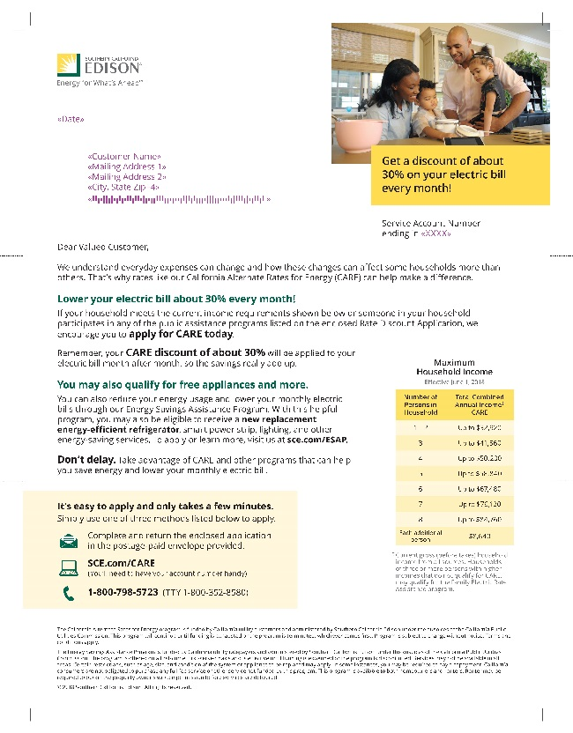
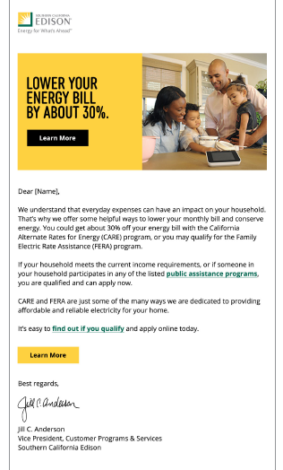
SCE Marketing & Outreach – Bundled Programs
Direct to Consumer Marketing efforts promoted both CARE and ESA to create a suite of offerings to use less and to pay even less each month

Slide 14
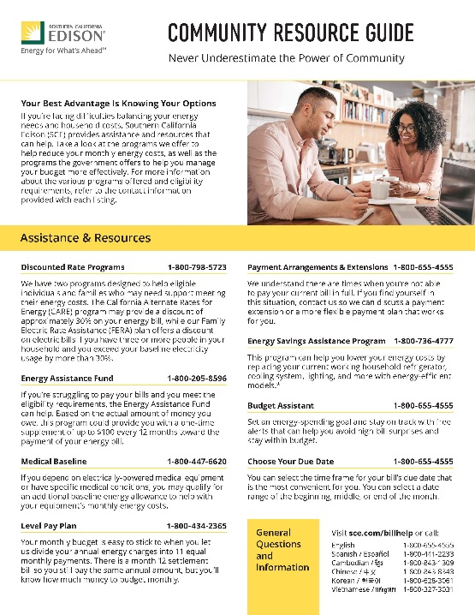
SCE Marketing & Outreach – Collateral Material
Direct to Consumer Marketing efforts developed new collateral material to promote bundled programs, ESA, and bill assistance programs

Slide 15
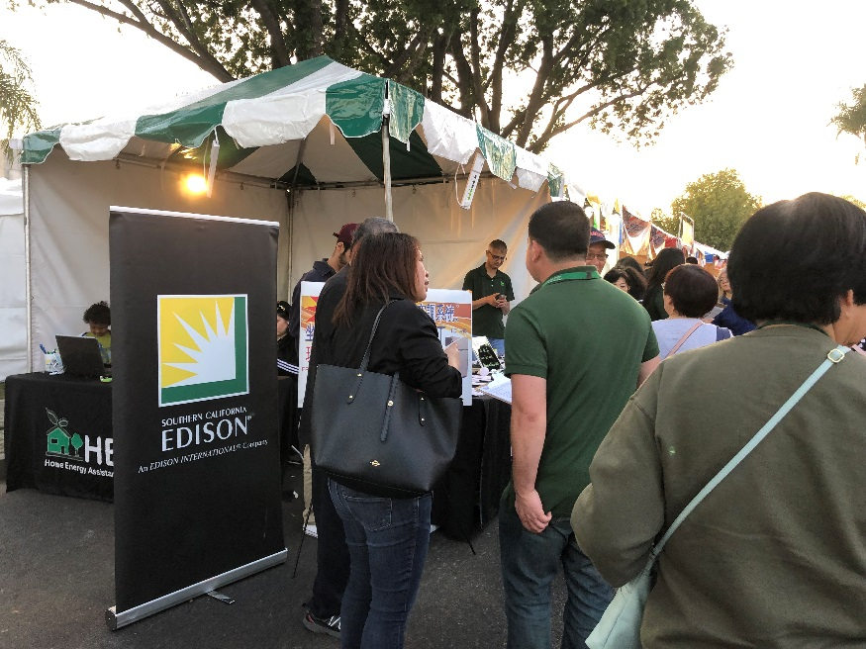
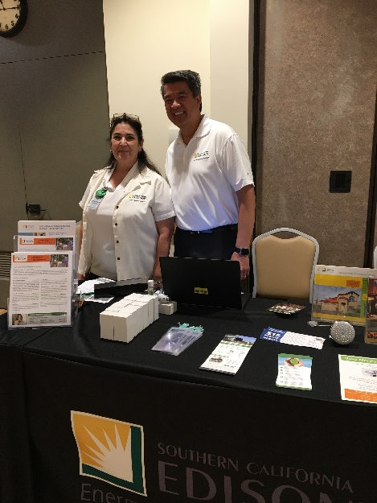
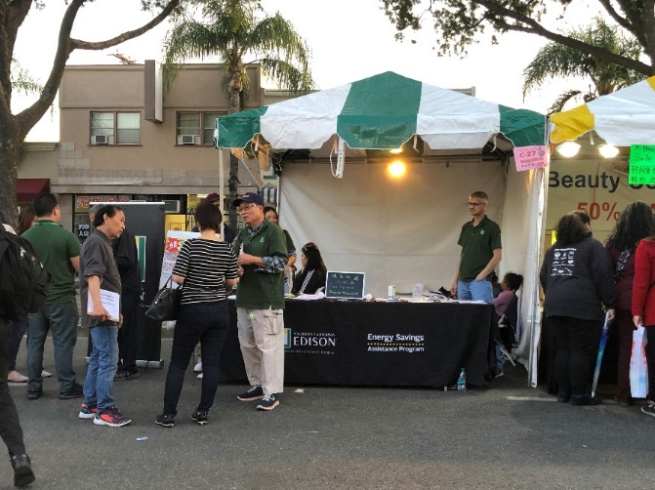
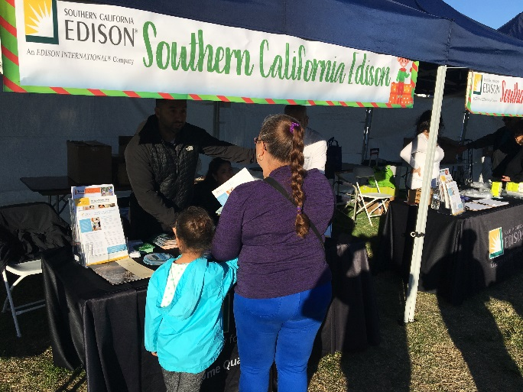
SCE Marketing & Outreach – Community Events

Slide 16
SCE Utility Contacts
CARE Program
Rosie Casillas, Manager - rosie.casillas@sce.com
ESA Program
Holly Merrihew, Manager - holly.merrihew@sce.com
Regulatory
Eric Yamashita, Manager - eric.yamashita@sce.com

