Slide 1
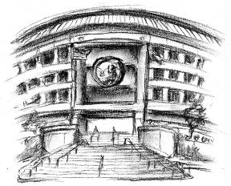
Water Utilities Update
Low-Income Oversight Board
Water Division
September 20, 2018

Slide 2
Topics
School Lead Testing
Commission OIRs
New Legislation

Slide 3
Assembly Bill 746
Mandatory School Lead Testing
Requires all Community Water Systems serving a school built before 2010 to test for lead
Deadline July 1, 2019
Testing window: 1 more school year
Class A’s provide update reports quarterly
Water Division is performing outreach to small water IOUs
By July 1, 2019, all CPUC regulated water utilities will have completed lead testing
Notes:
3

Slide 4
Current Status
(As of August 2018)
921 Schools Tested
16 over limit (0.8%)
- Corrective actions taken
45%
IOUs serve 2,000 Schools
Statewide (as of June 2018)
13,000 schools
3,135 tested (24%)
115 over limit (0.1%)

Slide 5
Affordability OIR
R.18-07-006
Issued on July 23, 2018
Goals
Define affordability
Assess and measure affordability
Energy, Communications, and Water
All Class A & B Water IOUs are parties
Prehearing Conference and Scoping Memo to be determined
Notes:
5

Slide 6
Water Low-Income OIR
R.17-06-024
Phase I
Consolidation
Forecasting
Regulatory changes
Phase II
Standardization & Effectiveness of current Low-Income programs
Program name, monthly discounts, program cost recovery, etc
Jurisdiction over bottled water companies
Amended Scope
Changes to rate design to align with SB 606 & AB 1668
Sharing of data to municipals/public agencies
Notes:
6

Slide 7
Senate Bill 606 & Assembly Bill 1668
Water Management Planning
Senator Robert Hertzberg & Assemblywoman Laura Friedman
Both signed by Governor Brown on May 31, 2018
Require both urban & agricultural water suppliers to set annual water budgets and prepare for drought
Establishes standard for indoor residential water use
55 gallons per capita day until 2025
52 GPCD starting 2025
50 GPCD starting 2030
Making Water Conservation a California Way of Life
Notes:
7

Slide 8
Thank You
Viet (Kevin) Truong
Utilities Engineer
CPUC – Water Division
(415) 703-1353
vt4@cpuc.ca.gov

