Slide 1
2021 – 2026 Low Income Programs Application
Summary of Proposed Changes
LIOB Meeting
December 10, 2019

Slide 2
Summary of PG&E Requests
ESA Program
Budget - $1.1 billion for total program cycle
Multi-family budget portion is $262.6 million
Refresh program design to achieve energy savings, and improve health, comfort and safety for the most needy customers
CARE/FERA Program
Budget - $4.3 billion
Maintain CARE participation at 90 percent of eligible population and increase FERA participation
ESA Key Policy Changes
Flexibility to make more ESA program adjustments (fund shifting and ESA measure modifications) during program cycle via regulatory reports
ESA Working Group should be established to discuss program changes

Slide 3
New ESA Plus Program Structure
 | Single Family/Mobile Home |  |  | Multi-Family
 | BASIC Income self-certification and no property owner approval | COMPREHENSIVE Standard Program | COMPREHENSIVE PLUS Targeted Segments | Multi-Family Whole Building (MFWB) Plus Program
Objective | Easy way to get started with guaranteed services, reduce barrier of unwillingness | Provide offers/services for low – moderate energy users to help reduce use and increase health, safety and comfort | Provide unique offers/services to customer with greatest needs | Deed and Non-Deed restricted buildings - Third Party Administrator; Procurement Review Group and Independent Evaluator
Customer Opportunity | CARE customer - not ESA treated New CARE enrollments annually | CARE customers, not ESA treated New CARE enrollments annually | NEED STATES are: High Usage Electric and Gas, Medical Baseline, Disconnected, DAC/Tribal/Rural, Wildfire Threat | Buildings with 65% of tenants ESA eligible Low Income MF households
Measures | Simple Energy Savings Measures LED Lighting Power Strips Energy Education | Energy Savings & HCS HVAC added Prescriptive Duct Test & Seal Portable A/C, Furnace Repair/Replacement for Renters Domestic Hot Water added Water Heater Repair/Replacement for Renters Miscellaneous added Pool Pumps Enclosure Lighting Refrigerators & Clothes Washer Energy Education | Comprehensive Measures PLUS For High Usage: Diagnostic Driven Air Sealing Floor Insulation Air Purifier Portable A/C Energy Education (Tools) Air Purifier (no Rural) Portable A/C Minor Home Repair Plus Cold Storage | TBD based on Third Party solicitation to include CAM, in-unit measures, SPOC

Slide 4
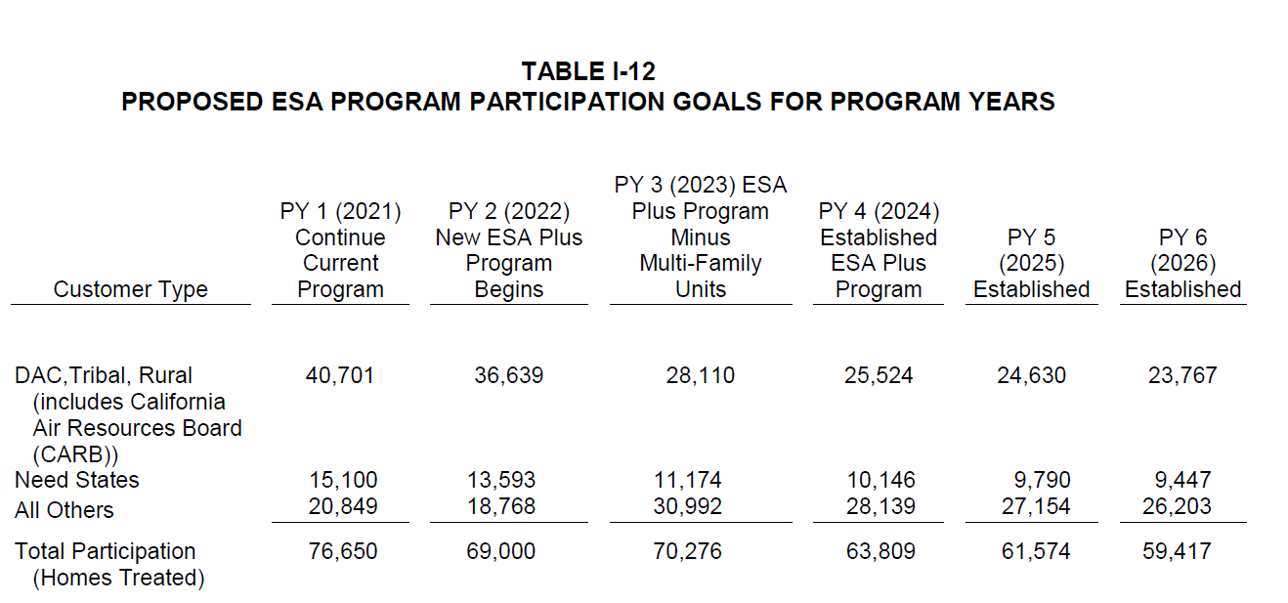
ESA 2021- 2026 Participation Goals – Homes Treated

Slide 5
ESA Cost Effectiveness Test Results
PG&E targets an average ESACET score of .70 for the program cycle at the portfolio level.
Program Year
ESACET Score
2021
2022
2023
2024
2025
2026
.59
.66
.71
.75
.79
.84
Vs.
Estimated average ESACET for program cycle 2017 – 2020: .94
The cost effectiveness score is a compilation of program costs, energy savings, and non-energy benefits.

Slide 6
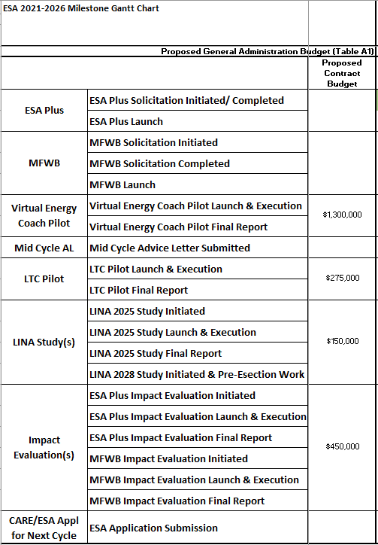
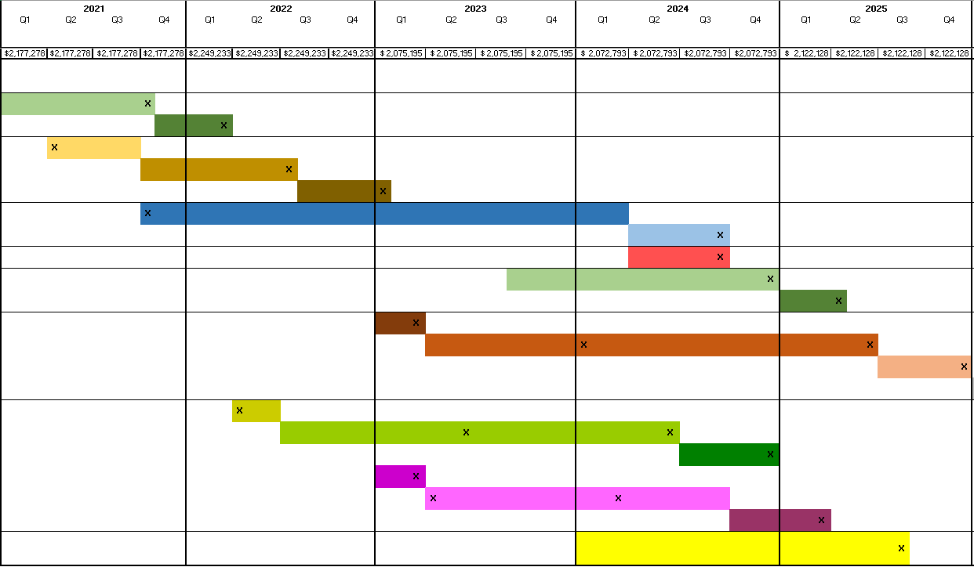
ESA Program Implementation - Milestone Gantt Chart
NOTE: Based on CPUC Decision in January 2021

Slide 7
Low Income Programs – Proposed Pilots
Virtual Energy Coach:
Test concept of “virtual coach” where education and frequent communications will help drive savings with program enrollments and behavioral changes
Leverage the Load Disaggregation project for customer recommendations and outreach
Long Term CARE Customer:
Test effectiveness of different outreach and communications to increase ESA participation among long term CARE customers (defined as 10 or more years continuously on CARE).

Slide 8
CARE/FERA Program 2021 - 2026 Proposed Changes
Change certification period for Non-profit, Ag, Migrant Farm Worker housing facilities from 2 years to 4 years
Change CARE eligibility estimate filing date from December to February
Enhance the CBOs outreach:
Propose increase capitation program payment from “up to $20” to “up to $30” for new CARE enrollment utilizing more holistic education to include ESA and rate options
Propose same payment for new FERA enrollment for agencies participating in the capitation program

Slide 9
Questions?
Contact Information:
Marlene Murphy Roach Lori Leiva Jungbluth
Director, Income Qualified Programs & DACs Principal, Programs Strategy
415.973.2090 415.973.3034
Marlene.murphyroach@pge.com lori.leivajungbluth@pge.com
Mary O’Drain
Expert, Regulatory Policy Analyst
415.973.2317
Mary.odrain@pge.com
Neil Singh
415.973.1541
Manager, Program Delivery
Neil.singh@pge.com

