Slide 1
Joint Utility Public Meeting
Highlights of 2015
CARE, FERA and ESA Program Accomplishments
June 1, 2016
© 2011San Diego Gas & Electric Company. All copyright and trademark rights reserved.

Slide 2
ESA Program Highlights
Homes Treated
 | Goal | Actual | % of Goal
Single Family | 10,397 | 9,902 | 95%
Multi Family | 8,373 | 9,687 | 116%
Mobile Home | 1,546 | 620 | 40%
Total | 20,316 | 20,209 | 99%
Notes:
Source: Annual Report Tables/ESA – Table 2

Slide 3
ESA Program Highlights
Energy Savings Achieved
 | Goal | Actual | %
kWh Saved | 7,886,586 | 3,760,368 | 48%
kW Demand Reduced | 697 | 438 | 63%
Therms Saved | 366,432 | 259,237 | 71%
Notes:
Source: Annual Report Tables/Summary - Table

Slide 4
ESA Program Highlights ESA Program Expenditures
Budget Category | Authorized | Actual
Appliances | $4,932,533 | $2,094,297
Domestic Hot Water | $2,055,518 | $993,059
Enclosure | $4,589,847 | $3,214,719
HVAC | $3,927,857 | $1,724,513
Maintenance | $570,879 | $243,185
Lighting | $2,775,286 | $1,754,965
Miscellaneous | $484,540 | $526,814
Customer Enrollment | $3,385,641 | $3,174,419
In-Home Education | $430,334 | $454,774
Pilots | -- | --
Training | -- | --
Inspections | $99,206 | $90,807
Marketing | $1,164,718 | $1,013,908
M&E Studies | $115,000 | --
*Other Administrative Costs | $2,373,631 | $2,070,138
Total | 26,904,990 | $17,355,596
*Regulatory Compliance, General Administration, Energy Division Costs
Notes:
Source: Annual Report Tables/ESA Table 12
Refer to ESAP Table 12 for carry-over dollars

Slide 5
ESA Program Highlights
ESA Program Enrollments
Disability Enrollments
Type of Enrollment | # Enrolled | % of Total
Standard | 5,849 | 29%
Categorical | 8,092 | 40%
Targeted Self Certification | 6,268 | 31%
Total | 20,209 | 100%
# Disability Enrollments | % Disability Enrollments
2,078 | 10%
Notes:
Annual Report Tables/ESA – Table 13
Disabled count: Berkeley Loveless. Percentage: Annual Report Template #1.5.1 (% also verified with data from B. loveless.)

Slide 6
ESA Program Highlights
Leveraging Efforts (External) –
ESA Program/LIHEAP Leveraging – SDG&E continued work with its two ESA Program/LIHEAP contractors, Campesinos Unidos, Inc. (CUI) & Metropolitan Area Advisory Committee (MAAC) to leverage enrollments.
SDG&E’s primary outreach and assessment contractor, Richard Heath and Associates, entered into a Memorandum of Understanding with the California Department of Community Services and Development (CSD) agencies, Metropolitan Area Advisory Committee (MAAC) and Campesinos Unidos, Inc. (CUI) to enroll eligible Low Income Home Energy Assistance Program’s (LIHEAP) bill assistance customers in the ESA Program. On site presence at MAAC bill assistance workshops yielded 192 new leads and 109 new enrollments for the ESA Program. CUI efforts, meanwhile, resulted in 978 new leads and 673 new enrollments.
Customers whose homes are not eligible for the ESA Program due to inability to meet program requirements are referred to CSD for possible participation in its Weatherization Assistance Program.
Notes:
Bullet 1: 2015 ESA CARE Annual Report, Sec. 1.6.1. (Prior bullet 2 Re: CSD’s solar water heating program – Deleted.)
Bullet 2: 2015 ESA CARE Annual Report, Sec. 1.6.1.
See Section 1.6 for more information on SDG&E’s Leveraging efforts.

Slide 7
ESA Program Highlights
Leveraging Efforts (External) – continued
- SASH Program – SDG&E has worked closely with GRID Alternatives to identify and serve any ESA Program eligible customers with all feasible measures.
In 2015, Grid Alternatives provided SDG&E with 119 referrals, resulting in two ESA Program enrollments.
Integration Efforts (Internal) – ESA Program/CARE Integration
Continued joint efforts to coordinate outreach, awareness, and enrollments/referrals
Joint online interest form made it easier for customers to enroll in both CARE and ESA programs
CARE high users were referred to ESA program for help in lowering their consumption
Joint marketing/advertising
Notes:
SASH Program: 2015 ESA CARE Annual Report, Sec. 1.6.1.
ESA/CARE Integration: (Unchanged)

Slide 8
ESA Program Highlights
Integration Efforts (Internal) - continued
ESA Program/EE Program Integration
Integrated program messaging where feasible
Guide for Energy Experts – Includes information on CARE & ESA Programs
Integrated marketing team
Joint community outreach (CBO’s, other community partners/organizations, branch offices)
Notes:
ESA/EE Integration: (Unchanged)
EUC: (Unchanged)

Slide 9
ESA Program Highlights
ESA Program/EE Program Integration
Energy Upgrade California (EUC)
In 2015, the ESA Program staff worked with the EUC staff to develop an integrated strategy targeted to property managers and owners for the 2015-2017 program cycle. This strategy includes:
Hiring an internal resource to act as the single point of contact for property managers and owners
Implementing a layered program approach for property owners/managers through the single point of contact to reduce confusion
Consolidate and redesign program processes to reduce duplication and complexity
Educate property owners/managers and renters on how to get the most energy savings from the program investment
Notes:
EUC: (Unchanged)

Slide 10
CARE Program Highlights
Penetration Rate
 | Program Target | 2015 Actual
Estimated Eligible | 370,088 | 370,088
Number of Participants | 333,079 | 271,247
Penetration Rate | 90% | 73%
Notes:
Table 2

Slide 11
CARE Program Highlights
Average CARE Monthly Gas/Electric Bill
Residential CARE Customers
Annual Subsidy for all CARE customers by Energy Source
 | Gas | Electric | Total
Monthly | $18.76 | $53.09 | $71.85
Electric | Gas | Total
$66,508,281 | 9,940,667 | $76,448,948
Notes:
Table 9 & Table 1

Slide 12
CARE Program Highlights
CARE High Usage Verification
Launched a manual process in June 2014 targeting the high users (over 400%), automated process was implemented in August 2015
8,202 customers were identify as high usage customers during 2015
Results of the 2015 verification process:
3,328 or 41% dropped due to non-response
2,012 or 25% responded but determined to be ineligible
2,862 or 35% were verified as eligible
Notes:
Table 3

Slide 13
FERA Program Highlights
Estimated Eligible | # Participants | Penetration Rate
47,109 | 5,799 | 12%
Average Monthly Discount per Participant | $22.70
2015 Cumulative Discount | $ 984,738
Total Administrative Costs | $47,023
*San Diego Gas and Electric FERA Program changed to a 12% line item discount effective September 1, 2015.
Notes:
Page 6 and 7 FERA Annual

Slide 14
CARE/FERA & ESA Marketing & Outreach 2015 Highlights
General Awareness
Partner Education & Outreach
TV, print, online advertising
Social media
Bill package
SDG&E app and website
CARE capitation agencies
Energy Solutions Partner Network
Multifamily outreach
Community Engagement
Direct Marketing
Events, presentations & workshops
Multicultural and rural outreach
Seniors and special needs outreach
SDG&E customer contact employees
Electronic/Direct mail
Outbound calls
Door-to-door canvassing

Slide 15
CARE/FERA & ESA Marketing Efforts 2015 Highlights
General Awareness Marketing
Provides a platform for high-level education with broad reach
Helps SDG&E connect with hard-to-reach customers such as rural, seniors, non-English speakers
Testimonial approach features actual SDG&E CARE and ESA customers
Tactics for 2015 consisted of: print, television, online, social media, SDG&E app and web site

Slide 16
CARE/FERA & ESA Marketing Efforts 2015 Highlights
Targeted Marketing
Provides an opportunity to connect with specific customer segments
SDG&E targeted areas with mid-to-high eligibility but historically mid-to-low penetration
Tactics for 2015 consisted of a multi-tactic approach using direct/email, outbound calls and door-to-door canvassing
SDG&E customer bill insert
Leveraging new CARE customers for ESA leads & enrollments

Slide 17
CARE/FERA & ESA Outreach Efforts 2015 Highlights
Door-to-Door Canvassing & Live Call Campaign
Door-to-door efforts target densely populated, multilingual, multifamily and/or senior populations.
Paired door-to-door with live calls in Q4 2015 with goal to increase CARE, FERA and ESA enrollments.
Results included 8,657 new CARE enrollments, 471 FERA enrollments and nearly 1,000 ESA Program leads. Additionally, garnered 4,851 CARE and 111 FERA recertifications.
Increase in new CARE enrollments from 2014 to 2015 with addition of live calls was nearly 20%. ESA remained the same.
CARE Partners (Capitation Agencies)
Leverages social service agencies with charter/mission to enroll eligible constituent in any assistance program.
20 agencies with nearly 50 county-wide locations.
Contributed nearly 4,000 new CARE enrollments in 2015.
Notes:
Owner: Todd Cahill & Brandi Turner

Slide 18
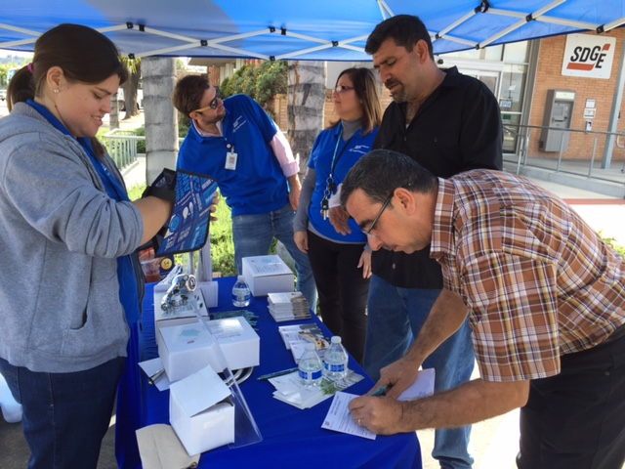
CARE/FERA & ESA Outreach Efforts 2015 Highlights
Branch Offices
Coordinated 18 customer solutions fairs at Branch Office locations on high-traffic days.
Contributed 5,284 new CARE enrollments, 35 new FERA enrollments and over 750 ESA Program leads.
Energy Solutions Partner Network
A network of 250 grassroots, community based organizations (most are nonprofits) that serve as storefronts in their zip codes to provide resources to their communities
In 2015, these partners helped to coordinate more than 1,100 activities.
events * workshops * presentations * enrollment days * social media

Slide 19
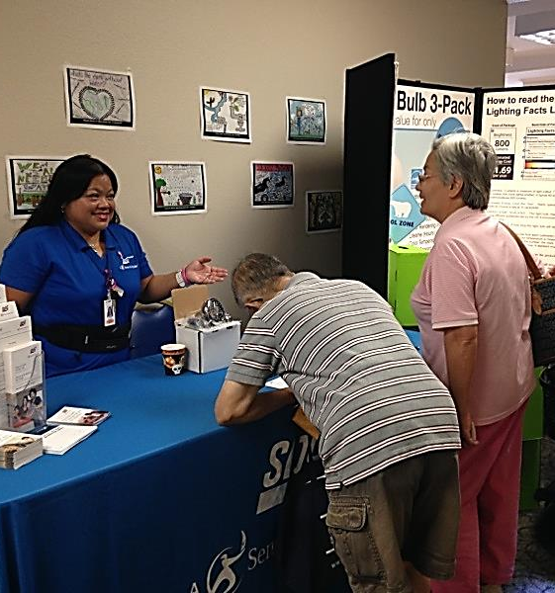
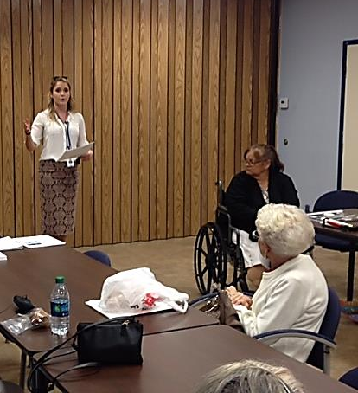
CARE/FERA & ESA Outreach Efforts 2015 Highlights
Multicultural & Rural Outreach
Community partners assist in coordination of activities including events, presentations, workshops, trainings and messaging through a variety of tactics.
Multicultural contractors also help to identify opportunities and staff with multilingual representatives.
Seniors & Special Needs Outreach
Partnered with community-based organizations to educate and enroll in CARE and ESA programs via multi-tactic approach.
Organizations include senior and community centers and nonprofit organizations like AARP, Access to Independence, Braille Institute, Deaf Community Services, Meals-on-Wheels and more.
Internal & Integrated Efforts
Branch Offices (mentioned earlier)
Customer Contact Center – over 15,000 requests for CARE applications and nearly 4,000 new CARE enrollments
Field, Collectors and other customer-facing groups

