Slide 1
Water Utilities Update
Low-Income Oversight Board
Rami Kahlon
Director
Kevin Truong
Utilities Engineer
Water Division
March 6, 2019

Slide 2
Topics
Precipitation/Snowpack
School Lead Testing
Water Division Case Study
OIRs Update
AB 401 Update
2017 Low-Income Data
Multi-Family Housing

Slide 3
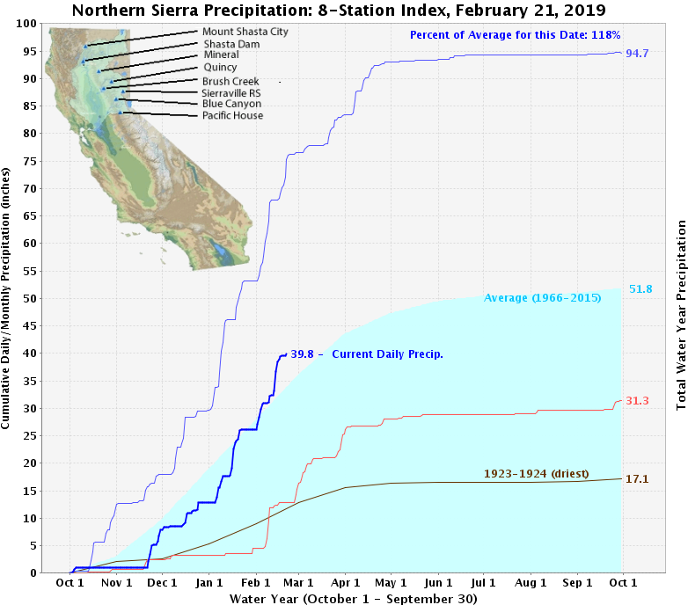
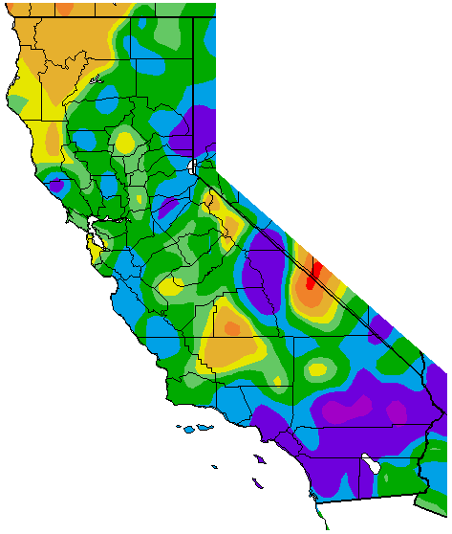
Precipitation
Percent of Average Precipitation
(Oct 1, 2018 – February 20, 2019
2016-2017 (wettest)
2013-2014
Department of Water Resources
Western Regional Climate Center
Notes:
3

Slide 4
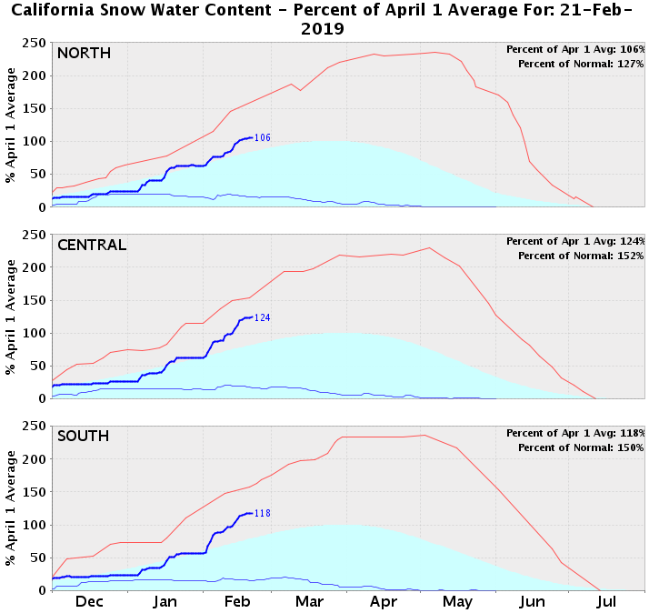
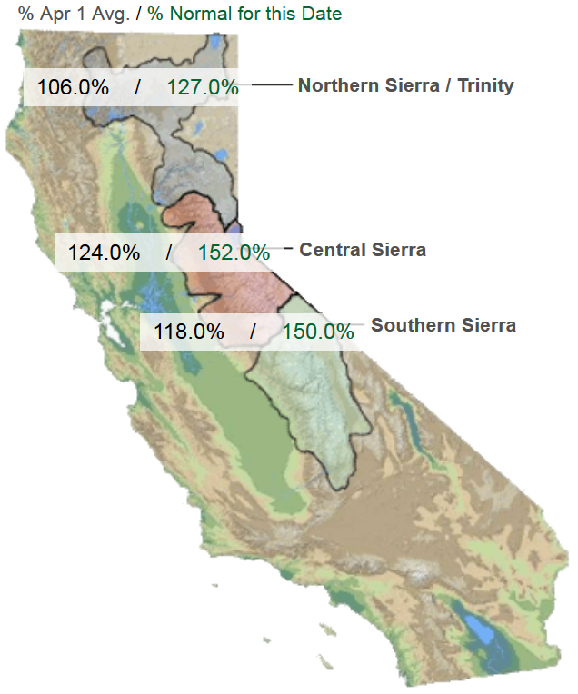
Snowpack
1982-1983 (max)
Average
2014-2015 (min)
1982-1983 (max)
Average
2014-2015 (min)
1982-1983 (max)
Average
2014-2015 (min)
Department of Water Resources
Notes:
4

Slide 5
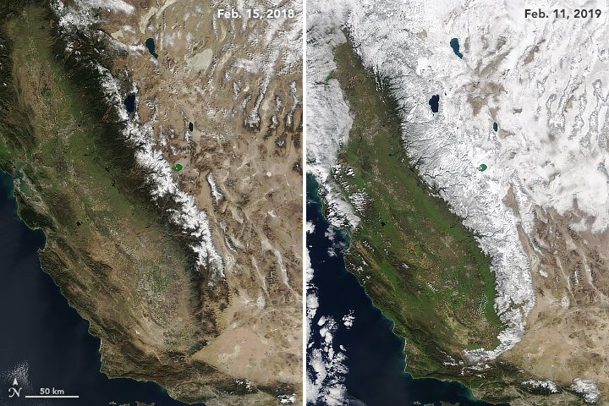
Snowpack
NASA
Notes:
5

Slide 6
School Lead Testing
Assembly Bill 746
All public schools must be tested for lead by July 1, 2019
1,167 Schools Tested
443 exempted
19 over limit (1.0%)
- Corrective actions taken
80%
IOUs serve 2,000 Schools
Statewide (as of Dec 2018)
14,500 schools
8,287 tested/exempted (57%)
213 over limit (1.5%)

Slide 7
Water Division Case Study
Low-Income Discount Programs
Evolution of water low-income programs
Began in 1996: California-American Water Company – Monterey District
Influence from CPUC 2005 and 2010 Water Action Plan
Data exchange with Energy Utilities in 2012 increased enrollment
Impact on a utility
San Gabriel Valley Water Company
50% of residential customer base enrolled in low-income program
Program became unsustainable
Changes made: Discount Surcharge
No difference in water usage between low-income and non low-income
More dependent on geographical location
Only 1 customer complaint in the past 5 years regarding low-income program
And we continue to progress…
Notes:
7

Slide 8
Rulemaking Proceedings
R.17-06-024: Water Low-Income Programs
Phase I
Further encourage consolidation
Since 2007: 37 acquisitions of IOUs
6 acquisitions of Municipals/Mutuals by IOUs
Improve water usage forecasting
Held forecasting workshop on Jan 18, 2019
Discussed methods to adjust for drought periods
Phase II
Standardize and increase effectiveness of current low-income programs
R.18-07-006: Affordability
Define and assess affordability
All utilities in each industry
Held workshop on Jan 22, 2019
Discussed approaches to measure affordability
Notes:
8

Slide 9
AB 401 Update
Statewide Water Low-Income Program
Draft report released on Jan 3, 2019
Less than half of California is served by a utility that offers rate assistance
Less than 20% of low-income household receive assistance
Recommendations
1 statewide program
Eligibility criteria of below 200% Federal Poverty Level
3 Tier discount benefit:
Discount based on fixed consumption of 12 CCF/month for Monthly Bill
Annual cost estimate: $606 Million
Progressive revenue source
Taxes, fees, etc. that would not impact low-income households
Distribution: energy bill vs. tax credit vs. electronic benefit transfer
Tier | Discount | Monthly Bill
1 | 20% | < $90
2 | 35% | $90 - $120
3 | 50% | > $120
Notes:
9

Slide 10
2017 Low-Income Totals
Class A IOUs
Customers enrolled: 233,000
Remained constant the past 3 years
Percentage of Residential: 19%
Annual Discount Total: $26 million
Average Discount per Month: $9.50
How to increase penetration rates?
Notes:
10

Slide 11
Multi-Family Housing
72% of low-income individuals do not directly receive water bill
Majority live in multi-family residential buildings
Master-metered
Senate Bill 7 became effective on Jan 1, 2018
New multi-family buildings must be submetered
Does not apply to buildings built before 2018
Pay water bill indirectly through rent
Alisal Water Corporation (Alco) 2018 Investigation
Class B water utility serving parts of Salinas
Received complaints from owners of multi-family properties
Regarding conservation surcharges after 2014 drought declaration in California
Discoveries
One landlord had submeters and created own water rates for tenants
Charged higher rates than service landlord received from Alco
Violated PU Code 2705.5
Notes:
11

Slide 12
Multi-Family Housing
California-American Water Company Advice Letter 1221
Filed on Jan 18, 2019
Request: Allow multi-family buildings that only house low-income tenants to enroll in Cal-Am’s low-income program
Concern: How to ensure landlords pass on the discounts to low-income tenants?
CPUC not set up to pursue landlords
Uniform/Baseline Rates
Basic water usage built into fixed service charge
Similar to energy utilities
Baseline energy rates are priced lower
Baseline is determined by geographical location
Ease the fluctuation of water bills
Consider conservation legislation SB 606 and AB 1668
Starting 2022, basic water usage set at 55 gallons/person/day
Notes:
12

Slide 13
Thank You
Viet (Kevin) Truong
Utilities Engineer
CPUC – Water Division
(415) 703-1353
vt4@cpuc.ca.gov

