Slide 1



Joint IOU’s Unspent Funds for Energy Savings Assistance Program

Slide 2
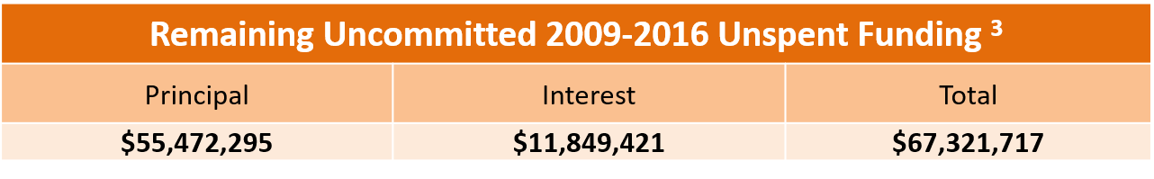
PG&E Remaining Uncommitted 2009-2016 Unspent Funding
Energy Savings Assistance Program (cont’d) Unspent/Uncommitted ESA Funds
Committed 2017-2020 ESA Unspent Funding
Year | Authorized Unspent Funding ¹ | YTD Expenditures ² | Remaining Committed Unspent Funding ⁴
2017 | $2,377,763 | $2,377,763 | $0
2018 | $18,570,835 | $2,477,114 | $16,093,721
2019 | $43,600,229 | $1,102,994 | $42,497,235
2020 | $59,329,898 |  | $59,329,898
Total | $123,878,724 | $5,957,871 | $117,920,853
¹ The amount of 2009-2016 unspent funds authorized for ESA 2017-2020 in Conforming AL Resolution and Mid-Cycle AL Disposition. These funds are shown in ESA Table 1A of PG&E’s Monthly and Annual ESA-CARE Reports.
² 2017-2018 ESA expenses from 2017-2018 ESA-CARE Annual Reports, filed May, 1 2018 and 2019. 2019 is YTD through June 30, from ESA-CARE Monthly Report for June, 2019, filed July 21, 2019. These funds are shown in ESA Table 1A of PG&E’s Monthly and Annual ESA-CARE Reports.
³ PG&E’s remaining uncommitted unspent 2009-2016 funding will be used to offset collections that would otherwise have been required in this program cycle, as directed by D.17-12-009, OP.137, and will be depleted by 2021. This funding is through June 30, 2019, and includes an average annual interest rate of 2.5%.
⁴ Unspent funding at year-end is carried forward to following years in the same cycle.

Slide 3
SCE Remaining 2009-2016 Unauthorized Unspent/Uncommitted Funds
Energy Savings Assistance Program (cont’d) Unspent/Uncommitted ESA Funds

Slide 4
SDG&E Remaining Unspent Uncommitted Funds
Energy Savings Assistance Program (cont’d) Unspent/Uncommitted ESA Funds

Slide 5
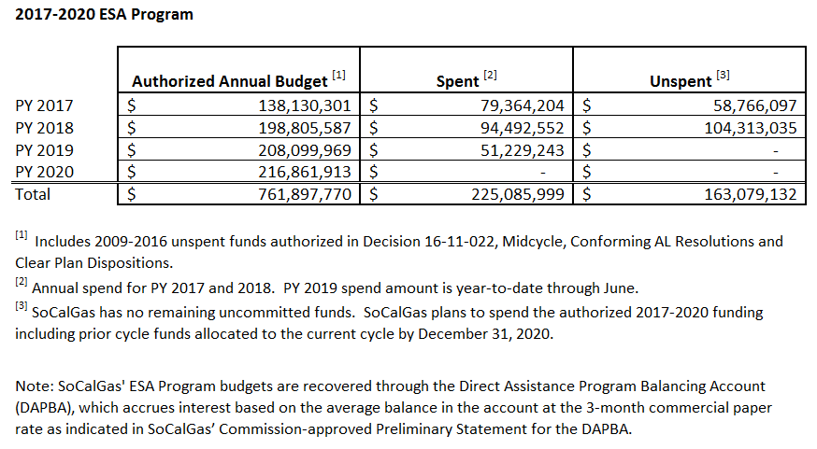
SoCalGas Remaining Unspent Funds
Energy Savings Assistance Program (cont’d) Unspent/Uncommitted ESA Funds

Slide 6
Energy Savings Assistance Program (cont’d)
Top Two Drivers for Unspent Funds
IOU | Drivers
PG&E | Authorized PY2017-18 (Table 1) Unspent Funds were carried forward to 2019: ESA budget under spent due to not meeting homes treated goals in 2017-2018, and over estimation of measures to be installed. We’ve onboarded additional contractors and anticipate addressing the delta in homes treated in 2019 and 2020. 2009-2016 Unspent Funds committed for ESA 2017-2020 through Conforming and Mid-Cycle Advice Letters (Table 1A): 1. Delayed launch of new measures pending 2018 Mid-Cycle Advice Letter Filing Resolution. 2. Delayed start installing measures for MultiFamily Common Area Measure (CAM) as a result of transitioning to a deemed measures program based on options provided by Energy Division; this spend will shift to 2020. Remaining Uncommitted 2009-2016 Unspent Funding: This is being used to offset 2020 collections that would otherwise have been required in this program cycle, per D.17-12-009, OP.137, and will be spent by 2021.
SCE | 1. Original "first touch" eligible population increasingly diminished as we near the end of the program cycle. 2. Inaccurate assumptions on customers Willingness & Feasible to Participate. Customers have been marketed to, but still choose to not enroll despite the program benefits. 3. So far, limited opportunities to leverage with CSD. Current projects have few potential measures that SCE can reimburse CSD for.
SoCalGas | 1. Penetration rates below the original forecast and goals. This is a result of the challenges the program faces in finding and enrolling new, untreated, eligible and willing customers. 2. Lower forecast rates of feasibility for some of the program measures.
SDG&E | 1. Over estimation of measure to be installed. 2. Lower than projected homes were weatherized after receiving the initial treatment.

