Slide 1



IOU CARE-ESA Program Updates
Low Income Oversight Board Meeting
San Francisco, CA
March 8, 2018

Slide 2

Energy Savings Assistance Program
PU Code Section 2790 requires the CPUC to provide energy efficiency services to qualifying low-income households. This program provides energy efficiency services such as weather stripping, insulation, and appliance upgrades to help these Californians better manage their energy bills.
Tribal Activities
IOU | Federally-Recognized Tribes | Recent Activity
PG&E | 51 | Completed initial CARE-ESA penetration assessments of eligible customer households on tribal lands. Continuing work to design comprehensive contact strategies and integrated program offering. Discussions with CSD re potential leveraging outreach and projects.
SCE | 12 | 42% of tribes within SCE service territory have been completed or offered programs services. SCE continues to work on contacting key members from the respective tribes.
SoCalGas | 20 | Sponsored Native American Indian Commission Pow Wow in Los Angeles in December. An information booth was at the event with Customer Assistance information. Meetings are scheduled for first quarter of 2018 with the President of the American Indian Chamber of Commerce of California, SoCal Indian Center and Sherman Indian High School to discuss further involvement and coordination.
SDG&E | 19 | Tribal outreach was conducted at Barona for Men and Woman's Health conference and also three food distributions at Southern California American Indian Resource Center sites.
Total | 103
2017 End-of-Year* Program Updates
ESA Authorized ESA Program 2017 Budgets and EOY Expenditures
 | 2017 Budget | YTD Expenditures | % | Unspent Funding **
PG&E | $152,928,421 | $121,041,750 | 79% | $183,079,952
SCE | $59,601,019 | $59,321,530 | 100% | $59,000,000
SDG&E | $30,649,505 | $17,360,035 | 57% | $23,322,672
SoCalGas | $126,782,639 | $77,493,310 | 61% | $287,043,744
Total | $372,736,182 | $249,670,600 |  | $617,446,368
2017 EOY ESA Households Treated
 | 2017 Goal | First Touch | Go-Backs | Total
PG&E | 90,030 | 48,437 | 34,270 | 82,707
SCE | 54,509 | 64,520 | 15,813 | 80,333
SDG&E | 20,316 | 12,397 | 5,054 | 17,451
SoCalGas | 110,000 | 36,028 | 53,289 | 89,317
Total | 274,855 | 112,945 | 74,156 | 269,808
2017 MULTIFAMILY UPDATES
SPOC: All IOUs have some SPOC facilitation at this time.
Common Areas: IOUs have provided their proposed approaches for MF common area measure implementation to the MFWG for discussion. Implementation plans were filed by Tier 2 AL on March 1, 2018.
2017 EOY ESA Annual Savings
Utility | ESA KWh | ESA KW | ESA Therms
PG&E | 55,763,625 | 64,988 | 1,434,682
SCE | 27,744,507 | 4,353 | N/A
SDG&E | 3,116,887 | 337 | 197,116
SoCalGas | N/A | N/A | 1,387,604
TOTAL | 86,625,019 | 69,678 | 3,019,402
SW PARTICIPATION IN 2017 BY TYPE
2017 ESA PROGRAM UPDATES
Go-Backs: All IOUs are implementing
  See Table
Energy Education: IOUs working together on training and collateral materials
* 2017 End-of-Year Through December 31, 2017, reported in IOU ESA-CARE Monthly Reports (January 22, 2018). Final 2017 results will be reported in IOUs’ 2017 Annual Report (May 1, 2018).
** **Unspent funds' balances do not reflect the reduction in available dollars from the Resolutions adopted re the IOUs' Conforming Advice Letters and Supplemental filings in December 2017, and show 2009-2016 total unspent funds.

Slide 3
CARE Program
PU Code Section 739.1(a) requires the CPUC to establish a program of assistance to low-income electric and gas customers with annual household incomes that are no greater than 200 percent of the federal poverty guideline levels.
2017 End-of-Year* Program Updates
Authorized 2017 CARE Program Budgets and EOY Expenditures
 | 2017 Budget | YTD Expenditures | % | YTD Rate Discounts
PG&E | $18,060,001 | $13,168,911 | 73% | $643,538,184
SCE | $9,981,652 | $6,706,298 | 67% | $375,043,839
SDG&E | $6,911,207 | $5,923,625 | 86% | $114,029,348
SoCalGas | $8,938,505 | $8,530,791 | 95% | $107,960,958
Total | $43,891,365 | $34,329,625 |  | $1,240,572,329
2017 EOY CARE Enrollment and Penetration
 | Customers Enrolled | Estimated Eligible | Penetration Rate
PG&E | 1,406,396 | 1,588,016 | 89%
SCE | 1,222,526 | 1,457,787 | 84%
SDG&E | 282,228 | 329,763 | 86%
SoCalGas | 1,564,126 | 1,819,451 | 86%
2017 EOY CARE New Enrollments
 | Newly Enrolled
PG&E | 250,003
SCE | 291,508
SDG&E | 70,746
SoCalGas | 270,642
* 2017 End-of-Year (EOY) Through December 31, 2017, reported in IOU ESA-CARE Monthly Reports (January 22, 2018). Final 2017 results will be reported in IOUs’ 2017 Annual Report (May 1, 2018).

Slide 4

SoCalGas
ESA Intensified Efforts for Aliso Canyon Emergency
Following the issuance of D.16-04-040 and D.17-12-009, a total of 85,733 homes were treated within the designated area through December, 2017.
  Treated w/o rule suspension: 36,014
  Treated with rule suspension: 49,719
  Therms saved w/o rule suspension: 518,930
  Therms saved with rule suspension: 590,441

Slide 5
Southern California Edison
ESA Intensified Efforts for Aliso Canyon Emergency
Following the issuance of D.16-04-040, a total of 127,436 homes were treated within the designated area through December, 2017.
  Treated w/o rule suspension: 43,363
  Treated with rule suspension: 84,073
  kWh saved: 30,731,577
  kW saved: 4,622

Slide 6
SoCalGas ESA Program
Percent of Homes Treated by County
2012-2017
 |  | Homes Treated
County | ESA Eligible | 2017 | 2016 | 2015 | 2014 | 2013 | 2012 | 2012-2017 Total Treated (YTD)
Fresno | 11,900 | 676 | 201 | 457 | 1,111 | 1,432 | 1,291 | 5,168
Imperial | 19,408 | 971 | 1,171 | 1,524 | 597 | 1,098 | 330 | 5,691
Kern | 42,430 | 3,612 | 1,481 | 1,773 | 3,326 | 4,325 | 3,594 | 18,111
Kings | 15,838 | 482 | 500 | 589 | 1,493 | 1,848 | 1,157 | 6,069
Los Angeles | 1,082,318 | 46,496 | 32,311 | 33,981 | 39,310 | 47,965 | 43,713 | 243,776
Orange | 254,723 | 5,196 | 4,556 | 6,505 | 5,181 | 6,432 | 6,081 | 33,951
Riverside | 253,259 | 15,607 | 7,971 | 13,678 | 12,884 | 13,315 | 11,782 | 75,237
San Bernardino | 185,543 | 10,797 | 4,803 | 7,920 | 9,841 | 12,123 | 11,008 | 56,492
San Luis Obispo | 27,355 | 728 | 856 | 768 | 849 | 1,049 | 639 | 4,889
Santa Barbara | 44,962 | 986 | 720 | 1,172 | 1,219 | 1,277 | 913 | 6,287
Tulare | 58,840 | 2,884 | 1,158 | 2,513 | 4,755 | 5,956 | 5,009 | 22,275
Ventura | 59,870 | 882 | 880 | 2,234 | 2,362 | 1,405 | 812 | 8,575
Total | 2,056,446 | 89,317 | 56,608 | 73,114 | 82,928 | 98,225 | 86,329 | 486,521
Notes:
2017 treated reflects paid invoices through December 31, 2017. Please note that this total does not represent all program activity performed in 2017. The final treated amount will be reported in the 2017 Annual Report filed on May 1, 2018.
ESA only treats a fraction of the estimated eligible customers per year with the cumulative goal of treating all eligible and willing customers by 2020. Percent shown does not include CSD homes treated or the 60% “Willing and Feasible To Participate (WFTP) factor authorized in D.16-11-022 and D.17-12-009.
2012-2016 data is from SoCalGas’ ESA-CARE Monthly Reports for December (ESA Tables 4a (and 4 from 2012)) submitted January 21 of the following year. 2017 data is from SoCalGas’ ESA-CARE Monthly Report for December 2017, submitted January 22, 2018. Note that End-of-Year Reporting from ESA is not final, and final homes treated reported in the Annual Report may be slightly higher.
“ESA Eligible” is the total number of SoCalGas customers that are income-eligible to participate in ESA in 2017 (not the number of customers eligible in each year).
ESA unspent funds are not allocated by county.

Slide 7
PG&E ESA Program
Homes Treated by County: 2013-2017
Notes:
[1] From ESA Annual Reports. 2017 treated data is from the Monthly Report for December 2017 (filed January 21, 2018), Table 4A. EOY Reporting reflects invoices paid through December 31, 2017. Final 2017 homes treated totals will be updated and reported in the Annual Report, filed May 1, 2018.
[2] Athens data from IOU's Annual Estimates of CARE Eligible Customers compliance filing, Feb 9, 2018.
[3] Includes all treated households, including "First Touch" and "Go-Backs/Re-Treated" households that don't count toward the 2020 goal.
Note that ESA only treats a fraction of the estimated eligible customers per year, with the cumulative goal of treating all eligible and willing customers by 2020. Totals shown here do not include CSD homes treated or the 60% “Willing and Feasible To Participate (WFTP) factor authorized in D.16-11-022 and D.17-12-009. They also do not include over 872,000 ESA homes treated from 2002-2012, which would be included in PG&E’s penetration towards the 2020 goal.

Slide 8
SCE ESA Program
Homes Treated by County: 2012-2017
 |  | Homes Treated²
County | SCE’s ESA Eligible¹ | 2012 | 2013 | 2014 | 2015 | 2016 | 2017 | 2012-2017 Total Treated (YTD)
Fresno | 366 | 0 | 0 | 0 | 0 | 0 | 0 | 0
IMPERIAL | 177 | 0 | 0 | 0 | 0 | 2 | 0 | 2
INYO | 1,686 | 11 | 2 | 4 | 5 | 13 | 9 | 44
KERN | 28,939 | 964 | 1127 | 1143 | 1,192 | 1023 | 1347 | 6,796
KINGS | 9,274 | 338 | 390 | 323 | 302 | 352 | 294 | 1,999
LOS ANGELES | 593,507 | 31,482 | 29708 | 32666 | 19,875 | 16757 | 35277 | 165,765
MADERA | 3 | 0 | 0 | 0 | 0 | 0 | 0 | 0
MONO | 2,403 | 1 | 0 | 0 | 2 | 3 | 4 | 10
ORANGE | 219,334 | 6,336 | 6184 | 7755 | 5,597 | 3645 | 8407 | 37,924
RIVERSIDE | 206,027 | 10,904 | 11684 | 12401 | 9,244 | 8579 | 14745 | 67,557
SAN BERNARDINO | 260,968 | 13,799 | 15853 | 17586 | 8,979 | 8054 | 16340 | 80,611
SANDIEGO | 2 | 0 | 0 | 0 | 0 | 0 | 0 | 0
SANTA BARBARA | 21,206 | 64 | 66 | 40 | 18 | 28 | 38 | 254
TULARE | 60,440 | 2,676 | 2219 | 3181 | 2,178 | 1647 | 2665 | 14,566
VENTURA | 64,670 | 2,284 | 1798 | 1654 | 1,177 | 967 | 1207 | 9,087
Total | 1,469,000 | 68,859 | 69,031 | 76,753 | 48,569 | 41,070 | 80,333 | 384,615
Notes:

Slide 9
SDG&E ESA Program
Homes Treated by County: 2013-2017
County | ESA Eligible [2] | 2013 | 2014 | 2015 | 2016 | 2017 | 2013-17 Total
San Diego | 303,325 | 17,509 | 21,905 | 19,362 | 17,833 | 15,970 | 92,579
Orange County | 18,048 | 59 | 134 | 847 | 1,959 | 1,481 | 4,480
Total [1][3] | 321,373 | 17,568 | 22,039 | 20,209 | 19,792 | 17,451 | 97,059
1] 2013-2016 are from ESA Annual Reports. 2017 treated data is from the Monthly Report for December 2017 (filed January 21, 2018), Table 4A. Final 2017 data will be updated and reported in the Annual Report, filed May 1, 2018.
[2] Athens data from IOU's Annual Estimates of CARE Eligible Customers compliance filing, Feb 9, 2018.
[3] Includes all treated households, including "First Touch" and "Go-Backs/Re-Treated" households that do not count toward the 2020 goal.
Note that ESA Program goal is to treat all eligible and willing customers by 2020. Totals shown here do not include CSD homes treated or the 60% “Willing and Feasible To Participate" (WFTP) factor authorized in D.16-11-022 and D.17-12-009.

Slide 10
SDG&E
Low Income Solar Offerings
Multi-Family Affordable Solar Housing (MASH)
  Administered by Center for Sustainable Energy
Single-Family Affordable Solar Housing (SASH)
  Administered by Grid Alternatives
Green Tariff (GT) Program – allows customers to meet some of their energy needs through local renewable generation
Enhanced Community Renewables (ECR) Program – allows customers to contract directly with third-party renewable developer to purchase energy from a local renewable facility
  10 MW of SDG&E’s ECR & GT Capacity is reserved for eligible customers in Environmental Justice Areas (top 20% most impacted and disadvantaged communities in service territory)

Slide 11

SoCalGas
Solar Water Heating Program
Part of the California Solar Initiative (CSI) Thermal program, SoCalGas offers solar water heating rebates of up to $4,366 ($5,397 for low income) to single-family homeowners, up to $800,000 to multi-family and commercial businesses, and up to $500,000 for solar pool heating systems for commercial and multi-family properties.
  SoCalGas processed to date 859 single family low income applications, total of $3.9M in incentives and equating to 100K in annual expected therms saved.
    Approximately 1,000 applications pending for review.
  For SoCalGas Multi Family Low Income customers, processed 380 applications, total of $12.6 M in incentives and equating to over 609K therms of expected energy savings.

Slide 12
Low Income Solar Programs - MASH
Mash Track 1C and 1D data is current as of Feb. 21, 2018.
 |  | Wait List |  | Under Review |  | Reserved |  | Completed |  | Application Totals |  | Total | Percent of Total Budget by Track² | Remaining Budget
 |  | Capacity (MW) | Budget ($) | Capacity (MW) | Budget ($) | Capacity (MW) | Budget ($) | Capacity (MW) | Budget ($) | Capacity (MW) | Budget ($) | Budget¹ ($)
SCE | Track 1C | N/A |  | 2.336 | 2,569,684 | 3.576 | 4,004,504 | 3.011 | 3,312,231 | 8.923 | 9,886,419 | 27,662,165 | 35.7% | 637,798
 | Track 1D |  |  | 3.677 | 6,618,964 | 5.836 | 10,389,883 | 0.072 | 129,101 | 9.585 | 17,137,948 |  | 62.0%
 | Unincentivized |  |  | -0.000 | N/A | 0.294 | N/A | 0.221 | N/A | 0.515 | N/A |  | N/A
 | Total | 2.449 | 4,144,721 | 6.013 | 9,188,648 | 9.706 | 14,394,387 | 3.304 | 3,441,332 | 19.023 | 27,024,367 |  | 97.7%
the spend rate of incentives; (2) current available funds; and (3) where the solar projects are located. (Jorge Rodriguez)
¹ Total Budget amounts for each utility include surpluses remaining from the previous MASH program's administrative and incentive budgets. Per CPUC Decision 15-01-027, which reauthorized the MASH program pursuant to AB 217 (Bradford), these surpluses were rolled over to fund the incentive budgets for the current MASH program. PG&E's budget includes $2,982,034 from its previous administrative budget and $2,946,755 in unallocated incentives. SCE's budget includes $4,300,536 from its previous administrative budget and $260,429 in unallocated incentives. CSE's budget includes $257,014 from its previous administrative budget and $73,575 in unallocated incentives.
² Percentage of Total Budget by Track refers to the sum of incentives in "Under Review", "Reserved" and "Completed" statues divided by the overall budget for each program track. Per CPUC Decision 15-01-027, there is an the overall 80% cap of funding for 1D projects.
300 applications were included for the generation of this chart.
Link: https://www.californiasolarstatistics.ca.gov/reports/mash_budget
*Track C is common area and Track D is individual units.

Slide 13
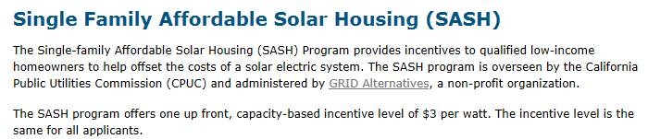
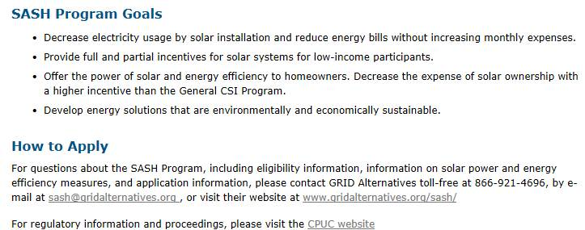
Low Income Solar Programs
SASH & CSI Thermal
CSI Thermal Program:
http://www.gosolarcalifornia.ca.gov/solarwater/index.php
SCE is no longer accepted applications from customers for solar water heating systems that displace electricity or propane.

Slide 14
PG&E
CSI Thermal Program
Intent:
Promote solar thermal systems that directly reduce demand for natural gas in homes and businesses.
Overview:
Created in 2007 with AB 1470; started administering in 2010
Provides incentives to install systems on residential, commercial, industrial, agricultural, government and nonprofit sectors to offset natural gas consumption for Domestic Hot Water (DHW) and other uses
Program Capacity & Accomplishments:
Pursuant to AB 797, 50% of the budget is now dedicated to Low Income or Disadvantaged Communities ($28.6M), and 10% to Industrial applications ($5.7M). $12.6M remains for the General Market.
1469 Projects installed, 1.6 M therms offset (includes Low Income)
625 Low Income projects installed, 0.6 M therms offset
Single Family |  | Multifamily/Commercial
General Market | Low Income | General Market | Low Income | Pools
$29.85 Capped at: $4,366 | $36.90 Capped at: $5,397 | $20.19 Capped at: $800,000 | $24.89 Capped at: $800,000 | $5.00 Capped at: $500,000
Notes:
Inception - Introduced by AB 1470, Kicked off in 2010
Eligibility - Res and CIGNA
Ideal Customer Profile - high hot water usage, high gas bill, green values, available space, high revenue
Intent -Promote solar thermal systems that directly reduce demand for natural gas in homes and businesses.
Goals – With passage of 797, goals were removed from statutory language
Barriers - high upfront investment, high permitting costs, high cost of copper (best material for heat exchange, conduct heat), low gas prices, lack of trained installers, lack of consumer knowledge, and lack of confidence in industry (poor quality installations).
Future - Per AB 797, the program will continue for two years until 2020 utilizing existing budget.

Slide 15
PG&E Single Family Affordable Solar Homes (SASH)
Goals:
The SASH Program provides incentives to qualified low-income homeowners to help offset the costs of a solar electric system
Overview:
SASH was launched in 2007 as part of CSI
Administered by Grid Alternatives
Extended until 2021 or funds are depleted
The SASH program offers one up front, capacity-based incentive level of $3 per watt.
Very low income customers may receive a 1kW fully subsidized (up to $10,000) system
Program Capacity & Accomplishments:
21 MW installed state-wide SASH, 9.54 MW in PG&E territory
3,202 PG&E projects completed
Notes:
SASH started in 2007 as part of CSI. It is the only program administered outside of PGE by Grid Alternatives. It is slated to last until 2021, and if you receive any questions about it, you can refer inquiries to the email address and number on this slide.

Slide 16
PG&E Multifamily Affordable Solar Housing Program (MASH)
Goals:
Stimulate adoption of solar power in the affordable housing sector
Improve energy utilization and overall quality of affordable housing through application of solar and energy efficiency technologies
Decrease electricity use and costs without increasing monthly household expenses for affordable housing building occupants
Increase awareness and appreciation of the benefits of solar among affordable housing occupants and developers
Overview:
Established in 2008 as part of CSI
Program is fully subscribed
  Incentives are fixed, up front (EPBB), capacity-based incentives for qualifying solar energy systems
  The amount of the incentive varies load type (1C – common area load $1.10 or 1D – Tenant load $1.80)
Program Capacity & Accomplishments:
35 MW installed state-wide MASH, 13.5 MW in PG&E territory
217 PG&E projects completed, 132 pending
Notes:
Inception - Introduced by AB 1470, Kicked off in 2010
Eligibility - Res and CIGNA
Ideal Customer Profile - high hot water usage, high gas bill, green values, available space, high revenue
Intent - to increase adoption rates of solar thermal systems to transform the market and reduce natural gas usage and GHG emissions
Goals - 200,000 solar thermal systems on customer homes/buildings by 2017. 180M statewide - 80M allocated to PGE for incentives. $54M in incentives is remaining.
Barriers - high upfront investment, high permitting costs, high cost of copper (best material for heat exchange, conduct heat), low gas prices, lack of trained installers, lack of consumer knowledge, and lack of confidence in industry (poor quality installations).
Future - Program slated to end at the end of this year, but there is pending legislation to extend the program for two years while utilizing existing budget.

Slide 17
MASH Budget Report
1. MASH Budget Report (Track 1C/1D)
 |  | Wait List |  | Under Review |  | Reserved |  | Completed |  | Application Totals |  | Total | Percent of Total Budget by Track² | Remaining Budget
 |  | Capacity | Budget | Capacity | Budget | Capacity | Budget | Capacity | Budget | Capacity | Budget | Budget¹
 |  | (MW) | ($) | (MW) | ($) | (MW) | ($) | (MW) | ($) | (MW) | ($) | ($)
PG&E | Track 1C | N/A |  | 0.424 | 456,601 | 6.51 | 7,157,549 | 2.241 | 2,464,907 | 9.175 | 10,079,057 | 27,874,929 | 36.20% | 3,046,913
 | Track 1D |  |  | 1.077 | 1,953,978 | 6.307 | 11,359,203 | 0.798 | 1,435,778 | 8.182 | 14,748,959 |  | 52.90%
 | Unincentivized |  |  | 0.011 | N/A | 0.667 | N/A | 0.096 | N/A | 0.775 | N/A |  | N/A
 | Total | 0 | 0 | 1.511 | 2,410,579 | 13.485 | 18,516,752 | 3.135 | 3,900,685 | 18.131 | 24,828,016 |  | 89.10%
SCE | Track 1C | N/A |  | 2.336 | 2,569,684 | 3.576 | 4,004,504 | 3.011 | 3,312,231 | 8.923 | 9,886,419 | 27,662,165 | 35.70% | 637,798
 | Track 1D |  |  | 3.677 | 6,618,964 | 5.836 | 10,389,883 | 0.072 | 129,101 | 9.585 | 17,137,948 |  | 62.00%
 | Unincentivized |  |  | 0 | N/A | 0.294 | N/A | 0.221 | N/A | 0.515 | N/A |  | N/A
 | Total | 2.449 | 4,144,721 | 6.013 | 9,188,648 | 9.706 | 14,394,387 | 3.304 | 3,441,332 | 19.023 | 27,024,367 |  | 97.70%
CSE | Track 1C | N/A |  | 0 | 0 | 0.103 | 113,589 | 1.251 | 1,376,049 | 1.354 | 1,489,638 | 5,503,249 | 27.10% | 618,527
 | Track 1D |  |  | 0 | 0 | 0.361 | 650,647 | 1.525 | 2,744,437 | 1.886 | 3,395,084 |  | 61.70%
 | Unincentivized |  |  | 0 | N/A | 0.304 | N/A | 0.005 | N/A | 0.309 | N/A |  | N/A
 | Total | 0.993 | 0 | 0 | 0 | 0.769 | 764,236 | 2.78 | 4,120,486 | 3.549 | 4,884,722 |  | 88.80%
TOTAL | Track 1C | N/A |  | 2.76 | 3,026,285 | 10.19 | 11,275,642 | 6.503 | 7,153,187 | 19.453 | 21,455,114 | 61,040,343 | 35.10% | 4,303,238
 | Track 1D |  |  | 4.754 | 8,572,942 | 12.505 | 22,399,733 | 2.394 | 4,309,316 | 19.653 | 35,281,991 |  | 57.80%
 | Unincentivized |  |  | 0.011 | N/A | 1.265 | N/A | 0.322 | N/A | 1.598 | N/A |  | N/A
 | Total | 3.442 | 4,144,721 | 7.525 | 11,599,227 | 23.96 | 33,675,375 | 9.219 | 11,462,503 | 40.704 | 56,737,105 |  | 93.00%
¹ Total Budget amounts for each utility include surpluses remaining from the previous MASH program's administrative and incentive budgets. Per CPUC Decision 15-01-027, which reauthorized the MASH program pursuant to AB 217 (Bradford), these surpluses were rolled over to fund the incentive budgets for the current MASH program. PG&E's budget includes $2,982,034 from its previous administrative budget and $2,946,755 in unallocated incentives. SCE's budget includes $4,300,536 from its previous administrative budget and $260,429 in unallocated incentives. CSE's budget includes $257,014 from its previous administrative budget and $73,575 in unallocated incentives.
² Percentage of Total Budget by Track refers to the sum of incentives in "Under Review", "Reserved" and "Completed" statues divided by the overall budget for each program track. Per CPUC Decision 15-01-027, there is an the overall 80% cap of funding for 1D projects.
300 applications were included for the generation of this chart.
MASH Budget Report
The MASH Budget Table 1 summarizes the committed and remaining budget for the new MASH program authorized by AB 217. Track 1C provides incentives for projects that provide <50% direct tenant benefits. Track 1D provides incentives for projects that provide >50% direct tenant benefits.
Mash Track 1C and 1D data is current as of Feb. 21, 2018.
https://www.californiasolarstatistics.ca.gov/reports/mash_budget/

Slide 18
MASH Budget Report
2. MASH Budget Report (Track 1A/1B/2)
 |  | Wait List |  | Under Review |  | Reserved |  | Completed |  | Application Totals |  | Total | Remaining
 |  | Capacity | Budget | Capacity | Budget | Capacity | Budget | Capacity | Budget | Capacity | Budget | Budget | Budget
 |  | (MW) | ($) | (MW) | ($) | (MW) | ($) | (MW) | ($) | (MW) | ($) | ($) | ($)
PG&E | Track 1A | N/A | N/A | N/A | N/A | 0.024 | 43,677 | 5.027 | 13,558,547 | 5.05 | 13,602,224 | 39,122,262 | 5,830,797
 | Track 1B | N/A | N/A | N/A | N/A | 0.953 | 2,582,109 | 4.868 | 17,107,132 | 5.821 | 19,689,241
 | Track 2 | N/A | N/A | N/A | N/A | N/A | N/A | 0.482 | 2,540,968 | 0.482 | 2,540,968 | 2,540,968 | 0
 | Total | N/A | N/A | N/A | N/A | 0.977 | 2,625,786 | 10.377 | 33,206,647 | 11.354 | 35,832,433 | 41,663,230 | 5,830,797
SCE | Track 1A | N/A | N/A | N/A | N/A | N/A | N/A | 4.823 | 13,615,283 | 4.823 | 13,615,283 | 39,238,650 | 605,081
 | Track 1B | N/A | N/A | N/A | N/A | N/A | N/A | 7.712 | 25,018,286 | 7.712 | 25,018,286
 | Track 2 | N/A | N/A | N/A | N/A | N/A | N/A | 0.657 | 4,617,382 | 0.657 | 4,617,382 | 4,617,382 | 0
 | Total | N/A | N/A | N/A | N/A | N/A | N/A | 13.192 | 43,250,951 | 13.192 | 43,250,951 | 43,856,032 | 605,081
CSE | Track 1A | N/A | N/A | N/A | N/A | N/A | N/A | 0.422 | 1,273,848 | 0.422 | 1,273,848 | 9,000,974 | 73,627
 | Track 1B | N/A | N/A | N/A | N/A | N/A | N/A | 2.025 | 7,653,499 | 2.025 | 7,653,499
 | Track 2 | N/A | N/A | N/A | N/A | N/A | N/A | 0.104 | 818,964 | 0.104 | 818,964 | 818,964 | 0
 | Total | N/A | N/A | N/A | N/A | N/A | N/A | 2.551 | 9,746,311 | 2.551 | 9,746,311 | 9,819,938 | 73,627
TOTAL | Track 1A | N/A | N/A | N/A | N/A | 0.024 | 43,677 | 10.272 | 28,447,678 | 10.296 | 28,491,355 | 87,361,886 | 6,509,505
 | Track 1B | N/A | N/A | N/A | N/A | 0.953 | 2,582,109 | 14.604 | 49,778,917 | 15.558 | 52,361,026
 | Track 2 | N/A | N/A | N/A | N/A | N/A | N/A | 1.244 | 7,977,314 | 1.244 | 7,977,314 | 7,977,314 | 0
 | Total | N/A | N/A | N/A | N/A | 0.977 | 2,625,786 | 26.12 | 86,203,909 | 27.097 | 88,829,695 | 95,339,200 | 6,509,505
300 applications were included for the generation of this chart.
MASH Budget Report
The MASH Budget Table 2 summarizes the committed and remaining budget for the original Multifamily Affordable Solar Housing (MASH) program. Tracks 1A and 1B provide incentives for solar PV systems that offset common area load and tenant loads, respectively. Track 2 provides incentives for projects that provide quantifiable "direct tenant benefits".
Mash Track 1A and 1B data is current as of Feb. 21, 2018.
Mash Track 2 data is current as of May 21, 2013.
https://www.californiasolarstatistics.ca.gov/reports/mash_budget/

Slide 19
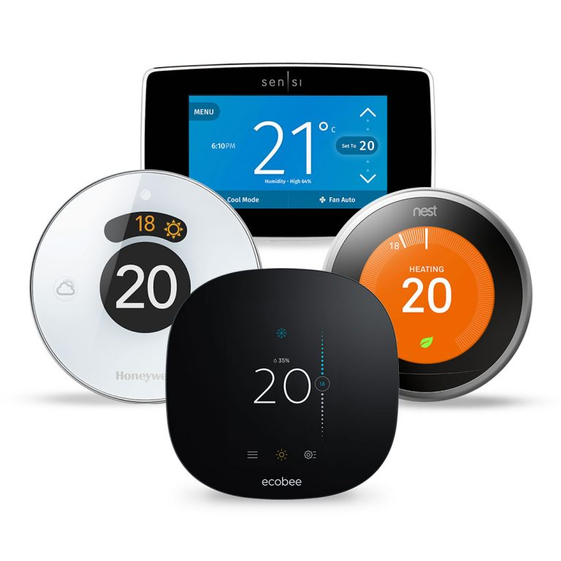
Smart Thermostats and Energy Management Technology & Education for Low-Income Customers

Slide 20
Assembly Bill 793
Enacted October 2015, this bill requires IOUs to:
  Provide incentives to residential or small/medium business customers to purchase energy management technology for use in the customer’s home or place of business.
  Develop a plan to educate residential customers and small and medium business customers about the incentive program
IOU programs and marketing plans were approved in CPUC Resolution E-4820 in April 2017
The bill also modifies the definition of “weatherization services for low-income customers” to include energy management technologies
  “Energy management technology” may include a product, service, or software that allows a customer to better understand and manage electricity or gas use in the customer’s home
Notes:
The IOUs shall include in their AB 793 Marketing Compliance Filing ALs specific strategies on how they plan to market EMTs to the communities with the highest disconnection rates in their service territories or in disadvantaged communities. The marketing efforts in these areas shall utilize greater resources and a more targeted effort than general marketing efforts
Weatherization modification should take into consideration both the cost-effectiveness of the measures as a whole and the policy of reducing energy-related hardships facing low-income households

Slide 21
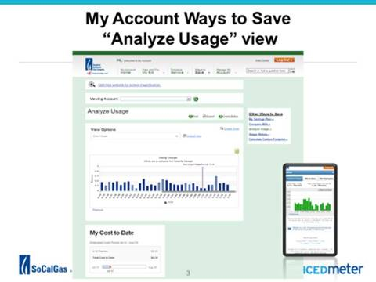
SoCal Smart Thermostats and Energy Management Technology Update
SoCalGas
SoCalGas promotes low-cost and no-cost EMTs:
  Customers with online MyAccount access can navigate to “Ways to Save” online tools
  Promotes Bill Tracker Alerts through outreach with Community Based Organizations (CBOs)
  Conducts targeted outreach in DACs to promote MyAccount online access
Offers joint Smart Thermostat program in conjunction with SCE
Promotes Stand Alone $50 SoCalGas-Only Rebate for Smart Thermostats for both single-family and multi-family customers
Launched an EMT marketplace at marketplace.socalgas.com
To avoid disconnection, CSRs provide MyAccount and Bill Tracker Alert information during informal billing inquiries for resolution
Requested to pilot Smart Thermostats in ESA Weatherization in AL 5256
Notes:
SoCalGas promotes low-cost and no-cost Energy Management Technologies, such as those available online and with mobile devices
Customers that have online My Account access can navigate to “Ways to Save” online tools. Please see example here
Los Angeles Opportunities Industrialization Centers is an organization that helps customers get online and how to navigate through our website, get more information on customer assistance program as well as show them how they can enroll in MyAccount
On October 3rd, SoCalGas held a Roundtable meeting in Visalia with CBOs in the SJV area to inform them about our programs and how they can partner with us to bring awareness to their constituency base
Combining the $125 SCE/SoCalGas rebate with our new gas Demand Response rebate ($75) can make a new low-cost Nest thermostat free ($169)

Slide 22

SCE
Launched SCE Marketplace (www.marketplace.sce.com) featuring EMT products, services, and information
Continue to feature EMT products, services, and information on the SCE Energy Management Center landing page (www.sce.com/EMC)
Promote EMTs through an integrated marketing campaign featuring digital banner ads, social media, and email communication, heavily targeted DAC and LI communities.
Promote DR program using smart thermostats in conjunction with SoCal Gas
  Technology partners include Nest, Energy Hub, Ecofactor, Honeywell, Zen Energy (alarm.com, ecobee, Lux, Radio Thermostat, Sensi)
  Deploy training teams to visit retailers including Best Buy, The Home Depot, Lowe’s in support of EMT home automation products, and target retailers in DAC and LI communities
Prominently feature and promote smart thermostat rebates on www.sce.com/rebates
Deliver bill onserts (over 4 million customers) featuring EMT products i.e. smart thermostats

Slide 23
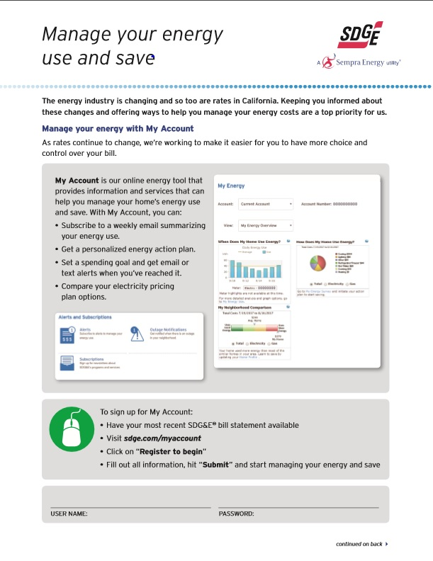
SDG&E
SDG&E promotes low cost/no cost EMTs, including Home Energy Check-Ups and Bill Forecast/Usage Alerts
Approximately 40,000 monthly CARE email promotions include a secondary message promoting My Account
ESA Energy Education module (post education through ESA contractors to customers being treated) includes enrollment in My Account and reviewing energy usage with customers
SDG&E provides $50 rebate on smart thermostat purchases
SDG&E is working to update and expand its online Marketplace (www.marketplace.sdge.com) to accommodate more EMT offerings
Notes:
A promotional insert has been developed to include in the Energy Education booklet that describes in detail the energy management tools behind My Account and how to enroll and sign up for alerts. Information on the availability of rebates for some SMART home appliances and devices is also included

Slide 24
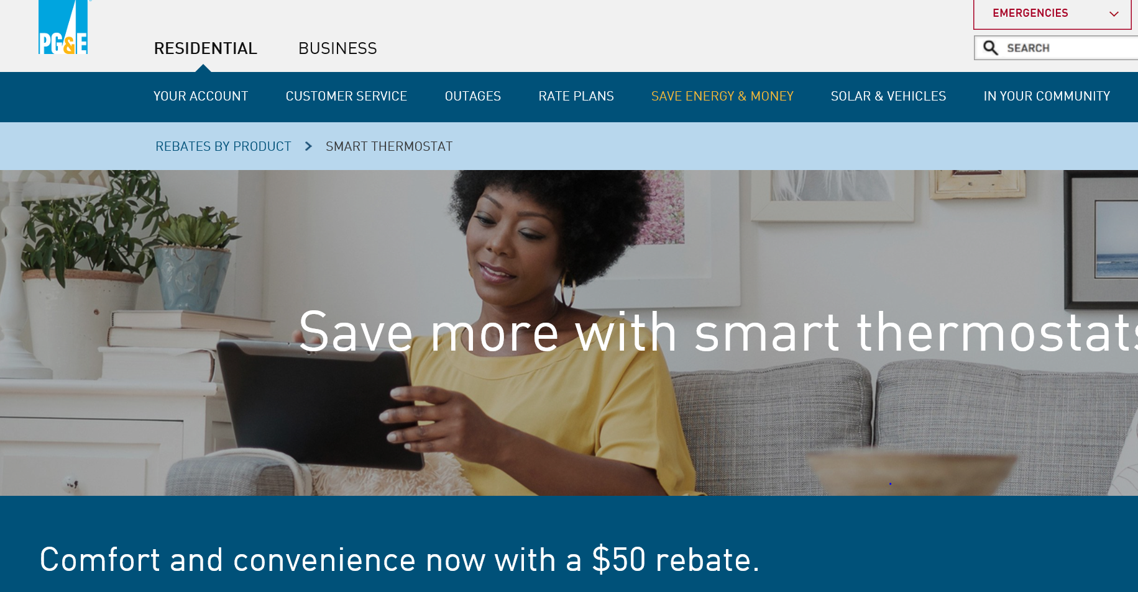
PG&E
ESA Enhanced Energy Education (provided by ESA contractors to customers being treated) includes enrollment and education in YourAccount and YourAlerts.
PG&E proposed an ESA Smart Thermostat Time of Use Pilot on March 1, 2018, targeted at low income customers with air conditioners in the Central Valley
PG&E promotes low-cost/no-cost EMTs--such as Energy Alerts, High Bill Alerts, and a Home Energy Checkup--to all residential customers
PG&E offers a remote energy analysis for each customer using Share My Data and provides customized recommendations to reduce energy usage.
EMT products are now listed online on the Marketplace (marketplace.pge.com), Connected Home and Smart Thermostats.
A $50 EE rebate is offered for the purchase of Smart Thermostats
Working in conjunction with SDG&E on integration of Share My Data vendors onto the Marketplace.

