Slide 1
CHANGES Program Report to the Low Income Oversight Board
Consumer Help and Awareness of Natural Gas and Electricity Services (CHANGES)
Self-Help for the Elderly
Milestone Consulting LLC
December 10 , 2019

Slide 2
CHANGES Services Provided Quarter 1 June 17 – September 30, 2019
Outreach – Over 260,000 potentially reached
Consumers Educated: 12,649
Needs Assistance cases: 1,060
Dispute Resolution cases: 491

Slide 3
Dispute Resolution cases Quarter 1 June 17 – September 30, 2019

Slide 4
Needs Assistance cases Quarter 1 June 17 – September 30, 2019

Slide 5
Outreach Activities
In the 2018-19 program year, outreach efforts potentially reached over 3.5 million consumers.
CBOs utilize their outreach budget by identifying the best outreach activity to reach the communities they serve.
Typically, outreach efforts incorporate both TEAM and CHANGES programs into their content.

Slide 6
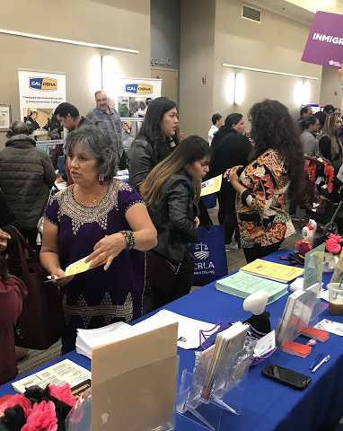
Community Events
Outreach is conducted at local ethnic festivals and holiday events, and health and resource fairs.
Events must reach a minimum of 500 people.

Slide 7
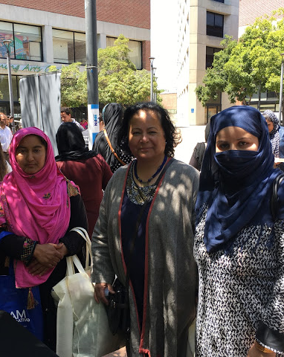
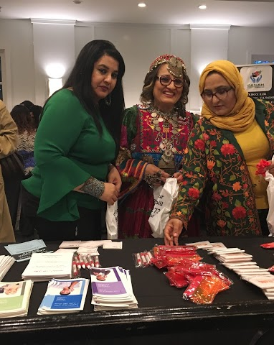
In the 2018-19 program year, outreach at community event touched 695,772 people at 143 events.

Slide 8
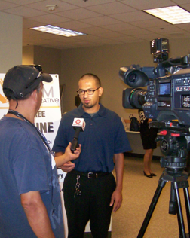
Media Outreach
CBOs provide program information through ethnic television, radio and print media.
In the 2018 – 2019 program year, 2,643,700 consumers were potentially reached through media outreach.

Slide 9
Community Presentations
Presentations at coalition, collaborative and task force meetings
Designed to reach consumers at non-TEAM & CHANGES CBOs
Referral process described
Must reach minimum of 5 organizations
Social Media
Postings on Facebook, Twitter and Instagram
Must be in-language
Minimum 5 postings required for payment
Least utilized outreach component by CBOs/Least likely to reach targeted populations

Slide 10
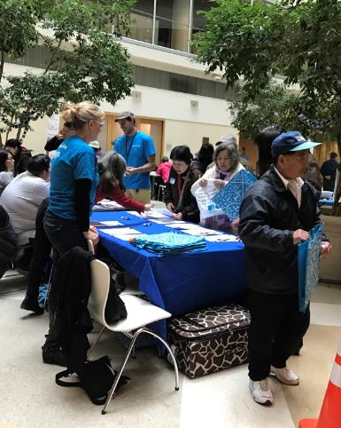
Bill Fairs
Organized jointly by CBOs in a geographic region
Typically include consumer education workshops and bill review
Time consuming versus level of response

Slide 11
Special Outreach Projects
CBOs may propose special projects specific to the needs of their communities.
Projects are intended to reach highly targeted audiences.
Limited funding allows CBOs to implement creative projects they otherwise would not have resources to conduct.
CBOs must submit brief proposals for approval prior to implementation.

Slide 12
Examples of Special Outreach Projects
Afghan women, unable to leave the home unattended, received home visits from female CBO staff to receive consumer education and bill review services.
Migrant farmworker families received children’s books accompanied by consumer education and food boxes. Literacy programs were modified to include consumer education.
A consumer information holiday celebration was presented to the Vietnamese community. Activities included live music, fashion show, special holiday lunch, prize raffles and consumer education presentations. The CBO expected 150 attendees but ended up hosting 255 consumers.

Slide 13
Referral Source May 1, 2018 – April 30, 2019

Slide 14
Program Contacts
Anni Chung
President & CEO
Self-Help for the Elderly
annic@selfhelpelderly.org
(415) 677-7600
Casey McFall
Chief Executive Officer
Milestone Consulting LLC
casey@milestoneconsulting.org
(310) 920-0648
Ravinder Mangat
CPUC, News & Outreach Office
ravinder.mangat@cpuc.ca.gov
(415) 355-5556

