Slide 1



Joint IOU’s Unspent Funds for Energy Savings Assistance Program
Low Income Oversight Board Meeting
Webex
June 12, 2020

Slide 2
PG&E Remaining Uncommitted 2009-2016 Unspent Funding
Energy Savings Assistance Program Unspent/Uncommitted ESA Funds
Committed 2017-2020 ESA Unspent Funding
Year | Authorized Unspent Funding ¹ | YTD Expenditures ² | Remaining Committed Unspent Funding ⁴
2017 | $2,377,763 | $2,377,763 | $0
2018 | $18,570,835 | $2,477,114 | $16,093,721
2019 | $43,600,229 | $10,126,094 | $33,474,135
2020 | $59,329,898 | $2,088,154 | $57,241,744
Total | $123,878,724 | $17,069,125 | $106,809,598
Committed 2009-2016 Unspent Funding to Offset Revenue Collection³
Principal | Interest | Total
$48,344,225 | $14,037,159 | $62,381,384
¹ The amount of 2009-2016 unspent funds authorized for ESA 2017-2020 in Conforming AL Resolution and Mid-Cycle AL Disposition. These funds are shown in ESA Table 1A of PG&E’s Monthly and Annual ESA-CARE Reports.
² 2017-2019 ESA expenses from 2017-2019 ESA-CARE Annual Reports, filed May, 1 2018, 2019 and 2020. 2020 is YTD through April 30, from ESA-CARE Monthly Report for April 2020, filed May 21, 2020. These funds are shown in ESA Table 1A of PG&E’s Monthly and Annual ESA-CARE Reports.
³ PG&E does not have uncommitted unspent fund. As directed by D.17-12-009, OP.137 and approved in Mid-Cycle Advice Letter 3990-G/5329-E, supplemental Advice Letter 3990-G-A/5329-E-A and 3990-G-B/5329-E-B, all current 2009-2016 accumulated ESA carry-over funds that haven't already been authorized for program activities shall be utilized to offset collections that would have otherwise required in this program cycle. This balance is through April 30, 2020, and includes an average annual interest rate of 1.57%.
⁴ Unspent funding at year-end is carried forward to following years in the same cycle.

Slide 3
Energy Savings Assistance Program Unspent/Uncommitted ESA Funds
SCE Remaining 2009-2016 Unauthorized Unspent/Uncommitted Funds

Slide 4
SDG&E Remaining Unspent Uncommitted Funds
Energy Savings Assistance Program (cont’d) Unspent/Uncommitted ESA Funds
 | Total ESA (Table 1 + 1A)
 | Authorized Budget [1] | Spent | Remaining
PY 2017 [2] [3] | $34,313,691 | $17,996,715 | $16,316,976
PY 2018 [2] [3] | $33,744,223 | $22,896,182 | $10,848,041
PY 2019 [4] | $34,652,791 | $19,084,426 | $15,568,365
PY 2020 | $35,509,153 | TBD | TBD
 | Total ESA (Table 1 + 1A)
 | Revenues Collected in Rates | Interest Earned | Program Year Expenditures | Current Year Unspent, Uncommitted, Collected
PY 2009-16 [5] |  |  |  | $10,362,880
PY 2017 [6] | $22,351,356 | $256,588 | $17,485,110 | $5,122,834
PY 2018 [6] | $31,323,325 | $655,589 | $23,347,010 | $8,631,904
PY 2019 [6] | $11,637,433 | $768,324 | $18,198,522 | ($5,792,765)
PY 2020 Amortization [7] |  |  |  | ($4,000,000)
Remaining Unspent Uncommitted Funds |  |  |  | $14,324,853
[1] Commission disposition letter authorized funding in SDG&E Advice Letter 3250-E2688-G.
[2] Unspent-Uncommitted funds from 2017 and 2018 were used to offset the 2019 ESA revenue requirements for electric ($10M) and gas ($10M) customers, as directed by the CPUC (SDG&E Advice Letters 3280-E and 2713-G).
[3] Expenses as reflected on Annual Reports (includes manual adjustments).
[4] Updated to reflect expenses as reported in the 2019 Low Income Annual Report filed on May 1, 2020.
[5] SDG&E's unspent/over collected funds at the end of 2016 totaled $23,322,672. Resolution E-4884 authorized $12,959,793 to be used in the 2017-2020 budget cycle. Unspent carryover funds from PY2017 and PY2018 were redistribution to PY2019 as authorized in SDG&E Advice Letter 3250-#/2688-G.
[6] Expenses as reflected in balancing accounts (does not include manual adjustments).
[7] Unspent-Uncommitted funds from 2019 were used to offset the 2020 ESA revenue requirements for electric ($2M) and gas ($2M) customers, as directed by the CPUC (SDG&E Advice Letters 3440-E and 2815-G).

Slide 5
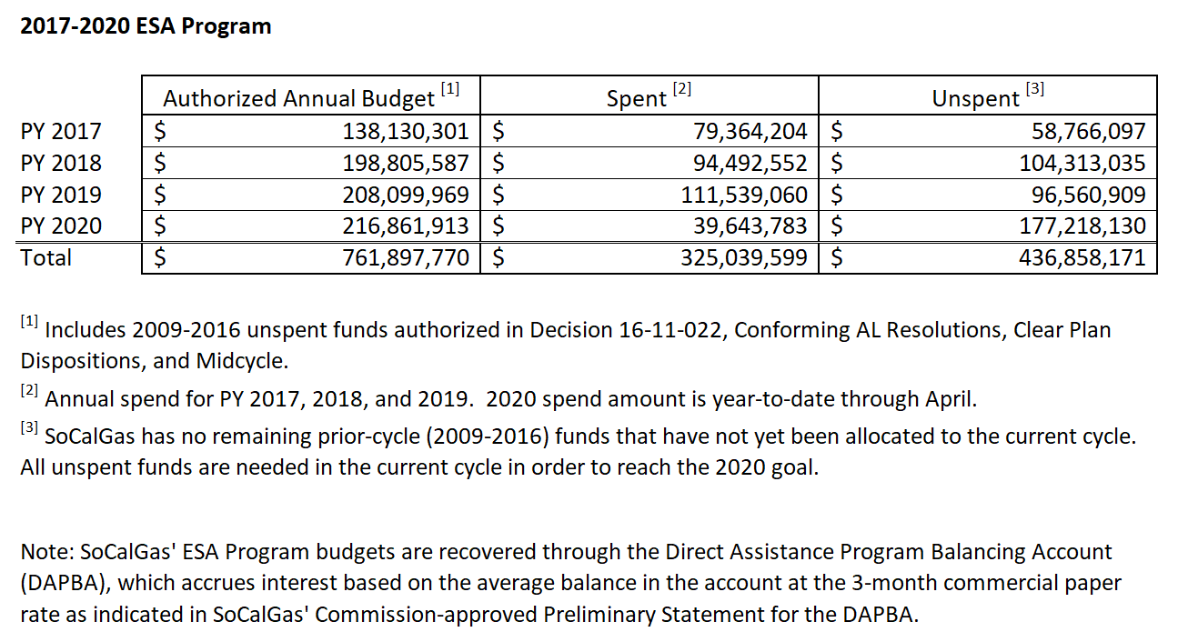
SoCalGas Remaining Unspent Funds
Energy Savings Assistance Program Unspent/Uncommitted ESA Funds

Slide 6
Energy Savings Assistance Program Unspent/Uncommitted ESA Funds
Top Two Drivers for Unspent Funds
IOU | Drivers
PG&E | Authorized PY2017-18 (Table 1) Unspent Funds were carried forward to 2019: ESA budget under spent due to not meeting homes treated goals in 2017-2018, and over estimation of measures to be installed. We’ve onboarded additional contractors and anticipate addressing the delta in homes treated in 2019 and 2020. 2009-2016 Unspent Funds committed for ESA 2017-2020 through Conforming and Mid-Cycle Advice Letters (Table 1A): 1. Delayed launch of new measures pending 2018 Mid-Cycle Advice Letter Filing Resolution. 2. Delayed start installing measures for Multi-Family Common Area Measure (CAM) as a result of transitioning to a deemed measures program based on options provided by Energy Division; this spend will shift to 2020. Remaining Uncommitted 2009-2016 Unspent Funding: This is being used to offset 2020 collections that would otherwise have been required in this program cycle, per D.17-12-009, OP.137, and will be spent by 2021.
SCE | 1. Remaining "first touch" eligible population is much smaller and harder to reach. Mitigation strategies to improve participation rates have been initiated (e.g. adding assessment agencies for HTR customers). Inaccurate assumptions on customers Willingness & Feasible to Participate. Customers have been marketed to, but still choose to not enroll despite the program benefits. 2. So far, limited opportunities to leverage with CSD. Current projects have few potential measures that SCE can reimburse CSD for.
SoCalGas | 1. Enrollment rates below the original forecast and goals. This is a result of the challenges the program faces in finding and enrolling new, untreated, eligible and willing customers and recent, new impacts from COVID-19. 2. Lower therm savings per unit installed, compared with the assumptions used to develop the original savings targets.
SDG&E | 1. The Impact Evaluation has lowered savings values for program measures, making it challenging to meet program savings targets. 2. Due to COVID-19, on March 20, SDG&E notified contractors of the suspension of non-emergency work. In addition to new changes in measure savings values, the suspension will likely impact energy savings shortfall throughout 2020.

