Slide 1
Building Decarbonization and the CPUC
Low Income Oversight Board
March 6, 2020
Rory Cox, Analyst, CPUC

Slide 2
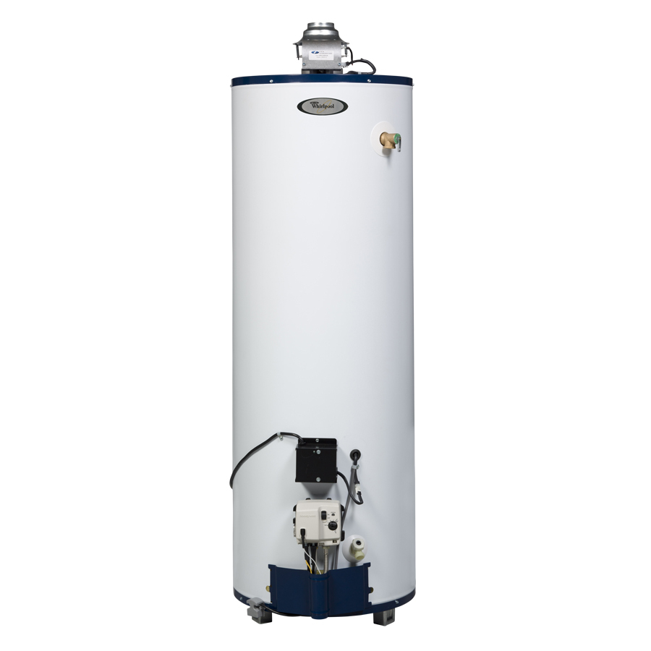
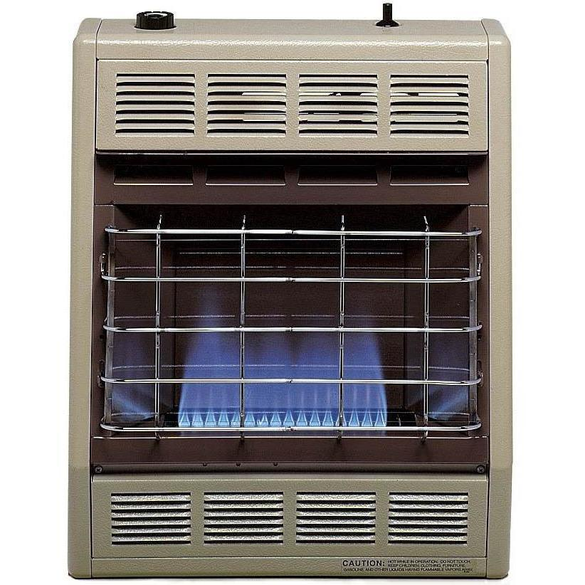
The Problem: 10% of GHGs directly from Buildings
70% of direct emissions come from residential sector
Most emissions (85%) come from space and water heating
Notes:
According the CARB’s 2017 GHG inventory, 9% of GHG emissions are from direct use of natural gas in buildings.

Slide 3
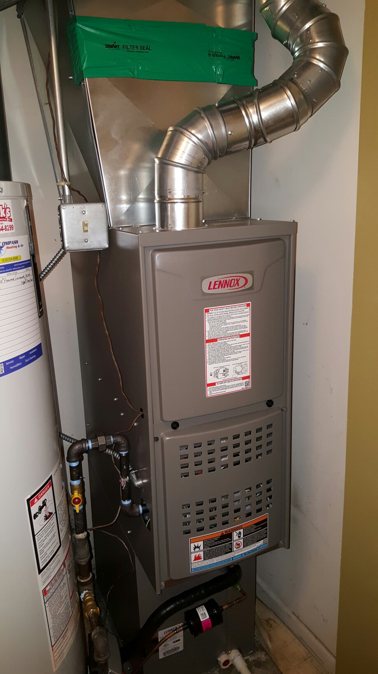
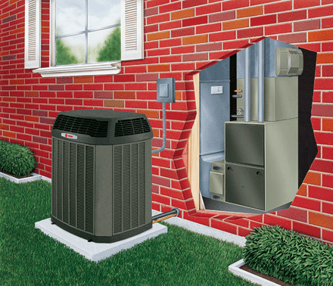
What is Building Electrification? (Ex. 1): Space Heating
Electric (heat pump)
Gas
Notes:
Note the heat pump is plugged into the exterior wall

Slide 4

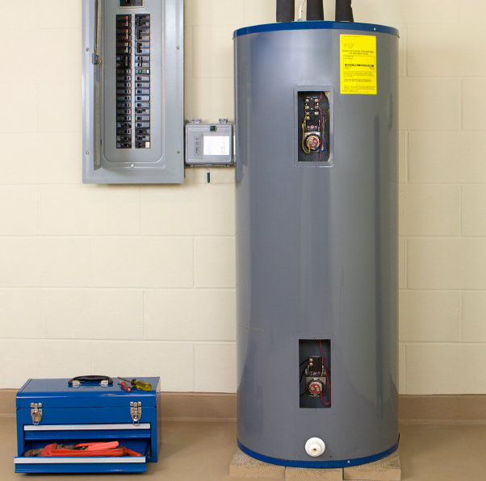
What is Building Electrification? (Ex. 2): Water Heating
Gas
Electric (heat pump)

Slide 5
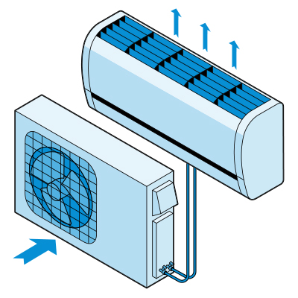
Building Decarbonization Policy Context: Legislation
Legislation Summary
SB 100 (De Leon) – 60% of electricity must come from renewable sources by 2030, carbon free by 2045.
AB 3232 (Friedman): Requires CEC to produce plans (with CPUC) to reduce buildings emissions by 40% by 2030.
SB 1477 (Stern): Allocates $50 million/year for BUILD and TECH programs, 30% for low income customers. Administered by CPUC.
SB 1013 (Lara): Puts state on path to low GWP refrigerants.
SB 49 (Skinner): Encourages development of “smart” appliances for load management

Slide 6
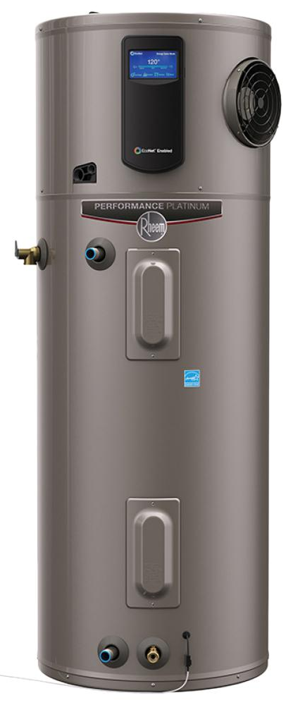
Building Decarbonization Proceedings
CPUC Proceedings - Highlights
R.15-03-010 – $56 million for Disadvantaged Communities in San Joaquin Valley.
R.19-01-011 –
  $120 million for space and water heating in existing homes (TECH).
  $80 million for low income new construction (BUILD).
R.12-11-005 – Funding from the Self Generation Incentive Program of $41 million available for elec. heat pump water heaters, with an additional $4 million for low income customers
R.13-11-005
  Revised rules so energy efficiency funding could be used for “fuel substitution”, allowing access to $600 million budget.
  Approved $250 million for Market Transformation Activities.
There’s more—a minimum of $381 million has been authorized for building decarbonization
Notes:
A Word of caution: each of these programs has its own set of rules and restrictions, depending on funding source:
-Low income programs
-Cap and Trade Allowances
-SGIP
-Energy Efficiency programs

Slide 7
State’s Goals for Building Decarbonization
AB 3232 (Friedman): Requires CEC to produce a plan (with CPUC) to reduce buildings emissions by 40% by 2030.
CEC, working with CPUC, has begun process.
From CEC Presentation given at Dec. 4, 2019, workshop, “Building Decarbonization Assessment Baseline.”
Notes:
Graph demonstrates that since 1990, GHGs from fuel combustion has gone down, while those from refrigerants have gone up. The goal of AB 3232 will be to develop a plan that will reduce GHGs by 27.5 million tons annually through the right combination of decarbonization efforts.

Slide 8
Low GWP Refrigerant Policy
Global Warming Potential (GWP) of Common Refrigerants
Refrigerant | 100-yr GWP | Uses
R-717 (Ammonia) | 0 | Industrial Heat pump for non-residential buildings
R-600a (Iso-Butane) | 0 | Industrial heat pump technology replacement for R-22
R-600 (N-Butane) | 0 | Industrial heat pump technology
R-744 (CO2) | 1 | Currently used for water heat pumps around the world and marketed in the US, cost issue
R-290 (Propane) | 4 | Used widely in Europe
R-1234yf and R-1234ez | 4 | Residential heat pumps for water heaters
R-447A (HFO L-41) | 583 | Replacement for R-410a in residential heat pumps
R-454B (HFO DR-5A) | 466 | Replacement for R-410a in residential heat pumps
R-32 | 675 | Drop in replacement for R-410a in residential heat pumps
DR-55 HFO | 698 | Mini Split Air Conditioner replacement for R-410a
R-466A | 733 | Non-flammable replacement for wide use in heat pumps
R-134a | 1430 | Current wide use in heat pumps
R-22 | 1810 | Current wide use in air conditioners
R-410a | 2088 | Current wide use in heat pumps
Low GWP
Mid GWP
High GWP
CEC’s Building Energy Efficiency Standards defines low GWP as < 150 GWP
CARB has proposed requiring refrigerants of < 150 GWP by 2022.
SB 1477 pilots: Incentives only for Mid-GWP refrigerants
Kicker incentives for using low GWP refrigerants
Notes:
The Building Decarb staff proposal proposes kicker incentives for appliances that use low GWP refrigerants.

Slide 9
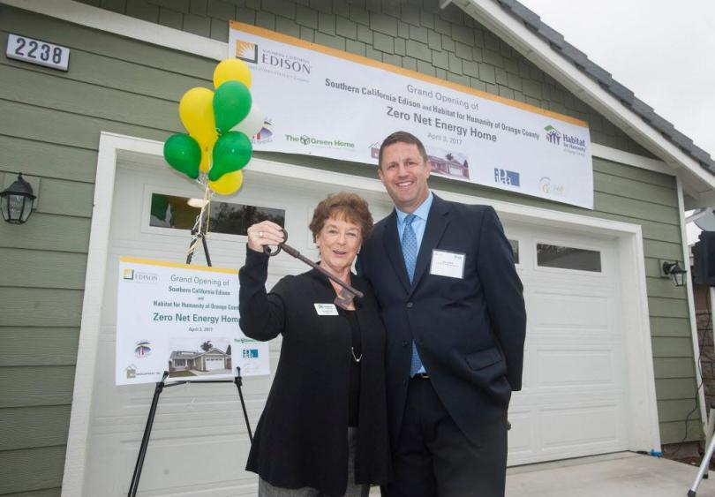
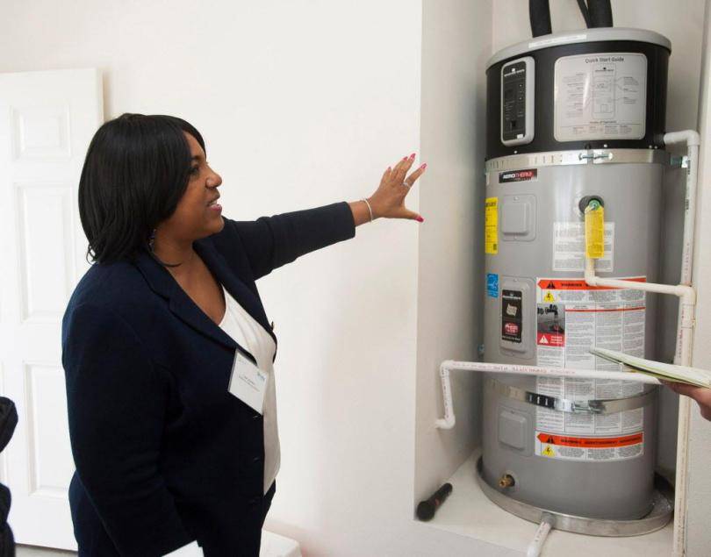
CPUC’s Proceeding on Building Decarbonization (R.19-01-011)
1. Implementation of SB 1477
Authorizes the CPUC to select a program implementer for BUILD and TECH programs
  BUILD = Building Initiative for Low Emissions Development
  TECH = Technology and Equipment for Clean Heating
May set rules and guidelines for program implementation, including design, participant eligibility, incentive levels, evaluation protocols
BUILD – Largely an all-electric, new construction program for low income housing
TECH – Largely focused on manufacturers, distributors, and contractors.
Habitat for Humanity all electric, ZNE home, Santa Ana. Photos: Orange County Register
Notes:
Both BUILD and TECH are funded by revenue from cap and trade funds.
BUILD = Building Initiative for Low Emissions Development – “to provide incentives to eligible applicants, as defined, for the deployment of near-zero-emission building technologies to significantly reduce the emissions of greenhouse gases from buildings, as specified.”
TECH = Technology and Equipment for Clean Heating (TECH). a statewide market development initiative, to require gas corporations to advance the state’s market for low-emission space and water heating equipment for new and existing residential buildings. The bill would require the commission, as a part of the initiative, to identify and target key low-emission space and water heating equipment technologies that are in an early stage of market development and that would assist the state in achieving its greenhouse gas emissions reduction goals. The bill would require the commission to develop guidelines and evaluation metrics, implement outreach strategies for hard-to-reach customers, and provide for job training and employment opportunities, in supervising the administration of the TECH Initiative.
Legislation calls out CSI as comparable program.

Slide 10
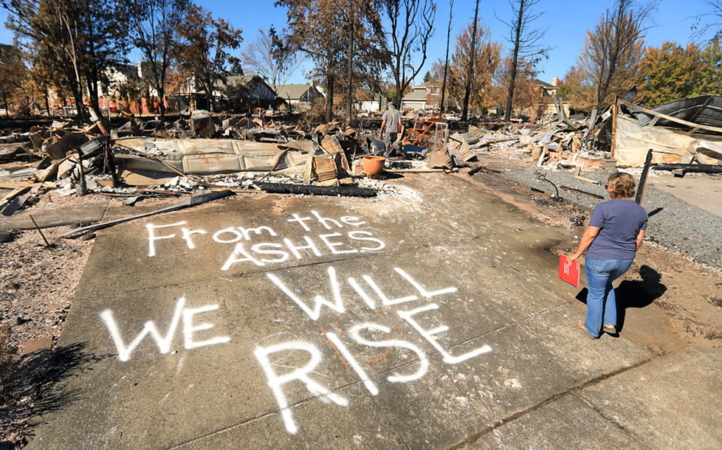
CPUC’s Proceeding on Building Decarbonization
2. Pilot programs for post-fire rebuilding
Considers consistent, unified statewide approach for fire victims to rebuild homes all electric
CPUC approved a PG&E program in Northern California, with Sonoma Clean Power as a partner.
CPUC approved similar program for SCE’s territory.
Photo: Sonoma Magazine

Slide 11
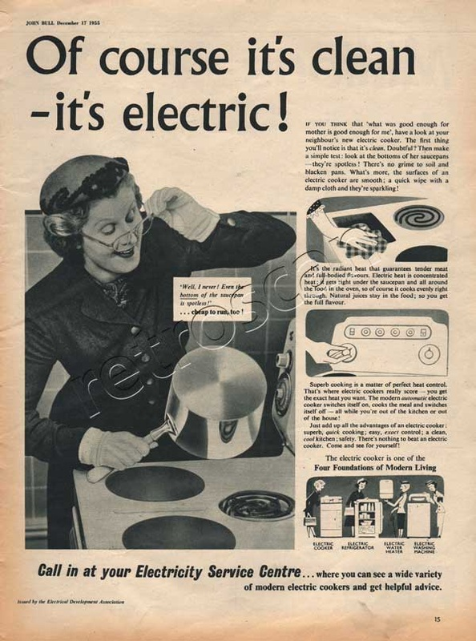
CPUC’s Proceeding on Building Decarbonization
3. Building and Appliance codes and standards
CPUC will consider specific program policies, procedures, and rules to incent builders to choose Title 24 compliance pathways that maximize GHG reductions.
4. Develop a Building Decarbonization Policy Framework
Development of a coherent and comprehensive set of Commission rules, policies, and procedures to accelerate the reduction of GHG from buildings.
Draw on lessons learned from the smaller-scale programs authorized by SB 1477 to scale up, including rate design.
Possible topics: Rate design and financing

Slide 12

Metrics: GHG Reductions and Bill Savings for BUILD and TECH
SB 1477 requirements
  Cost per metric ton of avoided GHG emissions
  Projected annual and lifetime utility bill savings
  Number of low-emission systems installed (BUILD)
  Market share for eligible technologies (TECH)
Cap-and-Trade fund requirements:
  Total avoided GHG emissions from each year’s expenditures
  Total expenditures
  Itemization of administration and outreach expenditures
Notes:
Three prongs: Not increase BTU consumption, be cost effective (TRC = 1), and not have environmental downside. Necessary to access public purpose funds.

Slide 13
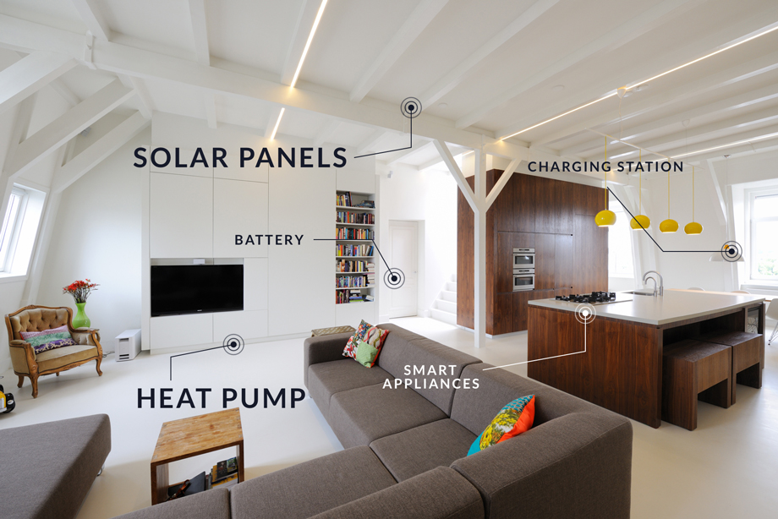
Questions?
Rory Cox
415-703-1093
rory.cox@cpuc.ca.gov
Image: https://www.thefctre.com/en/
Notes:
Three prongs: Not increase BTU consumption, be cost effective (TRC = 1), and not have environmental downside. Necessary to access public purpose funds.

