Slide 1
Energy Division Program Proceeding Updates
Staff Briefing for the Low Income Oversight Board (LIOB) Meeting
March 6th, 2020
Energy Division
California Public Utilities Commission (CPUC)

Slide 2
Low Income Needs Assessment
Disconnection OIR Update
ESA/CARE Proceeding

Slide 3
Disconnection OIR Update
Phase 1 will examine current policies and changes that can be made to reduce disconnections to a target by January 1, 2024. Proposed decision in Phase 1 by 2nd quarter 2020.
D.18-12-013 created interim measures to reduce disconnections as proceeding continues
Prevents disconnections of elderly and medical baseline customers (subject to payment plan)
Prevents disconnections during extreme weather
Provides a goal for each utility of maintaining disconnections at 2017 level
A ruling was issued in November 2019 to solicit parties’ comments on policy proposals that address disconnections, including an arrearage management program, a percentage of income payment plan pilot, and benefit of service process reform proposal.
Energy Division published the second workshop report in October 2019 and will submit a legislative report in April 2020.
Phase 1-A will address disconnections in SMJU territories.
Phase 2 will take a broader look at the disconnection process and consider innovative solutions.

Slide 4
ESA/CARE Proceeding
The IOUs submitted applications for their post-2020 ESA/CARE programs on November 4th.
The CPUC held a pre-hearing conference on January 17th, and released a scoping memo on February 18th.
ED is working with the IOUs to schedule workshops during March and April.
Notes:
D.16-11-022 p.32

Slide 5
2022 Low Income Needs Assessment Recent Activity
In January 2020, the Energy Division granted the IOUs authority to move forward with the 2022 Low Income Needs Assessment via advice letter approval.
The LIOB also held a LINA subcommittee meeting in January to discuss topics to include in the project scope.
The Scope of Work is currently under development for review and consideration and is expected to be completed in March 2020.
Notes:
Joint IOU Advice Letter - PG&E 4193-G/5718-E, SDG&E 3478-E/2828-G, SCG 5559, SCE 4132-E, submitted in December 2019 requested $500k to conduct the 2022 LINA and proposed a tentative schedule.

Slide 6
2022 Low Income Needs Assessment Upcoming Activity
Once the scope of work is finalized a request for proposal will be issued to solicit bids and select a consultant to conduct and complete the study.
The statutory deadline to complete this study is December 2022.
Coordination and collaboration between the Energy Division, IOUs and the LIOB and opportunities for stakeholder engagement will be ongoing throughout the process.
Notes:
PU Code requires a triennial assessment
“…The assessment shall evaluate low-income program implementation and the effectiveness of weatherization services and energy efficiency measures in low -income households. The assessment shall consider whether existing programs adequately address low-income electricity and gas customers’ energy expenditures, hardship, language needs, and economic burdens.”

Slide 7
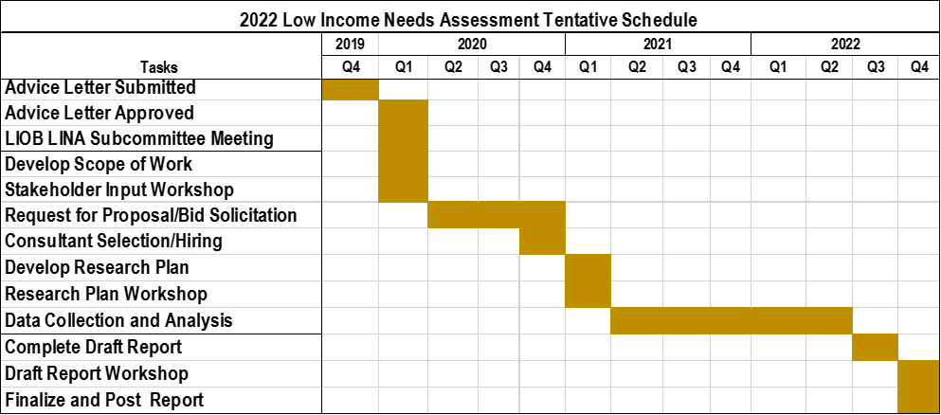
2022 Low Income Needs Assessment Tentative Schedule
Notes:
PU Code requires a triennial assessment
“…The assessment shall evaluate low-income program implementation and the effectiveness of weatherization services and energy efficiency measures in low -income households. The assessment shall consider whether existing programs adequately address low-income electricity and gas customers’ energy expenditures, hardship, language needs, and economic burdens.”

