Slide 1
San Diego Gas & Electric
Energy Savings Assistance Program
CARE Program
2012-2014 Marketing & Outreach

Slide 2
CARE & Energy Savings Assistance Program - Agenda
2011 Marketing & Outreach Initiatives
2012-14 Proposed Marketing & Outreach Initiatives

Slide 3
CARE & ENERGY SAVINGS ASSISTANCE PROGRAM 2011 PAID MEDIA

Slide 4
CARE & Energy Savings Assistance Program 2011 Paid Marketing
Tactic | Language/Ethnicity
Television | English & Spanish
Print | English, Spanish, African American & Asian (Chinese, Tagalog, Vietnamese)
Radio | English & Spanish
Online | English & Spanish
Outdoor | In-Language Transit Shelter Advertising (English, Spanish, Tagalog, Vietnamese)

Slide 5
CARE & Energy Savings Assistance Program Customer Testimonial
New Approach in 2011
Univision 10-min interview & 60-second radio spots
Personalized and meaningful story
Airing on De Viva Voz on KLNV La Nueva and KLQV Recuerdo

Slide 6
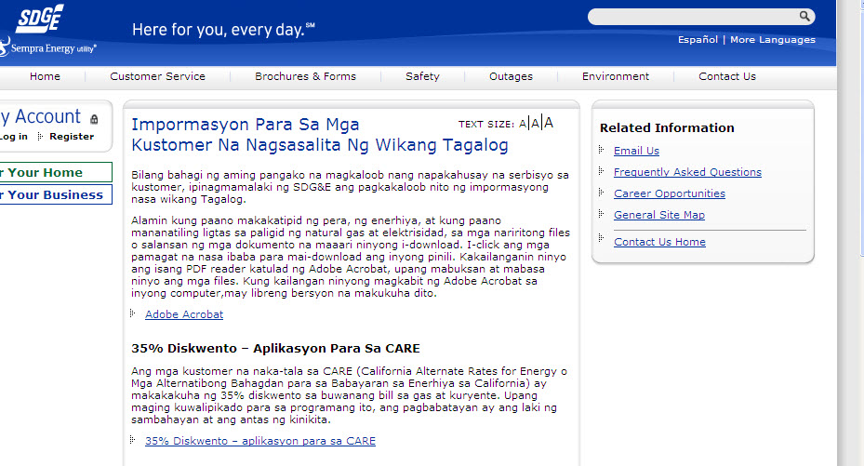
CARE & Energy Savings Assistance Program Languages Available
Print ads available in Spanish, Chinese, Tagalog and Vietnamese.
Website offers application in 12 languages: Spanish, Armenian, Tagalog, Khmer, Russian, Arabic, Chinese, Farsi, Hmong, Korean, Thai and Vietnamese.

Slide 7
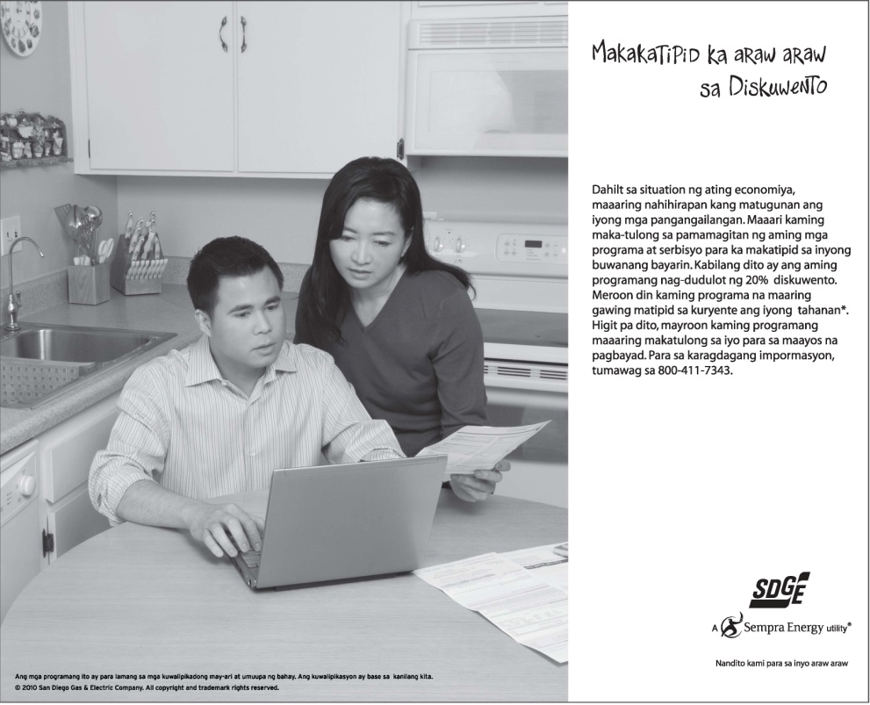
CARE & Energy Savings Assistance Program Sample Print Ads
Print ads available in Spanish, Chinese, Tagalog and Vietnamese .

Slide 8
CARE & Energy Savings Assistance Program Banner Ad Samples
Paid search: Google, Yahoo, Bing, Facebook
Display advertising: 10News, Union Tribune, NBC
Display publishers: CareerBuilder, Snagajob.com
Ad networks: Yahoo, ValueClick
Dedicated landing page: English & Spanish

Slide 9
CARE & Energy Savings Assistance Program Landing Page

Slide 10
CARE & Energy Savings Assistance Program Transit Ad Samples
Available in Spanish, Tagalog and Vietnamese.

Slide 11
CARE & ENERGY SAVINGS ASSISTANCE PROGRAM 2011 DIRECT MARKETING

Slide 12
CARE & ENERGY SAVINGS ASSISTANCE PROGRAM 2011 DIRECT MARKETING
English/Spanish direct mail campaigns
Email campaigns
English/Spanish automated voice messaging (AVM) campaigns
English/Spanish door to door campaigns
English/Spanish bill inserts

Slide 13
CARE Program 2011 Direct Mail Sample

Slide 14
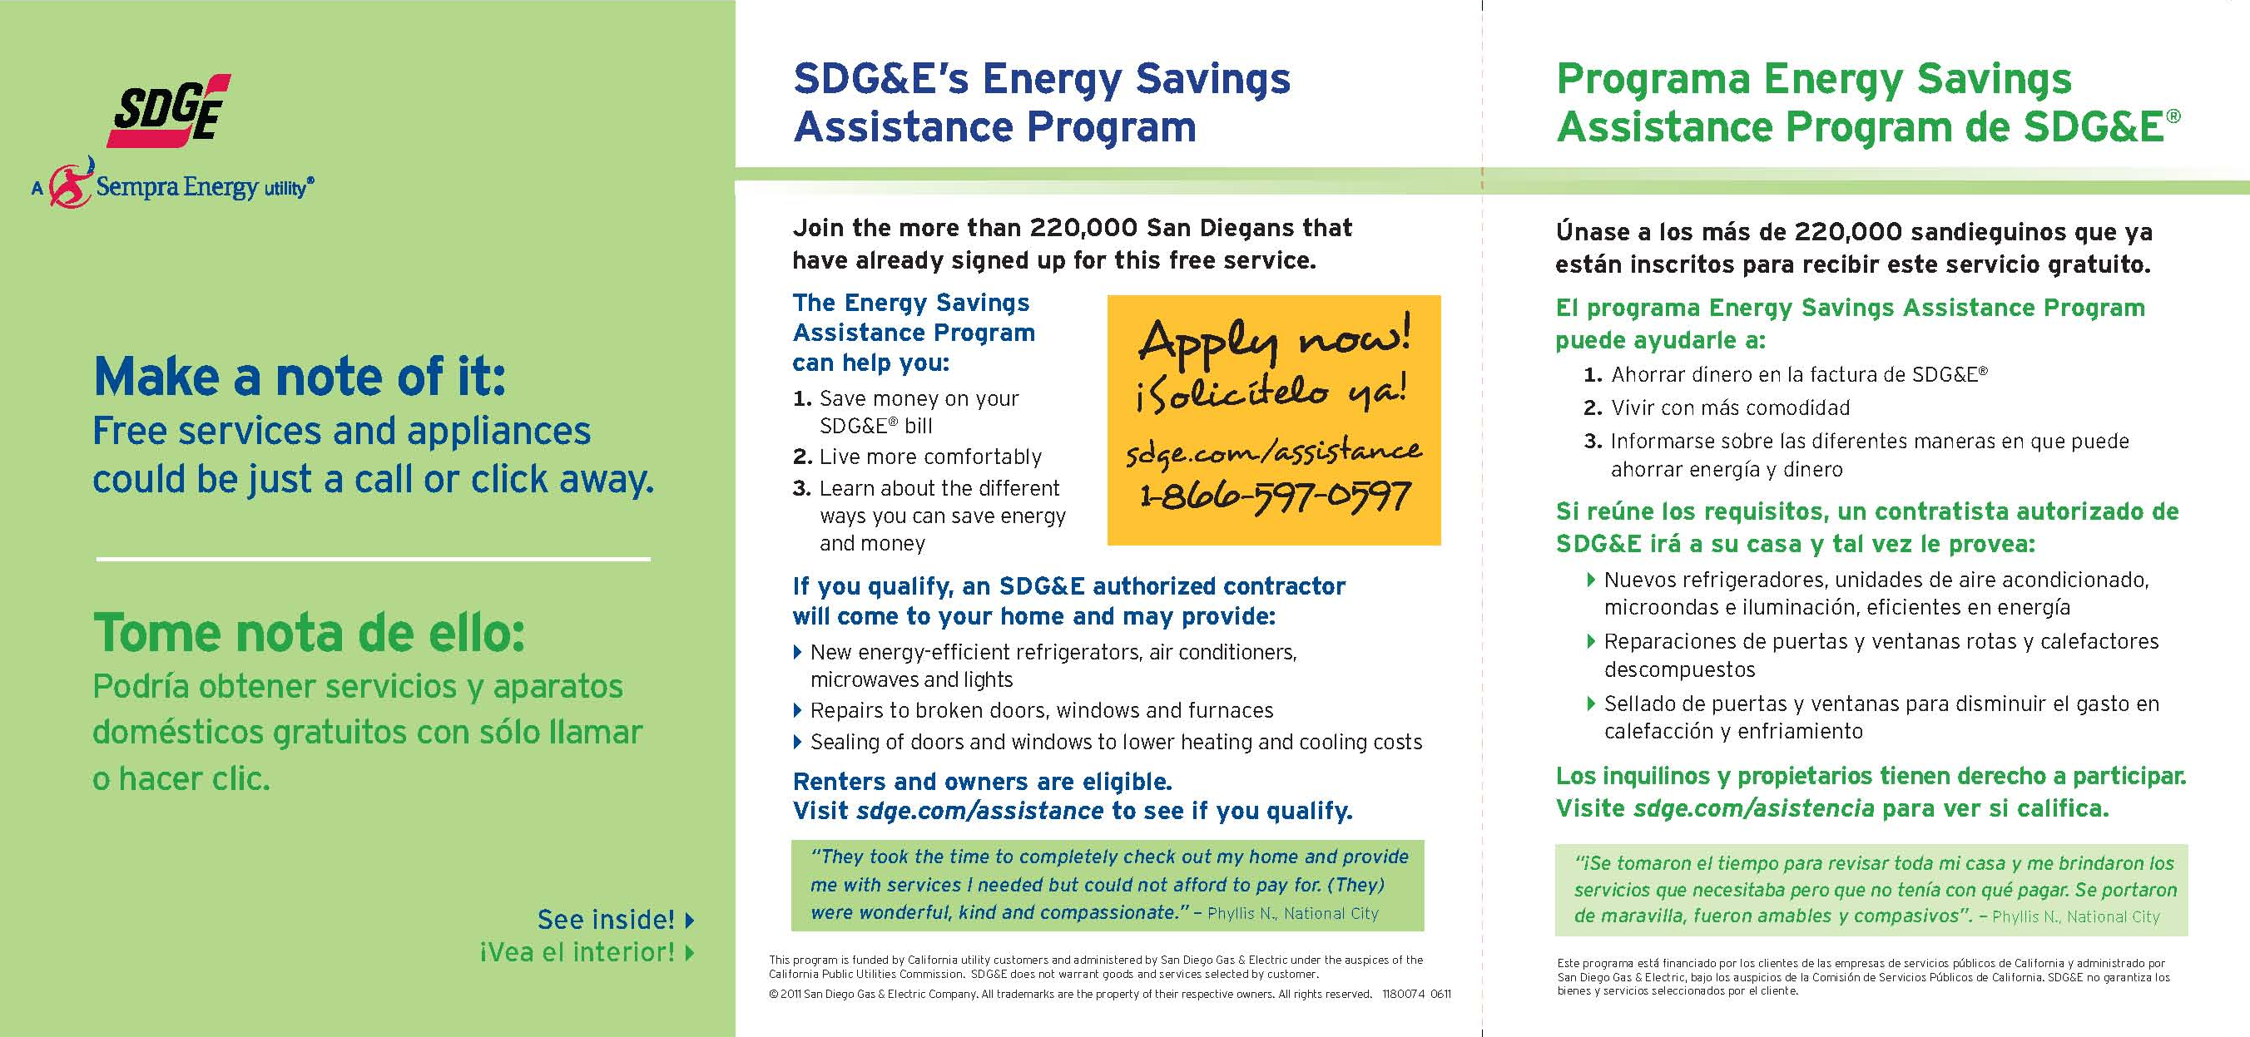
Energy Savings Assistance Program 2011 Direct Mail Sample

Slide 15
CARE & ENERGY SAVINGS ASSISTANCE PROGRAM OUTREACH

Slide 16
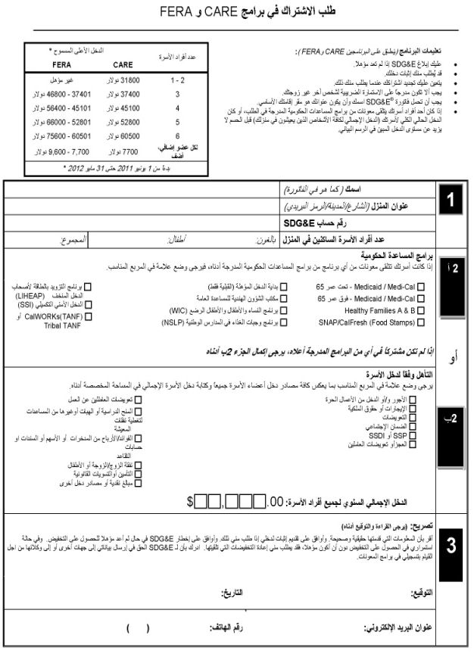
Multi-Lingual Multi-Cultural Outreach New Approach in 2011
Contracted with two local organizations expert in language and in culture services.
Provide outreach through churches, senior centers, schools, immigrant organizations and community events. Target African immigrants, African Americans, Vietnamese- and Arabic-speaking customers.

Slide 17
Service Industry Outreach New Approach in 2011
Hospitality- and service-industry outreach targeting employees of restaurants, hotel/motel industry
San Diego & Imperial County Labor Council sponsorship: presentations, informational displays, employee events, newsletter ads

Slide 18
Community-Based Organizations Outreach
Partnering with over 50 community- and faith-based organizations to help reach diverse communities including San Diego 2-1-1, a health & human service referral agency that offers assistance in up to 170 languages & dialects
Includes specific language, ethnic and immigrant population targets such as: Alliance for African Assistance, Horn of Africa, International Rescue Committee, Iraqi Community Social Services, Elder Help, Kurdish Human Rights, La Maestra Community Health Centers, Union of Pan Asian Communities and Somali Community Services
Working with agencies offering assistance to those with special needs such as hearing and visual impairments

Slide 19
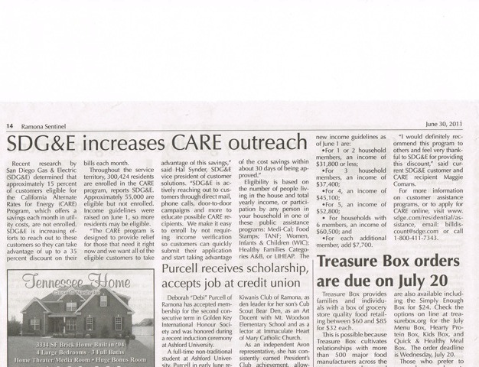
Community Newspapers New Approach in 2011
Collaborating with diverse communities to include program information in community publications
Publications include La Prensa, Hispanos Unidos, Bonsall Village News, Ramona Sentinel, Valley Roadrunner

Slide 20
CARE & ENERGY SAVINGS ASSISTANCE PROGRAM MARKETING & OUTREACH 2012-2014 EXPANDING SUCCESSFUL STRATEGIES WHILE EXPLORING NEW OPPORTUNITIES

Slide 21
Marketing and Outreach 2012-2014
What are we trying to do?
Enroll all eligible and willing customers in the CARE and Energy Savings Assistance Program
Develop a comprehensive plan to reach various cultural groups
Better understand the community with disabilities and help address their needs
Work with partners to cross-promote relevant programs to the low-income community

Slide 22
Marketing and Outreach 2012-2014
How do we get there?
Continue to work with advertising agencies to ensure media buys are appropriate for our service territory
Increase multi-lingual and multi-cultural outreach through grassroots channels and partnerships
Expand outreach to seniors, persons with disabilities and limited-English-proficient customers through appropriate channels
Continue to address the needs of the visually- and hearing-impaired population
Focus on underserved communities in outlying areas
Translate promotional material into additional languages (Energy Savings Assistance Program)

Slide 23
CARE & Energy Savings Assistance Program 2012-2014 Paid Media
Tactic | Language/Ethnicity
Television | English & Spanish
Print | English, Spanish, African American & Asian (Chinese, Tagalog, Vietnamese)
Radio | English & Spanish
Online | English & Spanish
Outdoor | In-Language Transit Shelter Advertising (English, Spanish, Tagalog, Vietnamese)

Slide 24
CARE & Energy Savings Assistance Programs 2012-2014 Direct Marketing
Direct Marketing | Language
Direct mail | English & Spanish
Email campaigns | English & Spanish (New)
AVM campaigns | English & Spanish
Bill inserts | English & Spanish
Door-to-door | English & Spanish

Slide 25
CARE & Energy Savings Assistance Programs 2012-2014 Outreach
Outreach | Language/Type
Multi-Lingual/Multi-Cultural | Various languages – Arabic, Vietnamese, Somali, Spanish, Swahili, and Zulu
Community/Faith-Based Organizations | Varies by agency
Disabilities | Braille, large font, closed caption, audio CDs, DVDs, TTY/TDD
Rural Communities | Geographically-targeted media
Service Industries | English & Spanish

